Slide 1
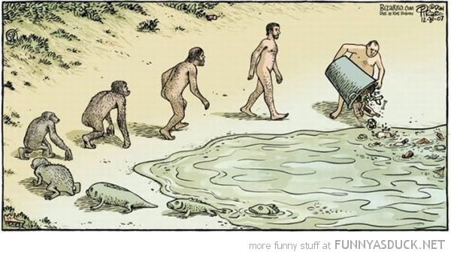
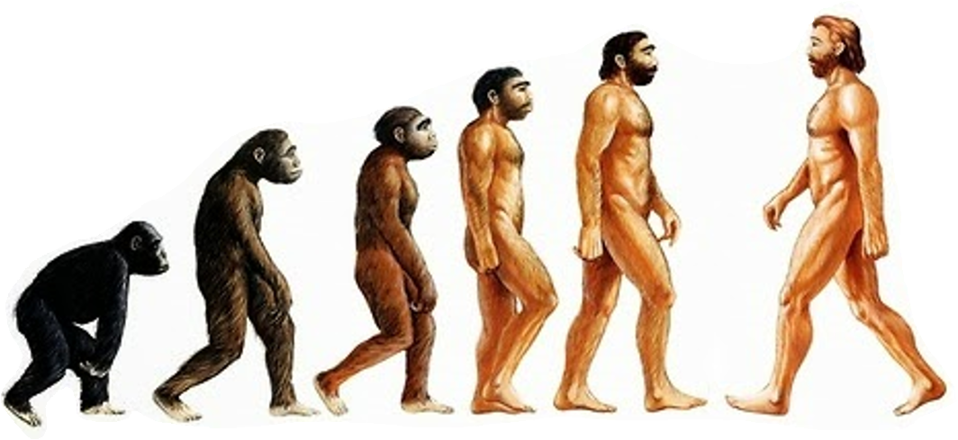
Human Evolution, Excretion and Digestion
Go back! We f*#ked everything up
Chapters 34, 41, and 44

Slide 2
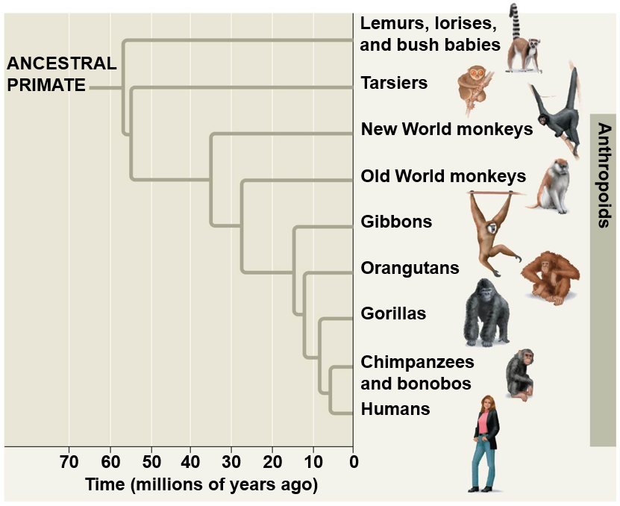
Humans and Apes
Homo sapiens characteristics
Bipedal
Larger brains
Language
Symbolic thought
Artistic expression
Use complex tools
Reduced jaw bones and ____ __________
Differ from chimpanzees in 19 regulatory genes

Slide 3
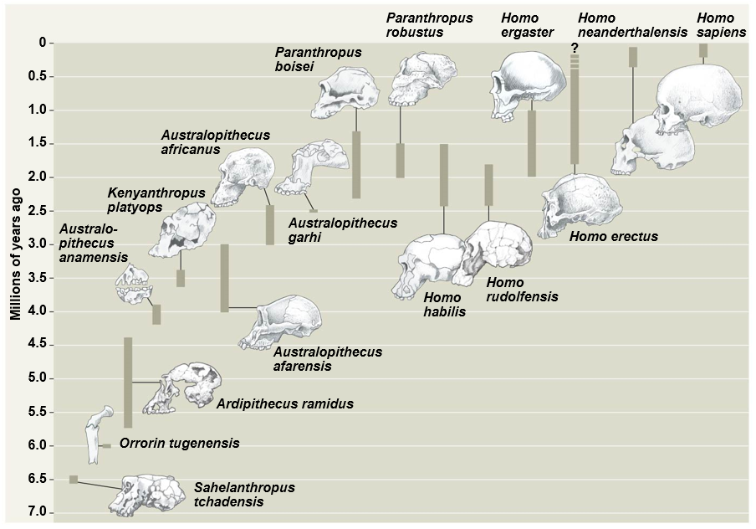
Paleoanthropology
____________: species more closely related to humans than chimps
Homo sapiens
Approx: 200,000 years old
Paranthropus
Approx: 2.2 to 1.3 mya
Australopithecus
Approx: 4.2 to 2 mya
Sahelanthropus
Approx: 6.5 mya

Slide 4
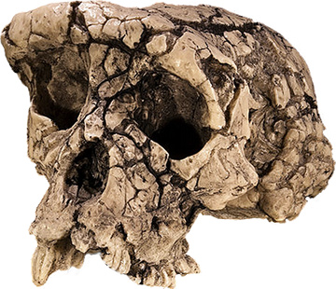
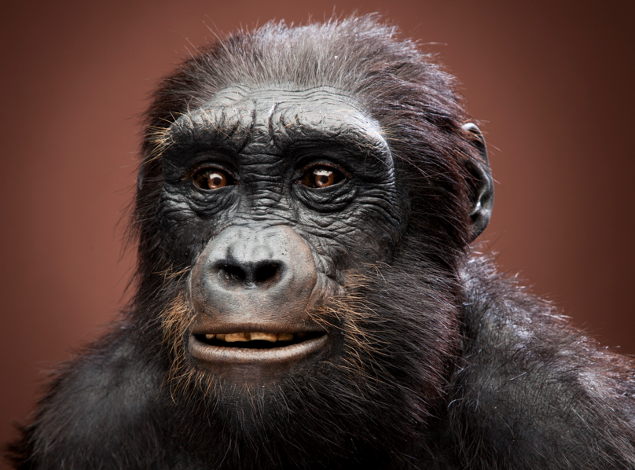
Human Evolution
Sahelanthropus
Approx. 6.5 million years ago
Reduced canine teeth
Anterior ______________ location
More upright posture
Small brains
Jaw projected in front of face

Slide 5
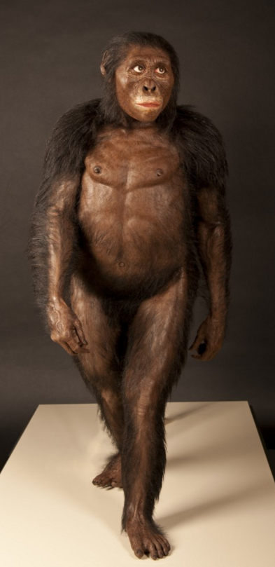
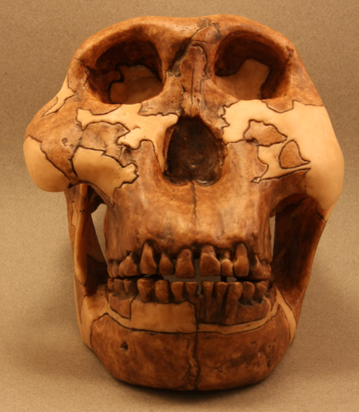
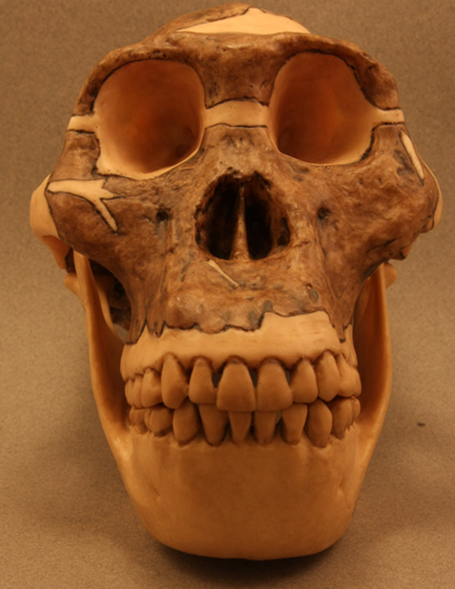
Human Evolution
Australopithecus
Between ~4.2 and 2 mya
_____________
Humans hands and teeth
Small brain
Stone tool use
A. boisei
A. africanus

Slide 6
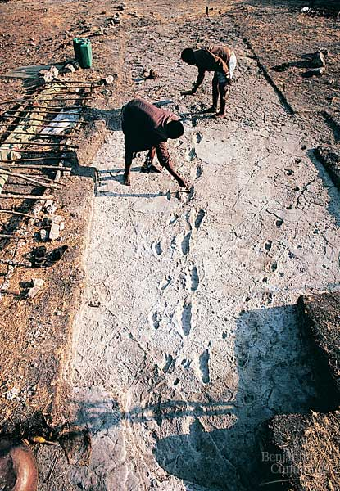
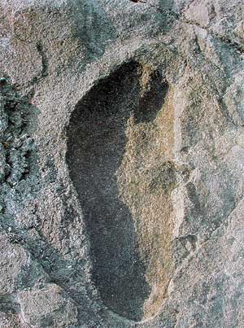
Human Evolution
Laetoli Footprints
Tanzania
Approximately 3.5 million years old
Evidence for bipedalism

Slide 7
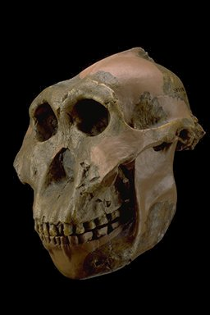
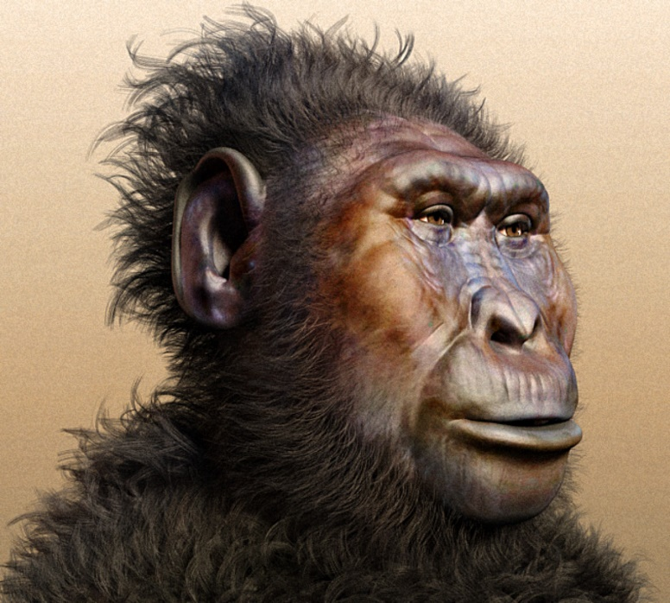
Human Evolution
Paranthropus
Massive cheek teeth and jaw muscles
Hard or tough foods
Diverged from Homo lineage ~3mya

Slide 8
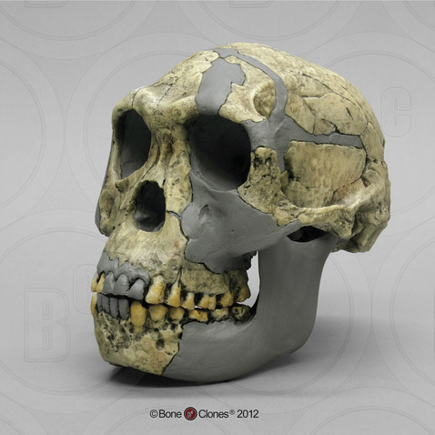
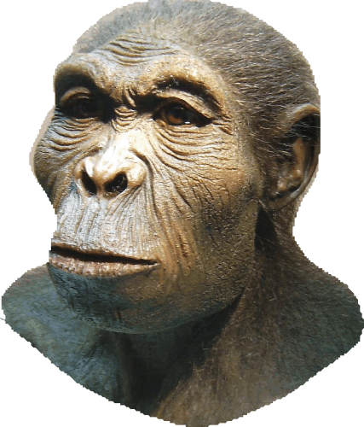
Human Evolution
Homo habilis
Range from ~2.4 to ~1.6mya
Shorter jaw and larger brain than Australopithecus
Sharp tool use
“Handy man”

Slide 9
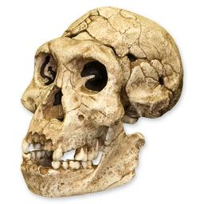
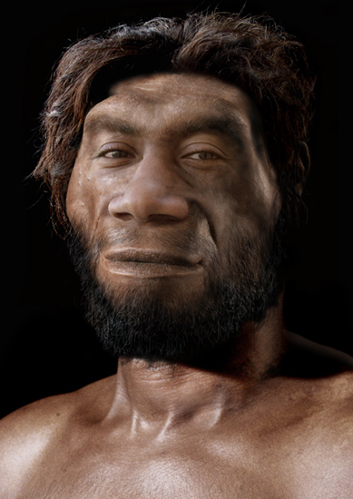
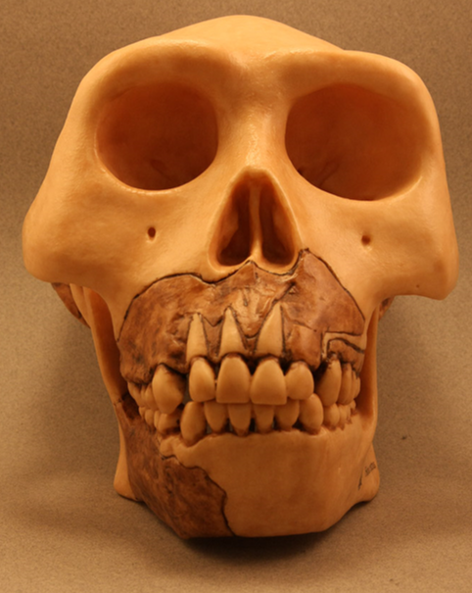
Human Evolution
Homo ergaster and Homo erectus
Much larger brain than Homo habilis
Smaller jaws and cheek teeth
_________ face
Long legs and arched feet
Long distance walking
Fully erect posture
H. erectus

Slide 10
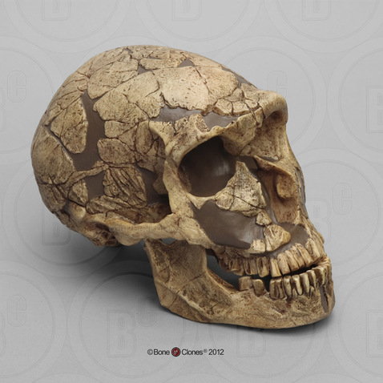
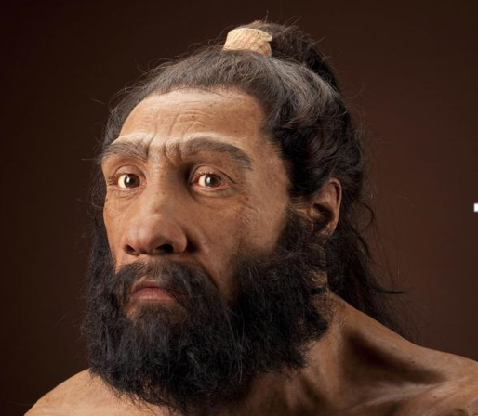
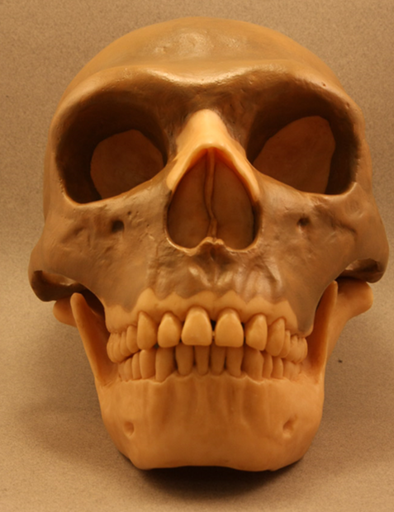
Human Evolution
Homo neanderthalensis
Diverged from Homo sapiens ~400,000 years ago
Extinct ~28,000 years ago
Sophisticated _______
Hunting
Larger brains than Homo sapiens
H. neanderthalensis

Slide 11
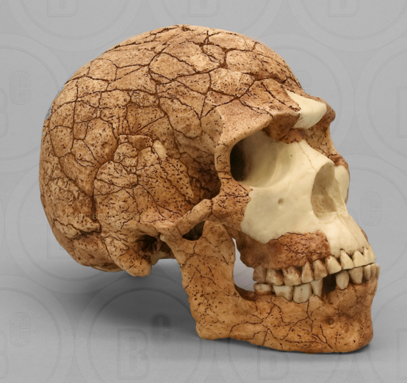
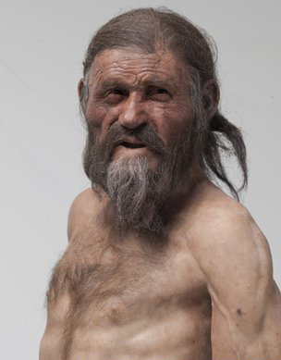
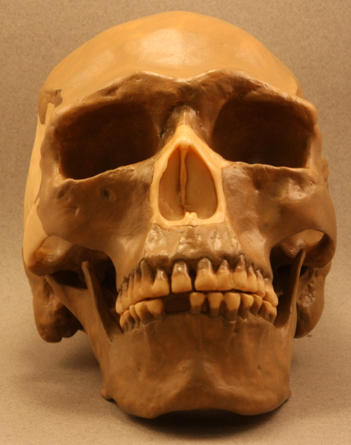
Human Evolution
Homo sapiens
Arose approx. 200,000 years ago
African origin
Very little cross breeding with neanderthalensis
“Cro-Magnon” man
Early European humans
Cro-Magnon

Slide 12
Origin of Modern Humans
___________ (monogeneus)
All races of humans evolved from an ancestor in Africa
Multiregional
Each race evolved from regional populations of Homo erectus

Slide 13
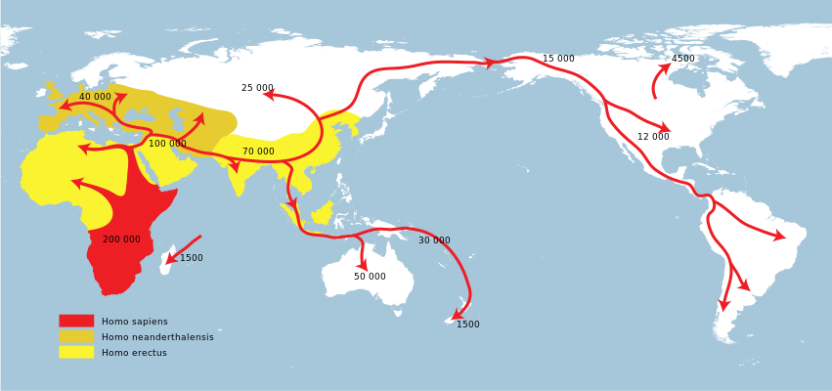
Dispersal of Homo sp.
Homo sapiens
South Asia ~70,000 years ago
Europe ~40,000 years ago
Cross bearing land bridge ~20,000 years ago
Retreating ice age
First humans in North America ~15,000 years ago

Slide 14
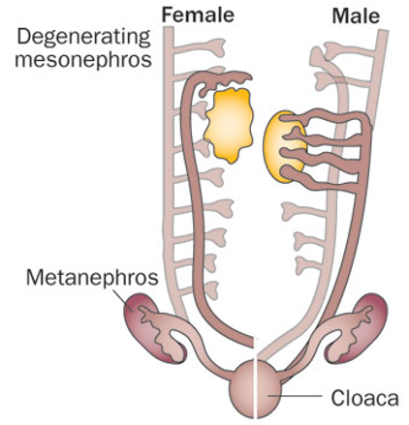
Human Excretory System
Metanephros
Final stage in vertebrate kidney development
Reptiles, birds and mammals
Develops from ___________ of mesonephric duct
Mesonephros become mesonephric duct in males

Slide 15
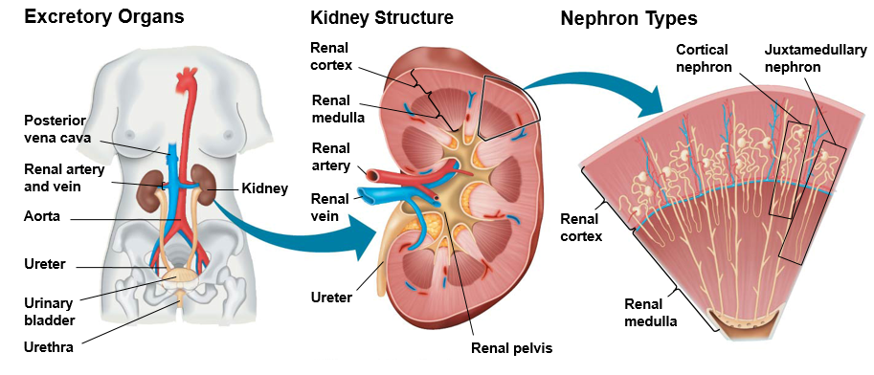
Human Excretory System

Slide 16
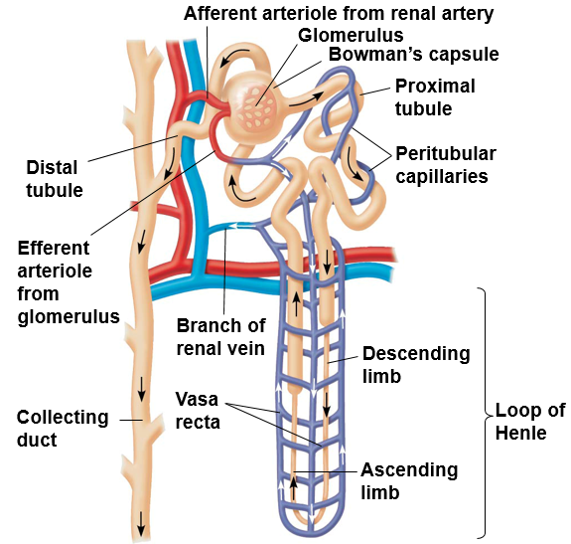
The Nephron
Glomerulus: ball of capillaries surrounded by ___________________
Proximal tubule: majority of reabsorption of water, ions (Na⁺, Cl⁻, Ca⁺, K⁺), and valuable nutrients (glucose and amino acids)
Maintains pH of body fluids
_________________: water absorption
Aquaporin proteins
Distal tubule: regulates absorption of K⁺, HCO3⁻ and NaCl
Maintains pH of body fluids

Slide 17
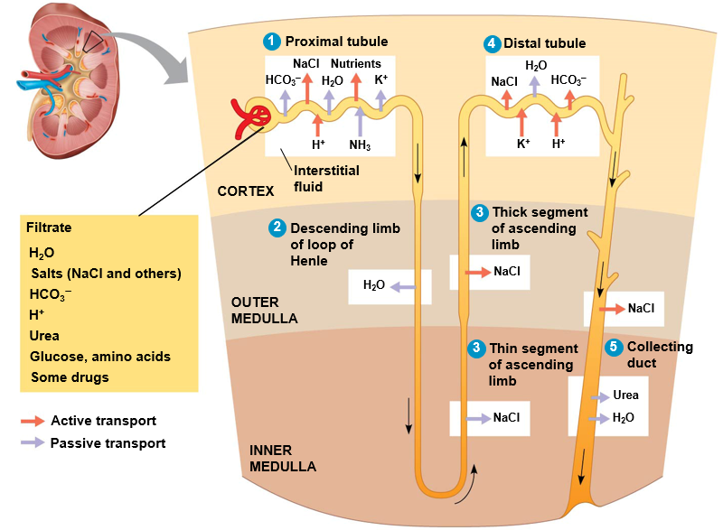
Filtration Through the Nephron
Proximal tubule reabsorbs NaCl, H₂O, K⁺, and nutrients
H₂O reabsorbed through ________ proteins in descending loop of Henle
NaCl reabsorbed via passive transport through thin segment and ______ transport through thick segment of ascending loop of Henle
K⁺ secreted into filtrate and NaCl reabsorbed in distal tubule
Hormonal control of permeability regulates reabsorption of H₂O, urea, and NaCl in distal tubule

Slide 18
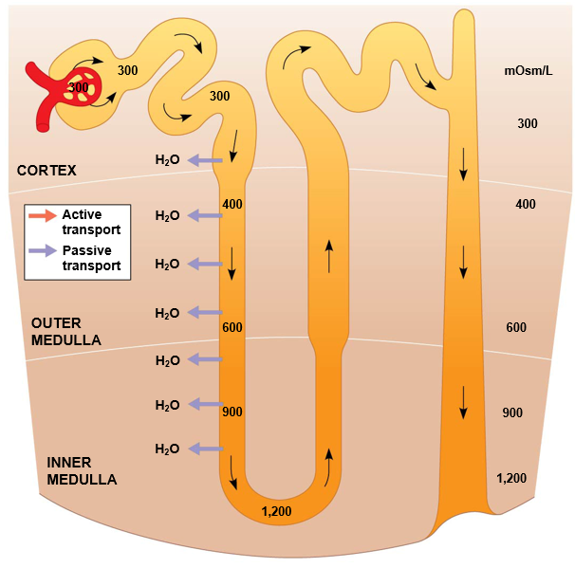
Solute Gradients and Water Conservation
H₂O passively diffuses out of aquaporins as it moves trough the descending limb of the loop of Henle
Few channels for NaCl or other solutes
Osmolarity of the filtrate _________ as it descends down the loop of Henle

Slide 19
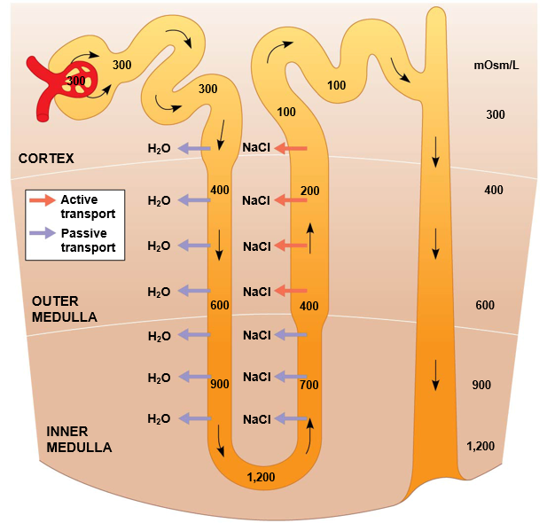
Solute Gradients and Water Conservation
Ascending limb of loop of Henle is permeable to NaCl but not ______
NaCl diffusing out of the ascending limb of loop of Henle maintains high osmolarity of interstitial fluid of medulla
Counter current multiplier system
Active transport

Slide 20
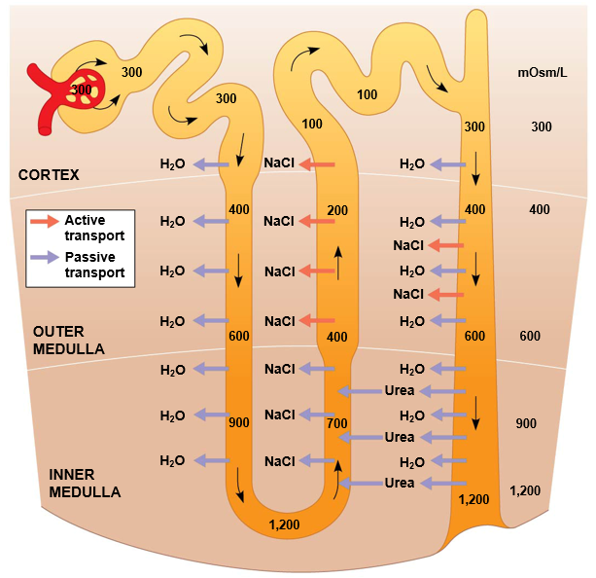
Solute Gradients and Water Conservation
Filtrate is hypoosmotic when entering distal tubule.
H₂O passively diffuses out of aquaporins as it moves trough the collecting duct, NaCl actively transported into medulla
Concentrated urine transported to renal pelvis, then to bladder through ureter

Slide 21
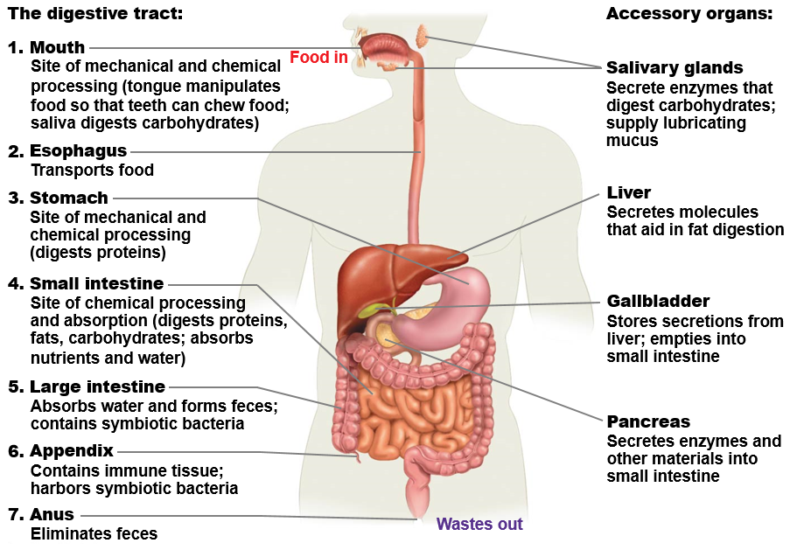
Human Digestive System

Slide 22
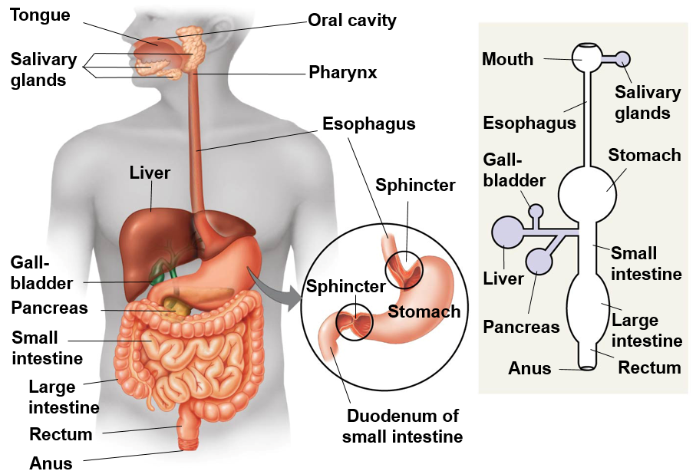
Human Digestive System
Accessary glands secrete digestive juices into digestive tract
Salivary glands: salivary amylase, lingual lipase
Liver: produces bile
Gall bladder: ______ bile
Pancreas: pancreatic lipase, pancreatic amylase, trypsin, chymotrypsin, elastase, carboxypeptidase
Peristalsis moves food through system, while ___________ regulate passage through compartments

Slide 23
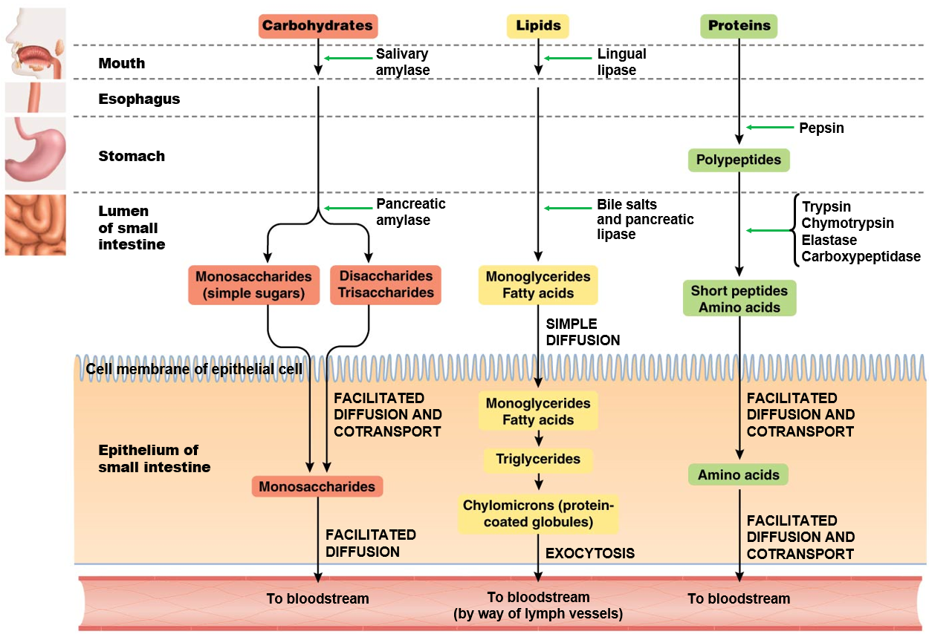
Location of Chemical Digestion
Lipid and carbohydrate digestion begins in _______
______ digestion begins in stomach
Pancreatic juices and bile are secreted into duodenum of small intestine where most digestion occurs
Most absorption of nutrients occurs in jejunum and ileum

Slide 24
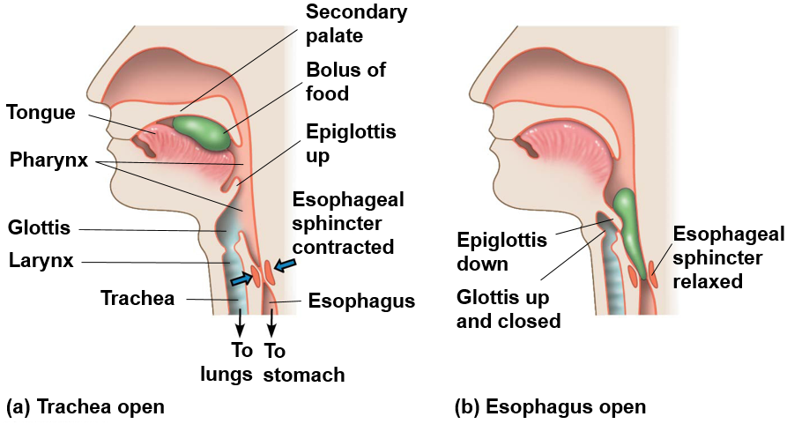
Swallowing and Breathing
Mechanical digestion begins with teeth chewing food
Secondary palate allows mammals to chew and breathe and the same time
Tongue manipulates bolus
________ prevents movement of food into trachea

Slide 25
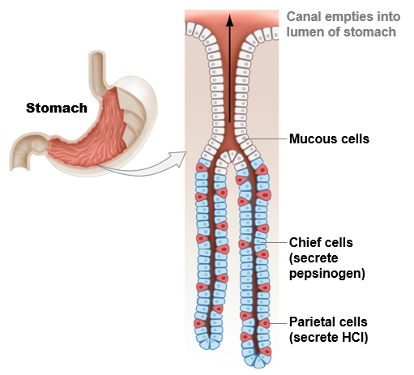
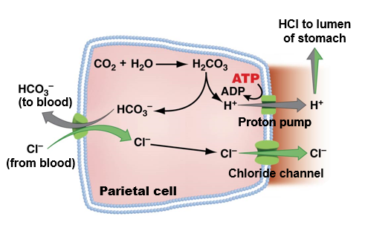
Formation of HCl and Pepsin in Stomach
Carbonic acid hydrolyses to form hydrogen ion and bicarbonate in parietal cells
Chlorine from blood enters gastric gland through chloride channels
__________ released by chief cells converted to pepsin by HCl in the lumen
Mucous cells release mucus which lubricates and protects cells lining stomach
HCl, pepsin, and mucus comprise gastric juices that form chyme

Slide 26
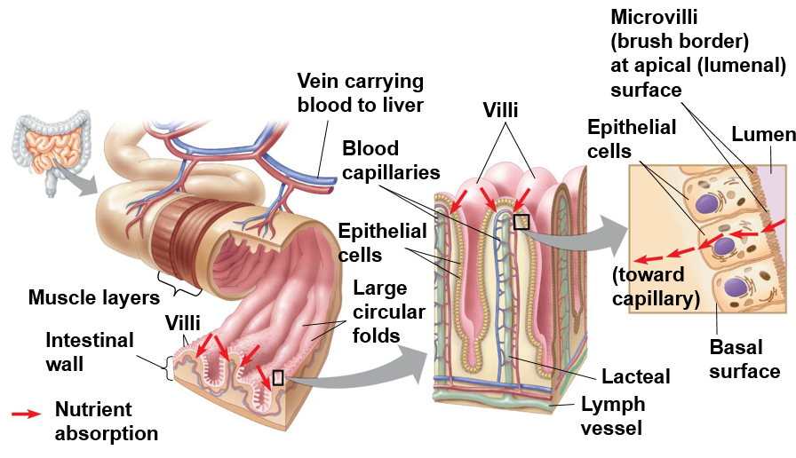
Absorption in the Small Intestine
Intestinal folds, villi and microvilli increase surface area
200-300m²
_______________ carries blood with nutrients to liver
Monosaccharides, amino acids and monoglycerides absorbed through epithelial cells villi

Slide 27
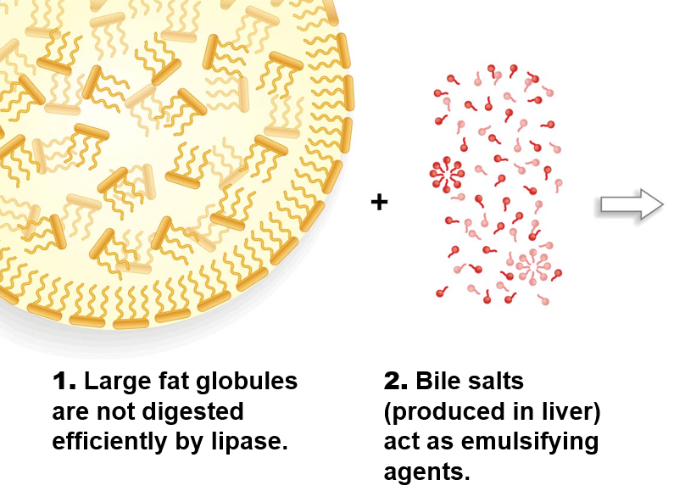
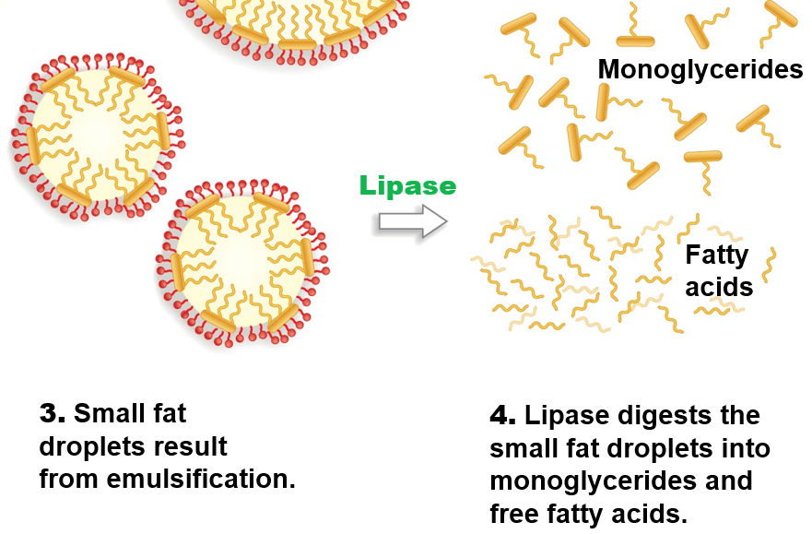
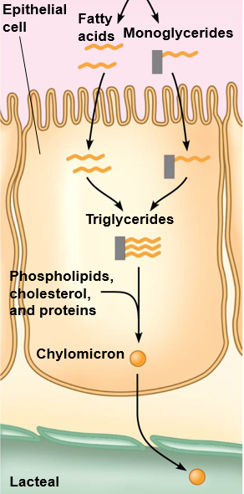
Emulsification of Lipids
5. Monoglycerides and fatty acids diffuse into epithelial cells and are reformed into triglycerides.
6. Triglycerides are incorporated into chylomicrons.
7. Chylomicrons enter lacteals and are carried away by lymph.
1. Large fat globules are not digested efficiently by lipase
2. Bile salts (produced by liver) act as emulsifying agents.
3. Small fat droplets result from emulsification
4. Lipase digests the small fat droplets into monoglycerides and free fatty acids

Slide 28
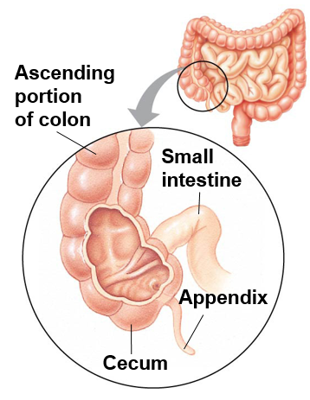
Absorption in the Large Intestine
Large intestine includes colon, cecum and rectum.
Absorbs water
Forms feces
Cecum: ____________ of plant material
Function insignificant in humans
_____________: minor role in immunity, may store “good” bacteria

Slide 29
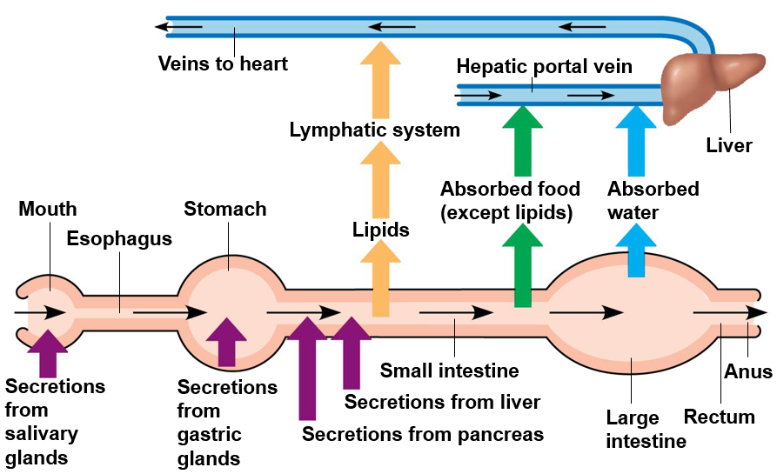
Summary of Digestive System

