Slide 1
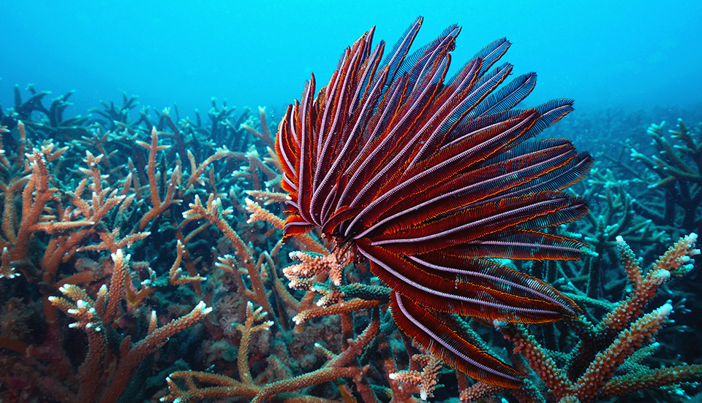
4. What phylum does this organism belong to?
5. What class does this organism belong to?
6. Does this organism have a true coelom?
7. What type of development does this organism go through?
1. What phylum does this organism belong to?
2. What body form is this organism demonstrating?
3. What type of digestive system does this organism have?
Notes:
Cnidaria
Polyp
Gastrovascular cavity
Echinodermata
Crinoidea
Yes
Deuterostome

Slide 2
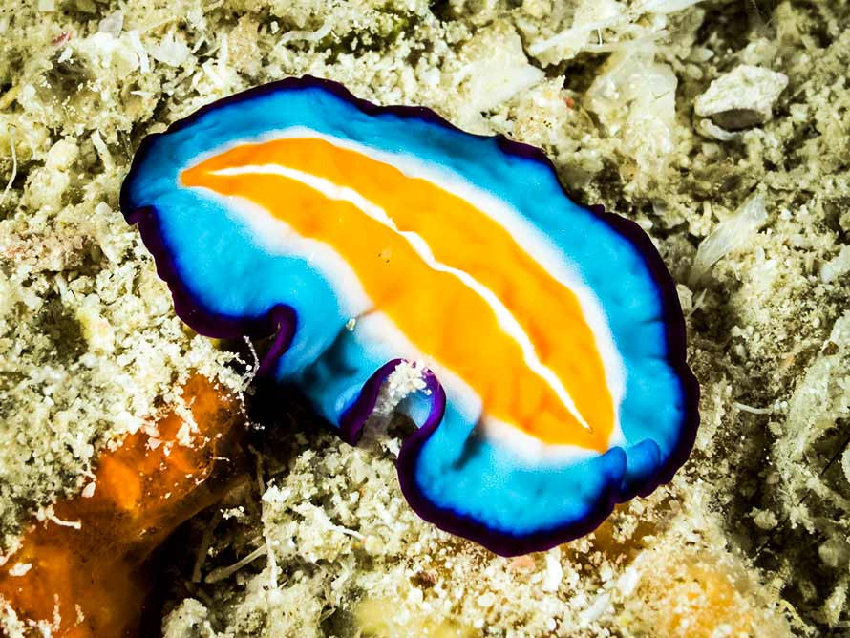
What phylum does this organism belong to?
Does this organism have a true coelom?
What type of digestive system does this organism have?
Notes:
Platyhelminthes
No, acoelomate
Gastrovascular cavity

Slide 3
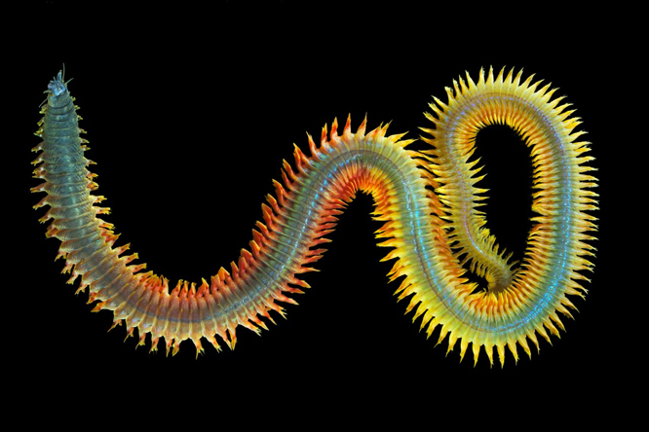
What phylum does this organism belong to?
What type of digestive system does this organism have?
What is the name of the paired appendages that run down the body of this organism?
Notes:
Annelida
Alimentary canal
Parapodia

Slide 4
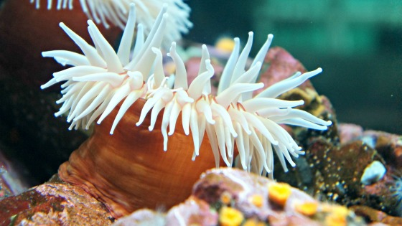
What phylum does this organism belong to?
What is the name of the specialized stinging cells found in organisms within this phylum?
What is type of symmetry does this organism have?
Notes:
Cnidaria
Cnidocytes
Radial

Slide 5
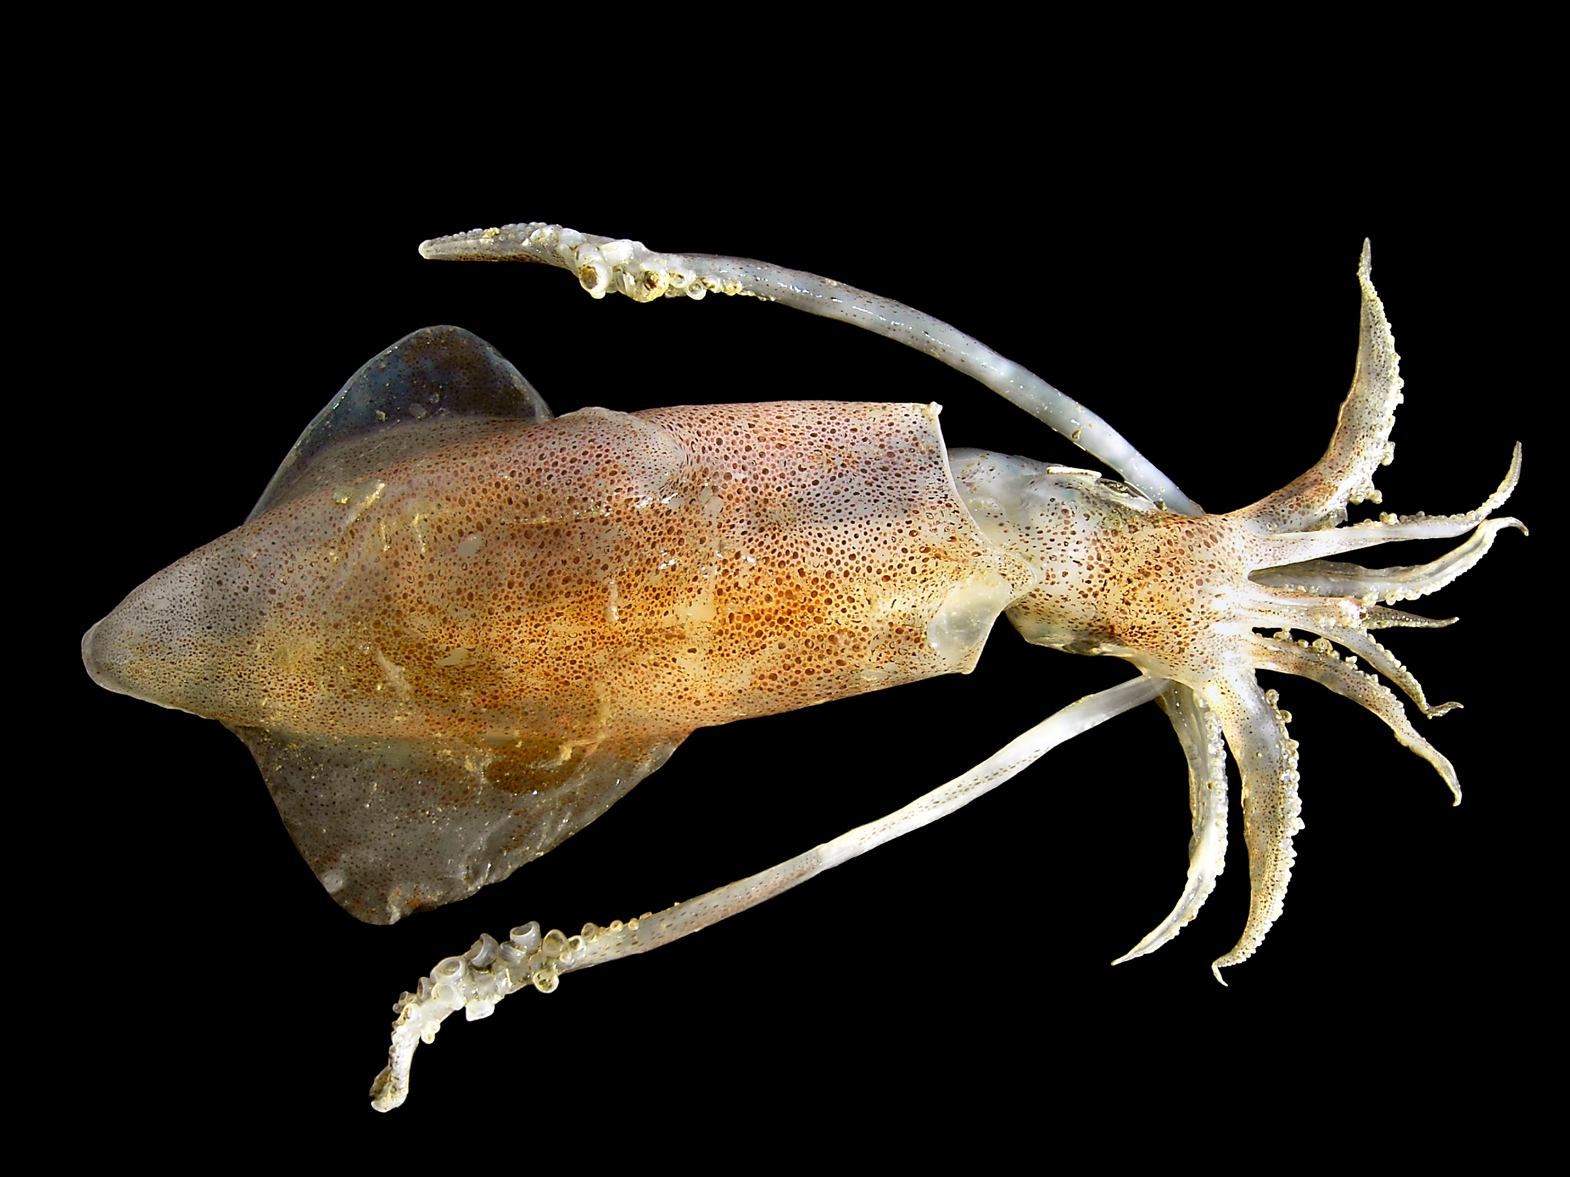
What phylum does this organism belong to?
What are the four body components found in most organisms within this phylum?
What class does this organism belong to?
How does this organism move?
Notes:
Mollusca
Mantle, Muscular foot, radula, visceral mass
Cephalopoda
Jet propulsion

Slide 6
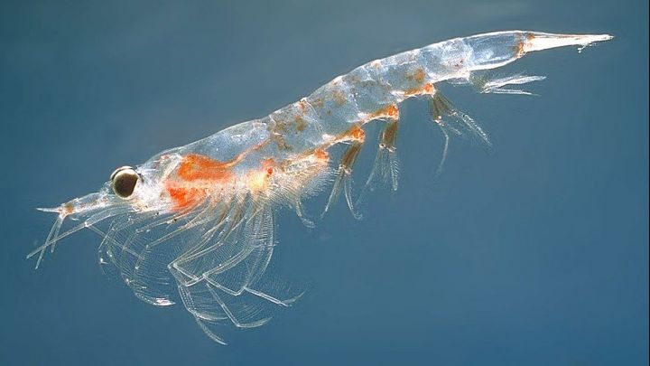
What phylum does this organism belong to?
What characteristics are unique to the phylum this organism belongs to?
What subphylum does this organism belong to?
What characteristics are unique to the subphylum this organism belongs to?
What type of development does this organism go through?
Notes:
Arthropoda
Exoskeleton, jointed appendages, two or three main body segments
Crustacea
Two antennae, biramous appendages
Protostome

Slide 7
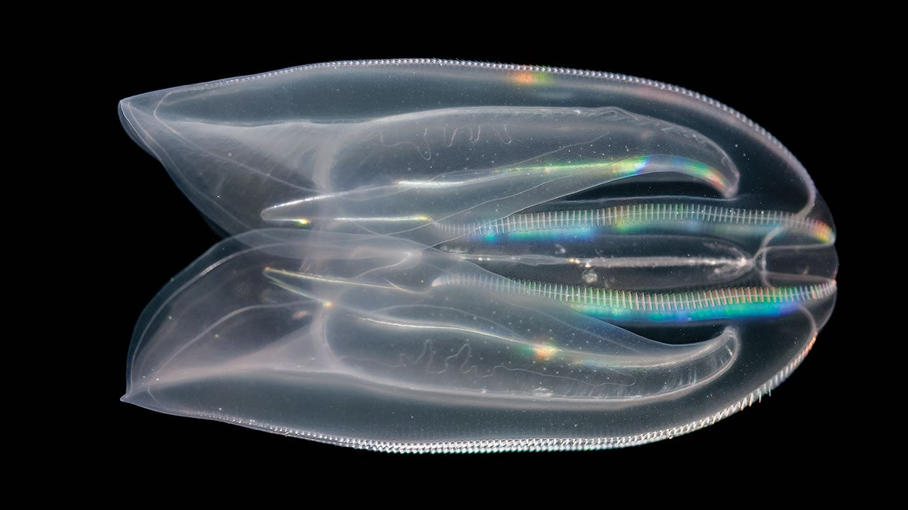
What phylum does this organism belong to?
How does this organism move?
What type of organization does this organism have?
Notes:
Ctenophora
Cilia
Tissue-level

Slide 8
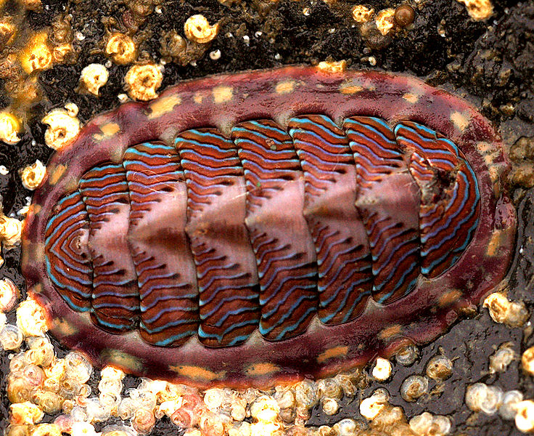
What phylum does this organism belong to?
What class does this organism belong to?
What type of symmetry does this organism have?
What type of development does this organism go through?
Notes:
Mollusca
Polyplacophora
Bilateral
Protostome

Slide 9
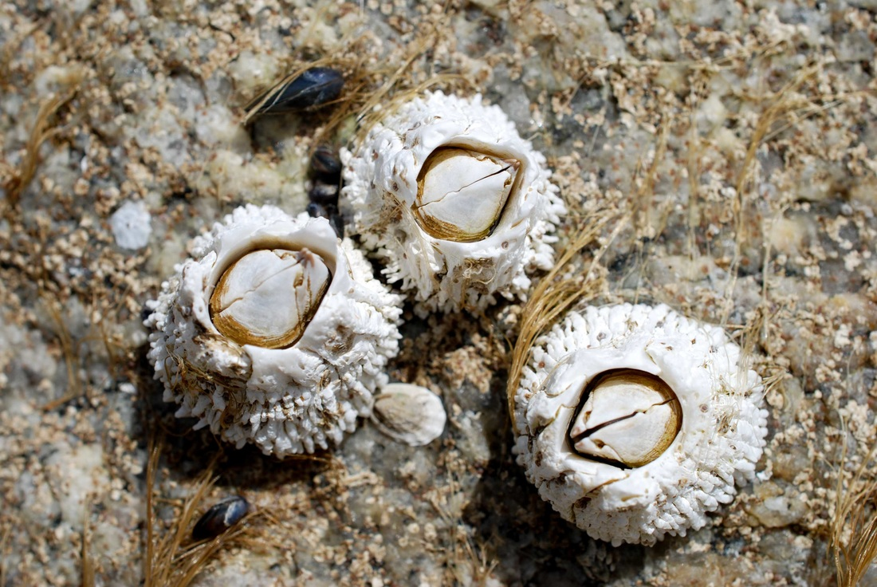
What phylum does this organism belong to?
What subphylum does this organism belong to?
What is the name of the specialized feeding structures used by these organisms?
Notes:
Arthropoda
Crustacea
Cirri

Slide 10
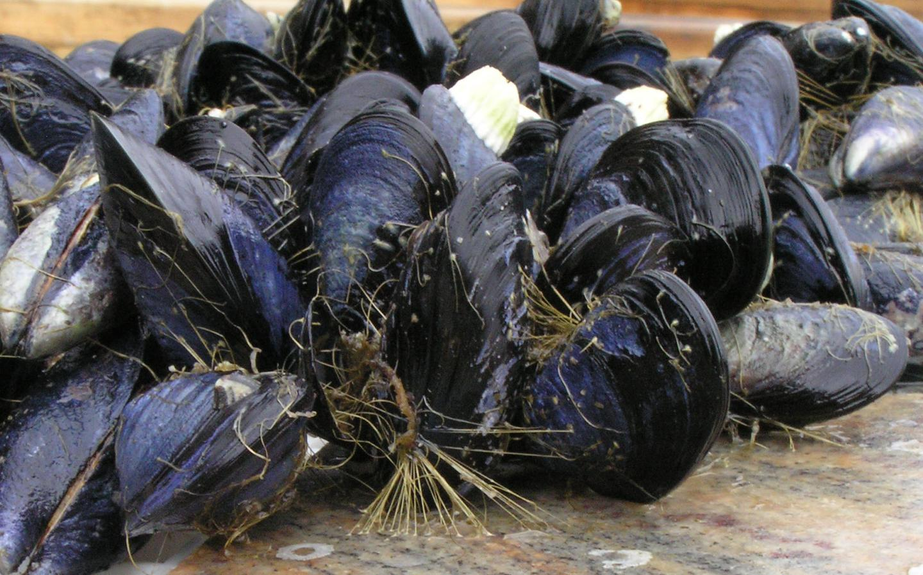
What phylum does this organism belong to?
What class does this organism belong to?
How does this organism feed?
What is lacking in this organism that is found in other classes within the same phylum?
Notes:
Mollusca
Bivalvia
Filter feeder
Radula

Slide 11
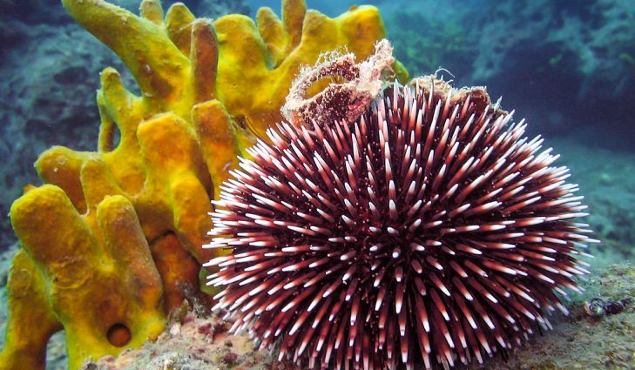
What phylum does this organism belong to?
What type of symmetry does this organism have?
What is the name of the specialized feeding cells found in this organism?
4. What phylum does this organism belong to?
5. What characteristic is unique to organisms in this phylum?
6. What type of symmetry does this organism have?
7. What class does this organism belong to?
8. How does this organism move?
Notes:
Porifera
Asymmetry
Collar cells or choanocytes
Echinodermata
Water vascular system
Radial
Echinoidea
Tube feet

Slide 12
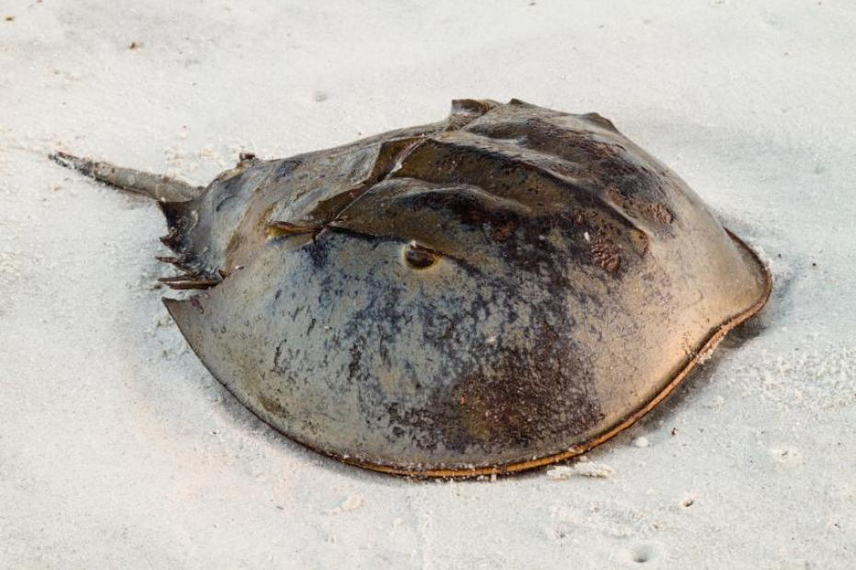
What phylum does this organism belong to?
What subphylum does this organism belong to?
What is the name of the specialized feeding structures used by these organisms?
Does this organism have an open or closed circulatory system?
Notes:
Arthropoda
Chelicerata
Chelicerae
Open

Slide 13
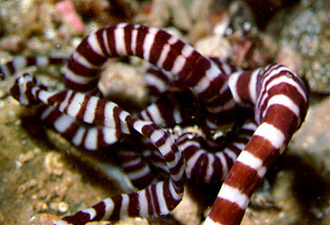
What phylum does this organism belong to?
What is the name of the specialized feeding structures used by these organisms?
Notes:
Nemertea
Proboscis

Slide 14
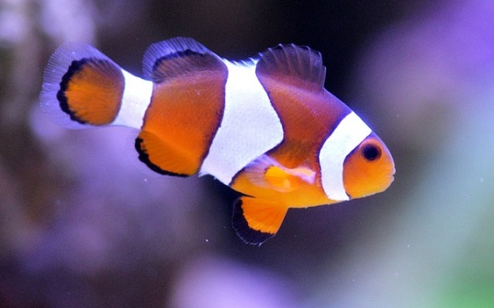
What phylum does this organism belong to?
What are the four body components that are unique to organisms within this phylum?
What type of development does this organism go through?
Notes:
Chordata
Dorsal hollow nerve cord, notochord, pharyngeal gill slits, post-anal tail
Deuterostome

