Slide 1
Evolution and Phylogeny
“There is grandeur in this view of life … from so simple a beginning endless forms most beautiful and wonderful have been, and are being, evolved”
- Charles Darwin
Chapters 24, 25 and 26

Slide 2
History of Evolutionary Thought

Slide 3
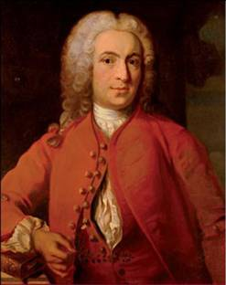
Precursors to Evolutionary Thought
Carl Linnaeus (1707 – 1778)
Swedish botanist, zoologist, and physician
Father of __________ (classifying organisms)
Binomial nomenclature
Ex. Homo sapiens

Slide 4
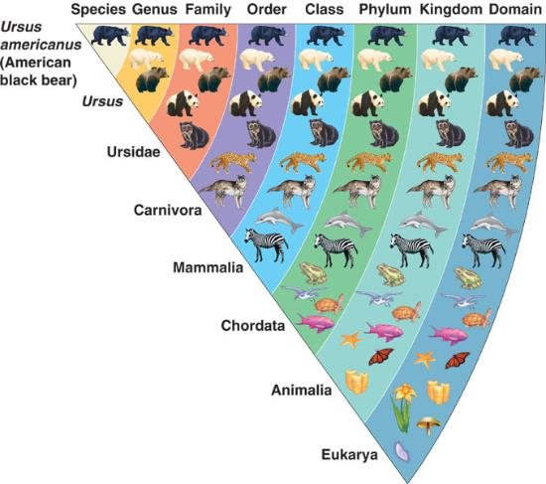
Classifying Organisms: Taxonomy
Domain
Kingdom
Phylum (plural, phyla)
Class
Order
Family
Genus (plural, genera)
Species (no specie!)
Notes:
Taxon = named taxonomic unit at any level of the taxonomy

Slide 5
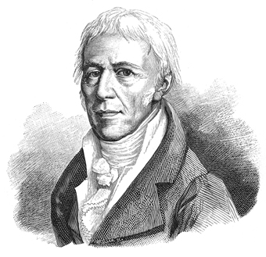
Precursors to Evolutionary Thought
Jean-Baptiste de Lamarck (1744 – 1829)
French naturalist
Proposed that organisms could ________ acquired traits
Changes that occurred during an organisms life could be passed on

Slide 6
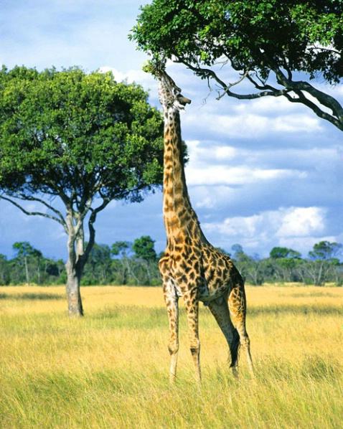
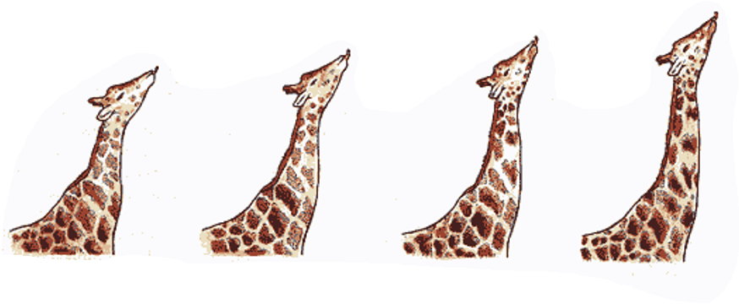
Lamarck on Giraffes
Giraffes that stretch their necks to reach higher branches will elongate their necks.
Giraffes will pass on longer necks to offspring.
Traits acquired through ______
Stretching

Slide 7
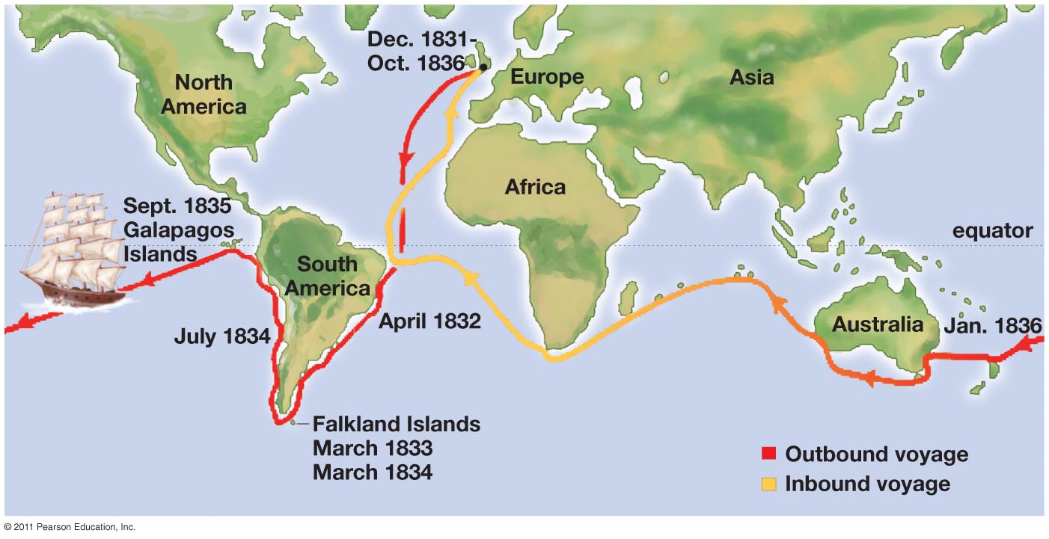
Charles Darwin’s Voyage
5 year trip around the world aboard H.M.S Beagle from 1831-1836

Slide 8
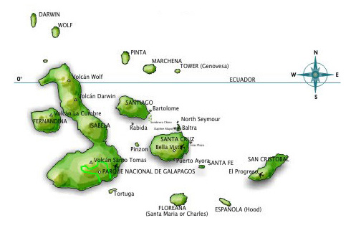
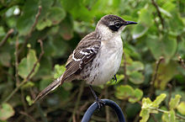
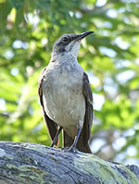
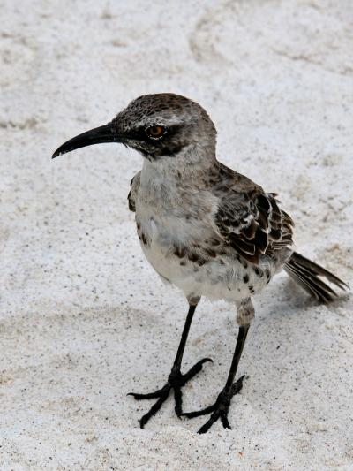
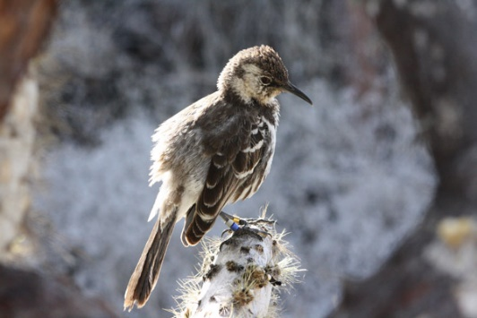

Slide 9
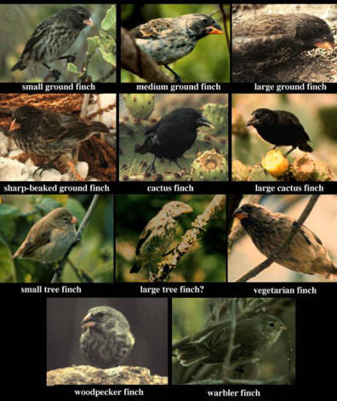
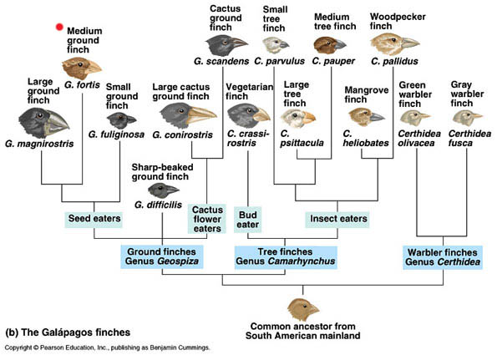
The Galapagos Finches
Notes:
Evolution was more evident on islands because the barriers are more defined.

Slide 10
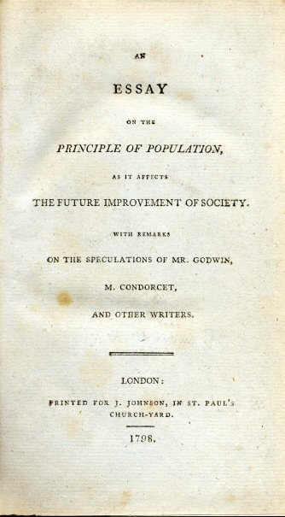
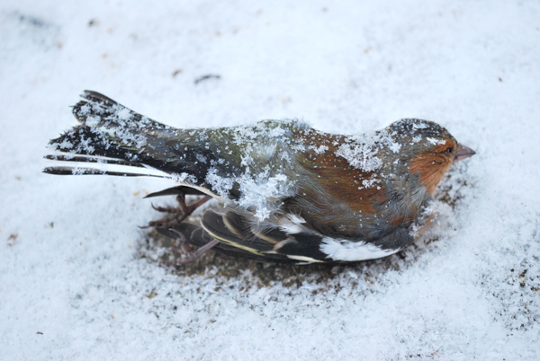
Crystallization of an Idea
Darwin read Thomas Malthus's An Essay on the Principle of Population 6th ed. (1826)
_________________ will be checked by limited resources, disease, famine
___________ of birds after a cold snap near Down House

Slide 11
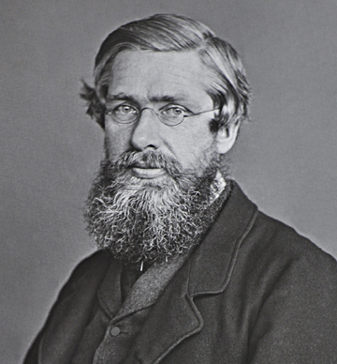
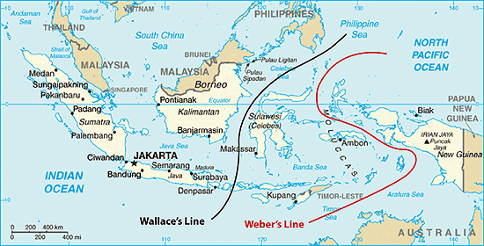
Alfred Russel Wallace
Collected specimens in Brazilian Amazon the throughout Malaysian Archipelago (Wallacea)
Father of _______________
Geographic barriers often separated closely related species
Wallace’s Line
Independently conceived idea of natural selection

Slide 12
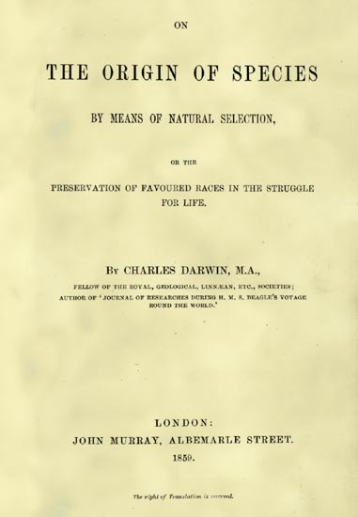
On the Origin of Species
Darwin publishes his theory
On The Origin of Species by Means of Natural Selection or the Preservation of Favoured Races in the Struggle For Life (1858)
Decent with modification
Natural selection

Slide 13
Introduction to Theory of Evolution
Common descent with modification: species of living things can undergo modification in successive generations, with these changes sometimes resulting in the formation of a new species
Species are united by a common ancestor
Natural Selection: the process through which traits that provide a _________________ to an individual organism grow more common in populations of organisms over successive generations
Environmental conditions determines or selects organisms best suited for that specific environment

Slide 14
Darwin’s Four Postulates
Natural Selection
Individual organisms in a population _____ in the traits they possess
Some of the trait differences are ___________
Only some individuals survive long enough to produce offspring and some produce more offspring than others
The subset of individuals that survive best and produce the most offspring is ___ a random sample of the population

Slide 15
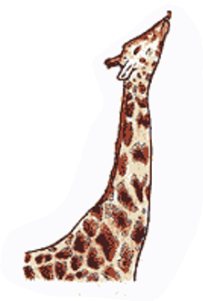
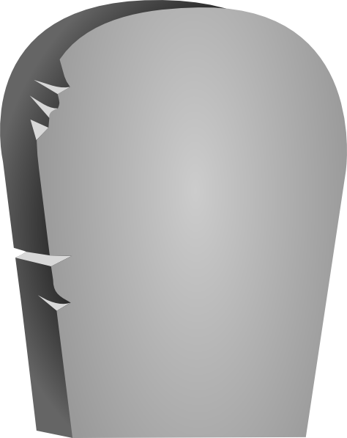
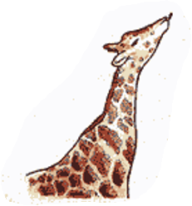
Darwin on Giraffes
Variation in neck length within a population of giraffes
Those with slightly longer necks will survive better where trees are hard to reach
Shorter necked individuals will fail to reach branches and die
Longer necked individuals will pass on their trait for longer necks
RIP
Short neck
*No stretching, just death

Slide 16
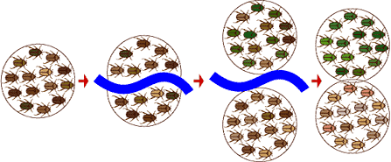
Evolution of a New Species
Macroevolution: Large-scale evolution occurring over long periods of time (geologic time) that results in the formation of _______________ (speciation)
Microevolution: Small-scale evolutionary change resulting from a change of the __________________ of a population
Speciation: Development of a new species through evolutionary processes
2 species
1 species
Time

Slide 17
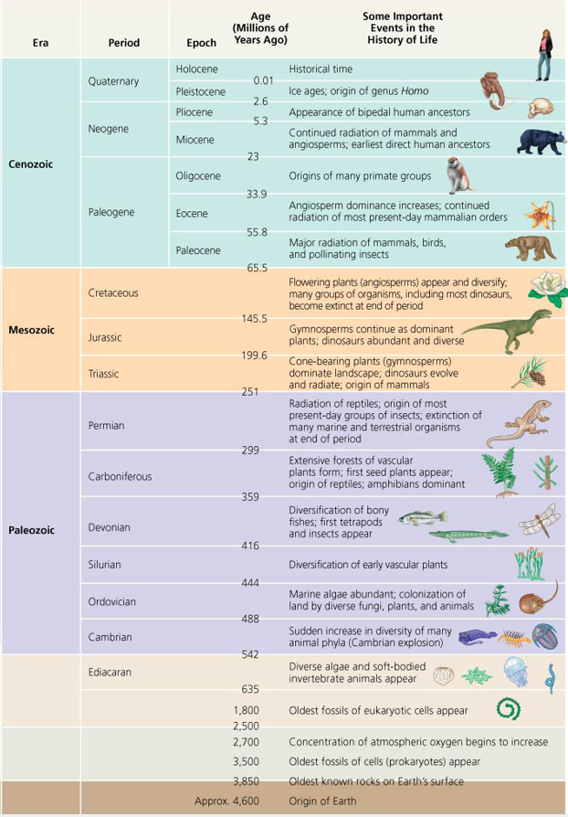
Geologic Timescale
History of Earth
4.6 billion years
Divided into Eras, Periods, and Epochs
Boundaries between Eras correlate with ______________
First organisms (__________) arose ~ 3.5 bya
First eukaryotes arose ~ 2.1 bya
First fungi arose ~ 1 bya
Moved to land around 500 mya

Slide 18
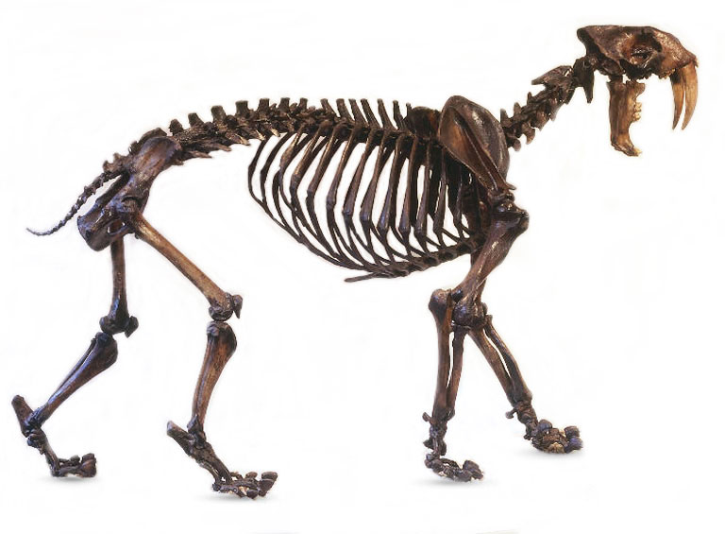
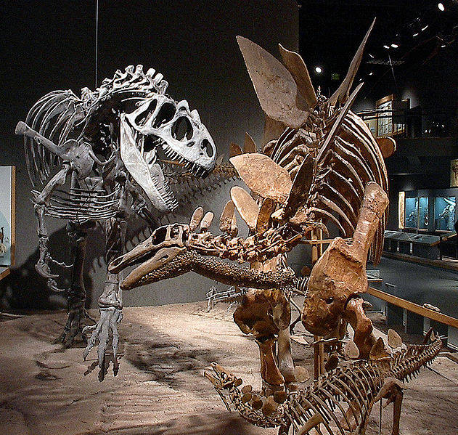
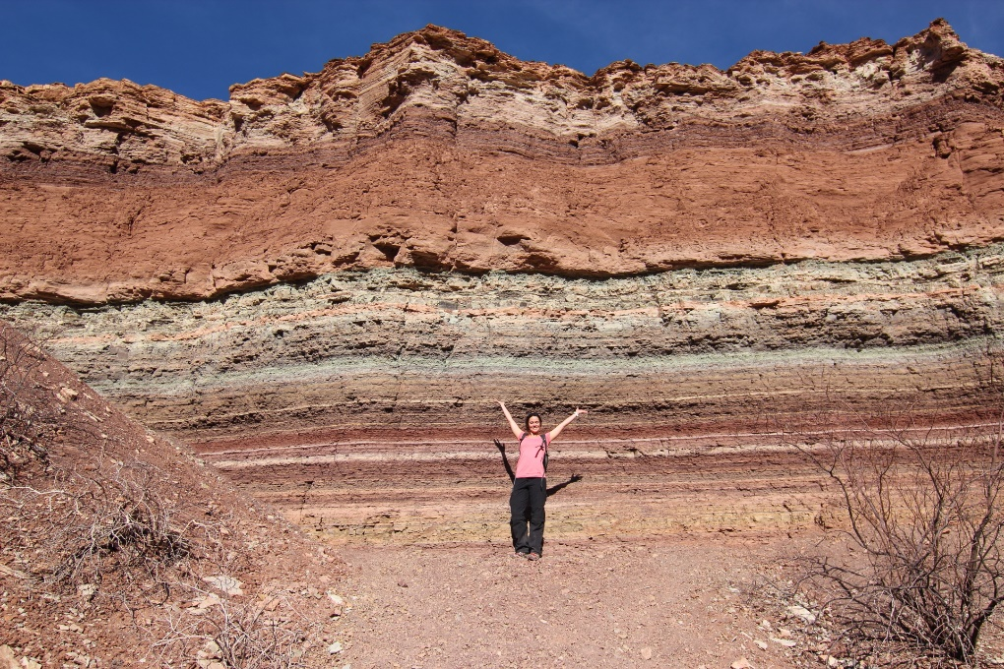
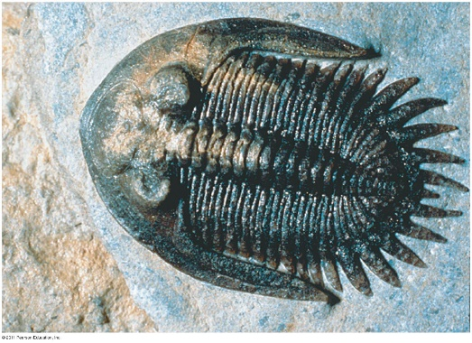
Evidence for Evolution
Fossil record
Evidence for extinction
Evidence for diversification

Slide 19
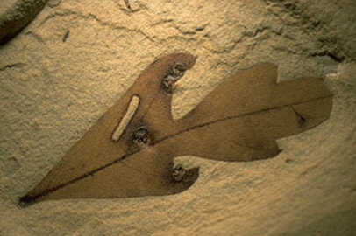
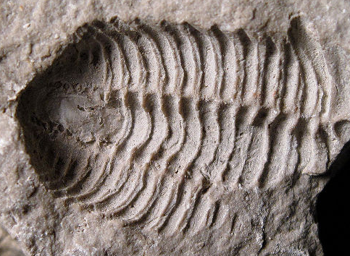
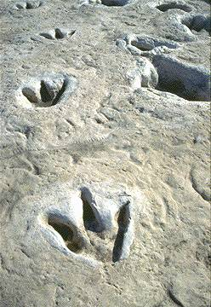
Evidence for Evolution
Fossil record
Organic material replaced by minerals
Petrified wood
Organic material: part of the organism was preserved
Casts: impressions made by an organism
Trace fossils: signs of life that were preserved
Footprints, burrows
Entire organisms

Slide 20
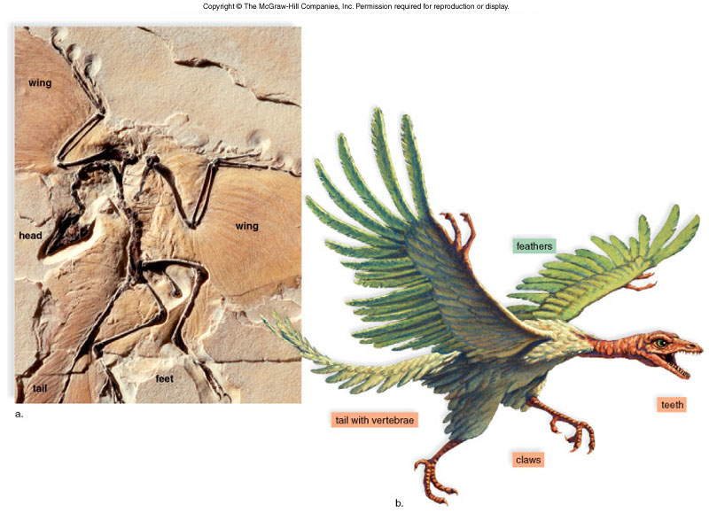
Evidence for Evolution
___________ forms: Intermediate states between ancestral form and its decedents
Archaeopteryx
Teeth of reptile
Feathers of bird
Tail with vertebrae like reptile
Claws of reptile

Slide 21
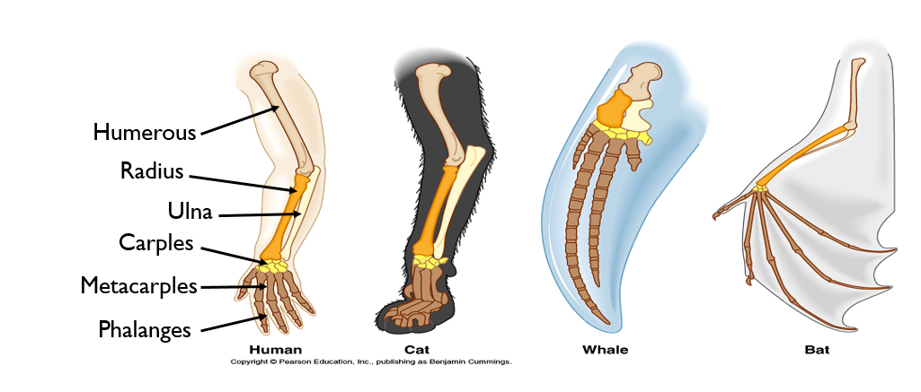
Evidence for Evolution
Morphology: study of physical forms of organisms
Homologous structures: _________________ structures among different taxa due to a common ancestor

Slide 22
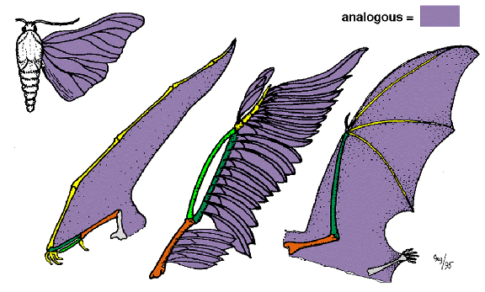
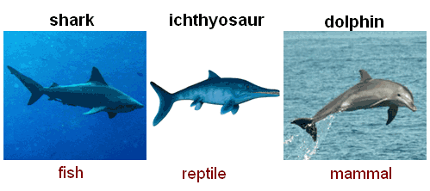
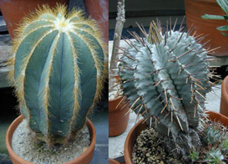
Evidence for Evolution
Analogous structures: structures from different species with similar function but ___________ evolutionary origin
_____________________: the independent evolution of similar features in species of different lineages
Notes:
Similar selective pressures drive evolution of similar characteristics
Homoplasy: same as convergent evolution, however the term is used in cladistics = “to mold in the same way”-Greek

Slide 23
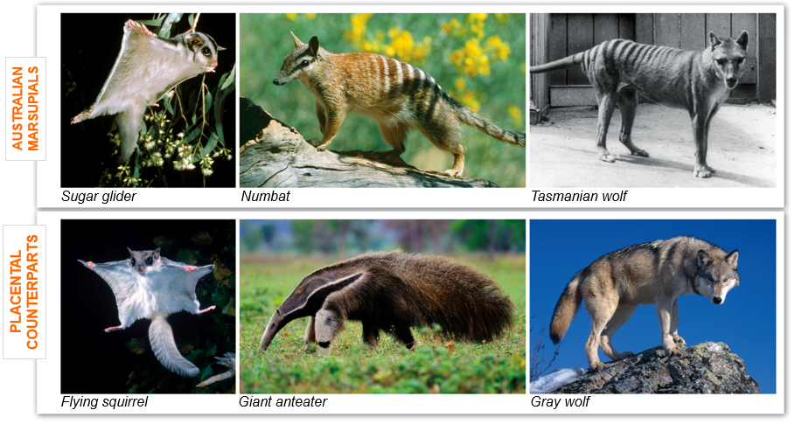
Evidence for Evolution
Convergent evolution of Australian marsupials and placental mammals occupying similar ecological niches
https://www.youtube.com/watch?v=nBpyAOpzlEE

Slide 24
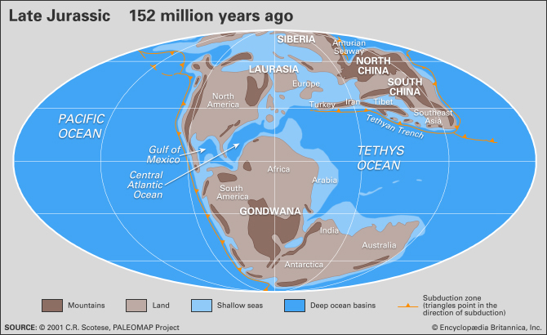
Evidence for Evolution
Biogeography: study of the distribution patterns of organisms around the world
Marsupials in South America and Australia

Slide 25
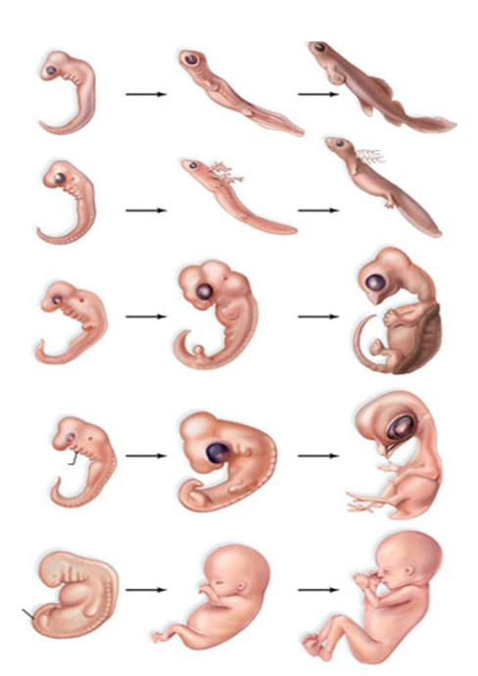
Evidence for Evolution
______________: study of development from fertilization to fetus stage
Similar structures during embryonic development among vertebrate groups
Pharyngeal gill slits
Post anal tail
Ontogeny recapitulates phylogeny
Ernst Haeckel
Fish
Salamander
Tortoise
Bird
Pharyngeal pouches
Human
Post-anal tail

Slide 26
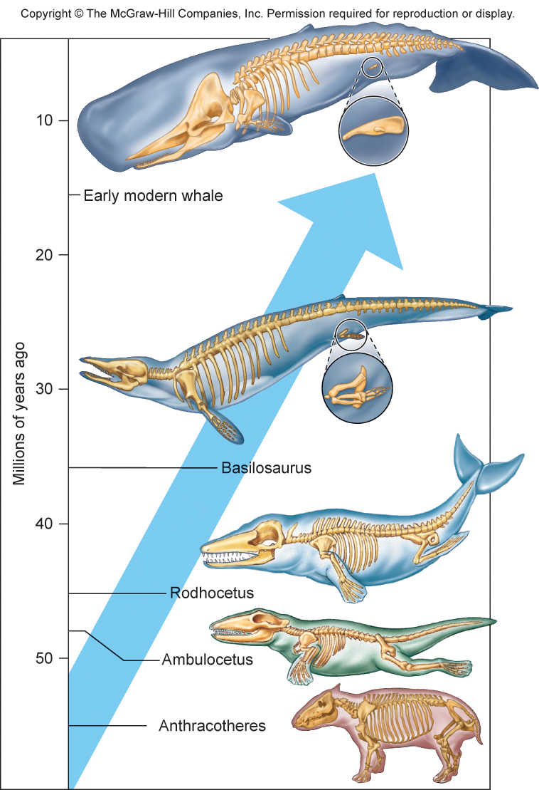
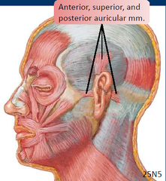
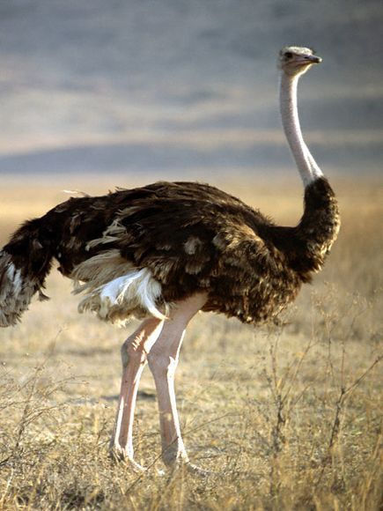
Evidence for Evolution
________________: a structure in an organisms whose original structure has been lost during the course of evolution

Slide 27
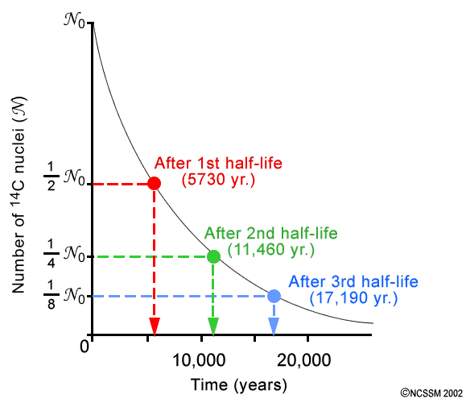
Evidence for Evolution
Radiometric dating: a technique used to date the age of an object by measuring the ______________ of radioactive elements within the object
Carbon dating
C¹² and C¹⁴
Half life of C¹⁴ = 5730 years
Uranium dating
Uranium-238 to Lead-206
Half life = 4.5 billion years

Slide 28
Check Your Understanding
A paleontologist estimates that when a particular organism lived it contained 64mg of the radioactive isotope Carbon-14. The fossil organism now contains 8mg of Carbon-14. The half-life of Carbon-14 is 5,730 years. How old is this fossil?
a) 0.3 million years old
b) 11,460 years old
c) 1,910 years old
d) 17,190 years old
e) -5,730 years old

Slide 29
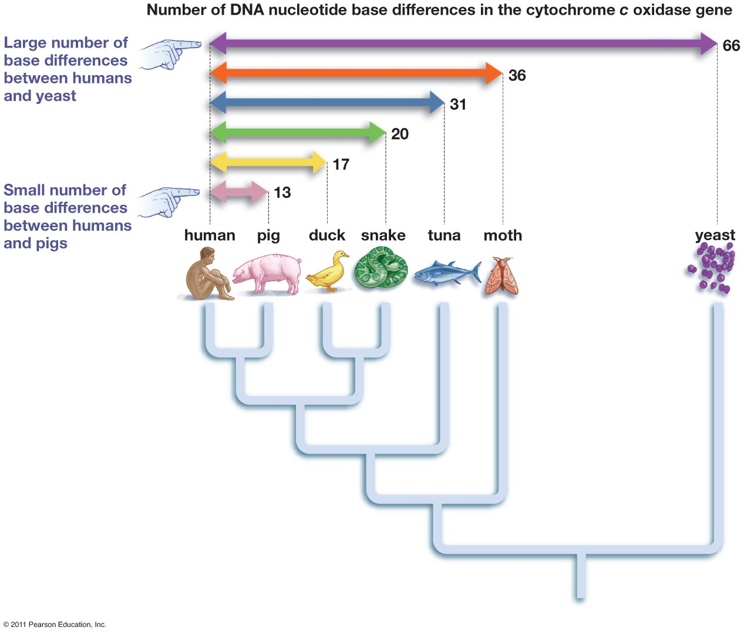
Evidence for Evolution
Similarities in DNA among close relatives
Species with similar traits have fewer base differences than species with dissimilar traits
Microsatellites: repeating sections of nuclear DNA (short tandem repeats or STRs)
Higher mutation rate than other sections of DNA
Mitochondrial DNA (mtDNA): DNA in mitochondria is only passed on through maternal germ line (no genetic recombination).
Higher mutation rate due to damage from oxidation
Cytochrome C oxidase

Slide 30
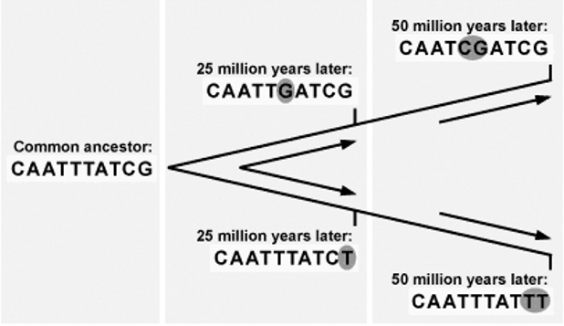
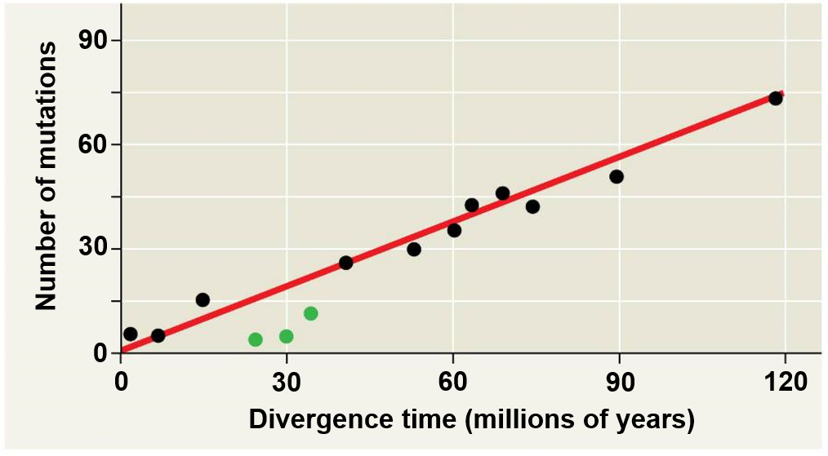
Using Molecular Clocks to Track Evolutionary Time
Molecular clock: Using a relatively constant mutation rate in DNA and protein sequences to estimating the time of evolutionary change

Slide 31
Check Your Understanding
Describe the differences between Lamarck's and Darwin’s theories on the means of evolutionary change.

Slide 32
Check Your Understanding
The remnants of pelvic bones in some whale species is an example of ______________.
a. convergent evolution
b. a vestigial traits
c. analogous structures
d. embryology
e. a transitional form

Slide 33
What is a Species?
_________________________: species are groups of actually or potentially interbreeding natural populations which are reproductively isolated from other such groups
Between 3 million and 15 million species exist on earth
Only 1.8 million species have been described
99% of all species that have existed are extinct!
Notes:
If two populations are separated but successful breed when brought together, they are considered the same species
Subspecies

Slide 34
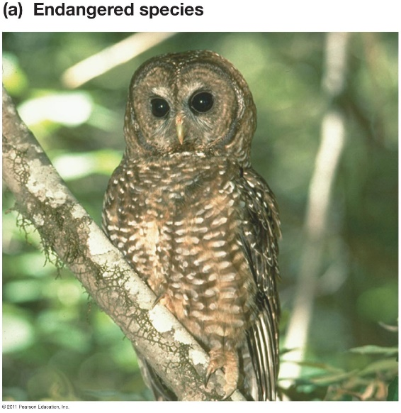
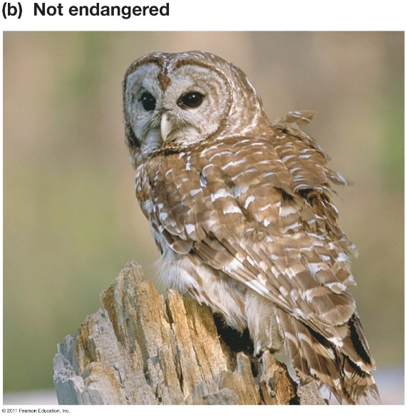
Describing Species
Ways species differ
Physical appearance
Adaptations
Behavior
Mating behavior
Vocalizations
Geographic range
Habitat type
Ecological niche
DNA
Molecular differences

Slide 35
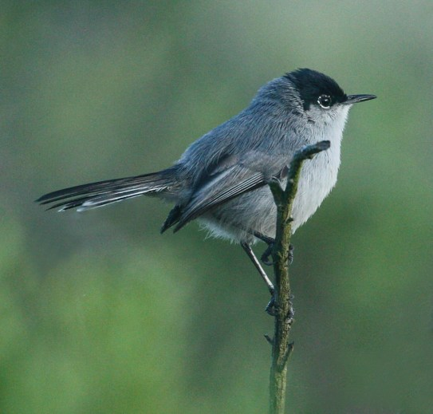
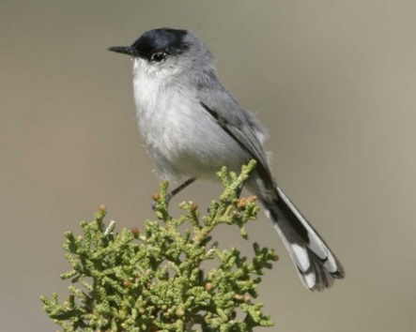
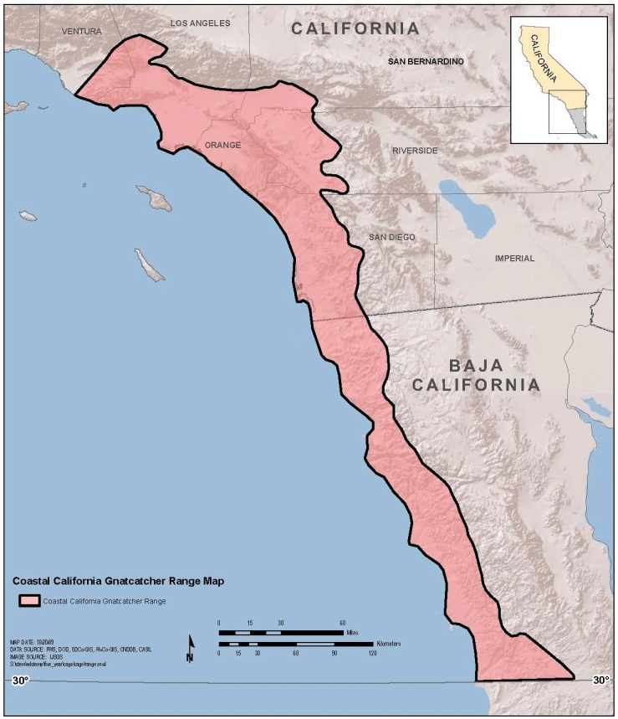
← California gnatcatcher
Black-tailed gnatcatcher →
Notes:
Coastal mountain range and Mojave desert separate sister species

Slide 36
Evolution of a New Species
Microevolution: Small-scale evolutionary change resulting from a change of the allele frequencies of a population
Macroevolution: Large-scale evolution occurring over long periods of time (geologic time) that results in the formation of new species (speciation)
Speciation: Development of a new species through evolutionary processes
2 species
1 species
Time

Slide 37
Mechanisms of Microevolution
Mutation: A permanent change in an organism’s DNA
Gene flow: The transfer of alleles from one population to another
Genetic drift: The random shift in the allele frequencies of a population
Natural Selection: The process by which individuals with certain beneficial traits produce more surviving offspring than individuals without those traits.
Sexual Selection: The process by which individuals with certain desirable traits reproduce more than individuals without those traits.

Slide 38
How do new species arise?
____________________ of population into two or more separate populations that no longer interbreed
Geological event
Migration into a new area
Shift in __________________ of separate populations
Genetic drift, natural selection, gene flow, sexual selection, mutation
Changes in allelic frequencies of populations results in differences that prevent individuals from each population from interbreeding with one another

Slide 39
Speciation with Separation
__________ speciation: speciation that results from the _______________ of populations by a _______ that prevents interbreeding between populations
Notes:
On the board
What are some examples of physical barriers that could separate populations?
Plate tectonics
Glaciation events
Canyon formation
Mountain formation
River changing course
Different habitats

Slide 40
Vicariance vs. Dispersal
Vicariance: splitting of an organisms native range through the ________________ to gene flow
Dispersal: movement of organisms to locations outside of their native range

Slide 41
Chimpanzee
Bonobo

Slide 42
Notes:
Salamander Ensatina eschscholtzii began migrating southward millions of years ago. Populations were split by the California central valley.
Example of a ring species

Slide 43
Biogeography of Camelidae: Dispersal
https://www.youtube.com/watch?v=lJNoAE0UHzY

Slide 44
Evolutionary Trends
Evolutionary trends are not ______________
Interaction between organisms and their current environment
Notes:
Browsers eat leaves and bark from trees while grazers eat mostly grasses that they clip off at ground level
Before the Pliocene, grazers were selected for while the browsers died off after diverging 35 million years before.
Equus is just a twig of a much larger bush.

Slide 45
Biotic Interchange
Biotic interchange: when barrier between previously separated biotas breaks down, resulting in drastic changes to biodiversity
Great American Biotic Interchange
Isthmus of Panama connected North and South America
Heading south: Bear, Cat, Camel, Horse, Elephant, Dog and Pig families
Heading north: Anteater, Porcupine, Armadillo, Sloth, and Possum families
Notes:
North American carnivores led to extinction of many South American animals.

Slide 46
Biogeography: Vicariance
Connection of North and South America at the Panama isthmus led to the vicariance of the pork fish populations.

Slide 47
Allopatric Speciation
Common in island chains (archipelagos)
Ex. Drosophila on Hawaiian Islands

Slide 48
Adaptive Radiation
Adaptive radiation: process in which organisms ______________, especially when exposed to a new environment with different challenges, new resources, and available niches
After mass extinction events
Cambrian explosion
Mammal diversification after Cretaceous mass extinction 65 Mya
Archipelagos
Galapagos finches
Hawaiian silverswords

Slide 49
Speciation Without Separation
_______________ speciation: Speciation without geographic separation
Ecological niche: The _____ of a species within its ecosystem.
Includes the interaction with all other organisms
Notes:
Sympatric = of the same country
More than 500 species of cichlids in Lake Victoria and Lake Malawi

Slide 50
Polyploidy
Polyploidy: a ________ of a set of chromosomes that results from an accident during cell division
Common in plants due to self pollination (asexual reproduction)
Leads to instantaneous speciation
Can lead to larger crop sizes
Large apples, pears and grapes are tetraploid
Large strawberries are octoploid
8n
2n
Notes:
Tetraploids offspring can self pollinate (plants) of mate with other tetraploid individuals. Mating with Diploid individuals yields triploid individual (3n) with reduced fertility

Slide 51
Hybrid Zones
Regions where two different species meet and mate
Three possible outcomes:
Reinforcement: reproductive barriers are strengthened
Hybrids diminish
Fusion: reproductive barriers are weakened
Two species fuse into one
Stability: Hybrid individuals persist

Slide 52
Hybrid Zones

Slide 53
How do evolutionary changes arise?
Evolutionary novelties
Exaptations
Evolution of genes that control development (“Evo-Devo”)
Changes in spatial pattern
Changes in rate and timing of development

Slide 54
Evolutionary Novelties
Novel and complex structures arise from __________________ to existing structures

Slide 55
Exaptation
Structures that evolved for one function but become __________ for another function.
Inner ear bones in mammals
Feathers in birds

Slide 56
Exaptation
Tiny wing nubs provide a thermoregulatory benefit, which leads to the selection for greater nub size.
At an intermediate size wing nubs provide an aerodynamic benefit
Greater wing size is selected for due to aerodynamic benefit

Slide 57
Evolutionary Development (Evo-Devo)
Study of the evolution and modification of development processes (ontogeny) of various organisms
Homeobox genes: 180 base pair DNA sequence that codes for a section of the protein that controls gene regulation
“Tool kit”
Notes:
Slight alterations in developmental genes that regulate developmental processes can have significant impacts on phenotype.
Presence of homeobox gene in both plants and animals provides evidence for evolution

Slide 58
Evolutionary Development (Evo-Devo)
__________: type of homeobox gene that determines body plan in animal embryos
Nearly identical in all animals

Slide 59
Evolutionary Development (Evo-Devo)
Change in gene expression
Alteration of developmental gene can cause significant morphological changes
Insects from crustacean-like ancestor
Notes:
Expression of Ubx gene suppresses leg formation in insects but not in crustacean.

Slide 60
Gene Expression: Promoters and Enhancers
Transcription factors (enhancer and promotor proteins) can increase or decrease the rate of transcription, which can increase or decrease gene expression.
Greater expression of Hoxc8 gene results is more thoracic vertebrae in mice compared to chickens
Notes:
All gene transcription requires that RNA polymerase be properly aligned at a noncoding sequence of DNA bases, called a promoter, that lies just “upstream” from a gene sequence
Separate groups of proteins, called transcription factors, bind to both the promoter and enhancer sequences. Thus, they facilitate the alignment of RNA polymerase at the promoter.
Different enhancer proteins among organisms can result in an increase or decrease of the transcription rate of the same gene, leading to differences in expression
Regulatory mutations likely more important in evolution than gene mutations

Slide 61
Evolutionary Development (Evo-Devo)
Allometric growth: variation in the relative __________ of different body parts

Slide 62
Evolutionary Development (Evo-Devo)
Heterochrony: evolutionary change in the ___________ of developmental events
“Different time”
Examples:
Growth rate of skull bones in human and chimpanzee infants
Growth of phalanges in bats
Decreased growth rate in pelvic bone of whales

Slide 63
Evolutionary Development (Evo-Devo)
Paedeomorphosis: when an organism reaches sexual maturity while retaining __________ characteristics
Mexican salamander
Birds?
Juvenile
Adult
Alligator
Dinosaur
Gills
Archaeopteryx
Image modified from Bhullar et al. 2012. Nature, Vol. 487 Issue 7406, p223-226
Notes:
The developmental genes in birds may have stopped the expression of the genes that led to an elongated face, reduced braincase and reduced orbit size.
Why? Large eyes and brain were likely selected for because birds would need to rely heavily on vision for flight and would require a larger vision center in the brain to process the visual ques

Slide 64
Evolutionary Development (Evo-Devo)
Allometric growth: a change in the ___ of growth of some body parts relative to other body parts

Slide 65
Organizing Evolutionary Relationships
Phylogeny: the evolutionary history of a species
Phylogenetic tree: hypothesis about evolutionary relationships where branch length often represents amount of evolutionary change or time
Cladistics: an analytical approach to classification that groups organisms based on shared characteristics
Cladogram: a phylogenetic tree formed using cladistics methods, which only infers the relationship between organisms based on shared traits
Notes:
Systematics: a discipline focused on classifying organisms and determining their evolutionary relationships.

Slide 66
Phylogenetic trees can be used to depict taxonomic classification and evolutionary relationships
1
= Last common ancestor between Mustelidae and Canidae
= Last common ancestor between coyotes and gray wolves
2

Slide 67
Understanding a Phylogenetic Tree
__________: organisms that share an immediate common ancestor
__________: lineage that diverged early in the phylogenetic history
Patterns of decent, not phenotypic similarity
Branching does not always signify age of particular species
Taxon did not evolve from sister taxon
Notes:
Crocodiles are more closely related to birds than lizards

Slide 68
Phylogeny Terms
Ancestral trait: a characteristic that existed in an ancestor
Symplesiomorphy: an ancestral trait shared by two or more taxa
Derived trait: a characteristic that is a modified form of an ancestral trait
_________________: a shared, derived characteristic
Used to ________________________
Clade: a group of species used in cladograms and phylogenetic trees, which contains one ancestor and ____________________
_________________
Outgroup: a taxa that diverged before all other taxa in the phylogenetic tree, which is used for reference

Slide 69
Interpreting Phylogenetic Trees
Synapomorphies are placed on the phylogeny to depict the groups with the derived traits

Slide 70
Interpreting Phylogenetic Trees
Eggs
Hair
Can be rotated on axes and still represent same evolutionary history
Notes:
Sister taxa = groups of organisms that share an immediate common ancestor
Basel taxon = lineage that diverged earliest in the displayed phylogeny

Slide 71
Interpreting Phylogenetic Trees

Slide 72
Check Your Understanding
Write the names of the listed organisms in the correct location in the phylogeny below. Place the synapomorphies in the correct location on the phylogeny.
Species list
Butterfly
Wolf
Coyote
Bear
Eagle
Rabbit
Mouse
Adaptations
Wings
Backbone
Mammary glands
Carnassial teeth (flesh eating teeth)

Slide 73
Phylogenetic Groupings
Monophyletic – Clade that includes ancestor and ____ of its descendants.
Paraphyletic – Grouping that includes ancestor and _____, but not all, of it’s descendants.
Polyphyletic – Grouping that lacks a most recent __________________.

Slide 75
Constructing a Phylogeny
Maximum Parsimony: adopting the simplest explanation that is consistent with the facts.
Tree which requires the ______________________ or the number of times a derived trait appears within the phylogenetic tree

Slide 76
Cladistics and Cladograms

Slide 77
Constructing a Cladogram
 | Taxa
Characters | Millipede | Body Louse | Beetle | Assassin Bug | Bee | Ant
Wings | 0 | 0 | 1 | 1 | 1 | 1
3 body regions | 0 | 1 | 1 | 1 | 1 | 1
Social | 0 | 0 | 0 | 0 | 1 | 1
Complete Metamorphosis | 0 | 0 | 1 | 0 | 1 | 1
Mobile Head | 0 | 0 | 0 | 0 | 1 | 1
Flattened Body | 0 | 1 | 0 | 0 | 0 | 0

