Slide 1
Ecosystems and Conservation Biology
“Here is your country. Cherish these natural wonders, cherish the natural resources, cherish the history and romance as a sacred heritage, for your children and your children's children. Do not let selfish men or greedy interests skin your country of its beauty, its riches or its romance.” ― Theodore Roosevelt
“Only when the last tree has died and the last river been poisoned and the last fish been caught will we realize we cannot eat money”
-Cree Indian Proverb
Chapter 36

Slide 2
Ecosystems
Ecosystem: a community of biological organisms with the non-living components with which the organisms interact.
Biotic factors: living components of an ecosystem
All the organisms within a given area (bacteria, fungi, plants and animals) including the interactions (predation and competition) among those organisms
Abiotic factors: non-living components of an ecosystem
Chemical components of the soil, water, and air
Precipitation, temperature, soil, humidity

Slide 3
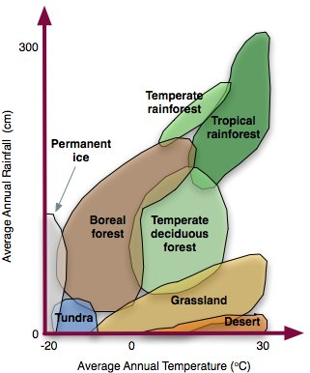
Classification of Biomes
Biome: large ecosystems on earth characterized by fluctuations (seasonality) in the temperature and precipitation
Rainfall and temperature are two most important factors in determining habitat and biome type

Slide 4
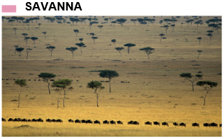
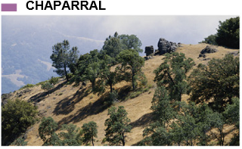
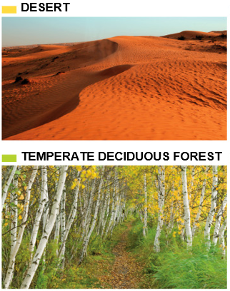
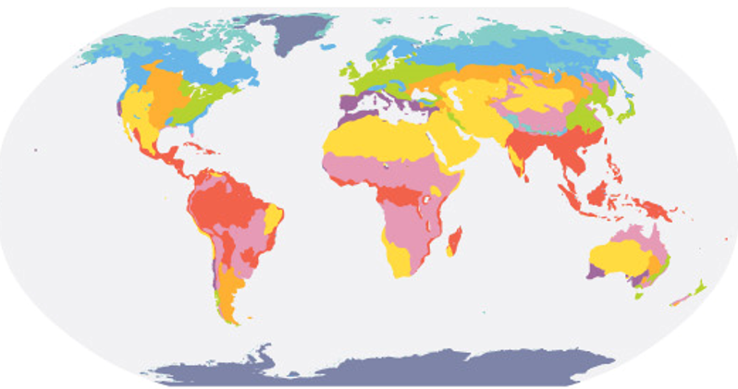
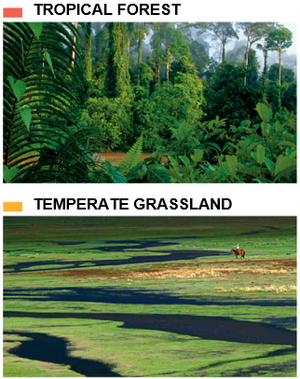
Major Terrestrial Biomes on Earth

Slide 5
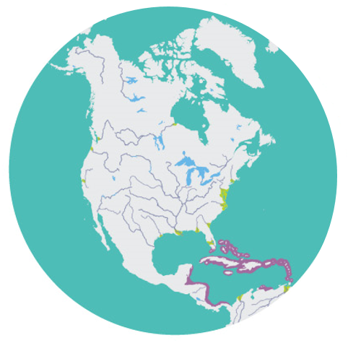
Major Aquatic Biomes in North America

Slide 6
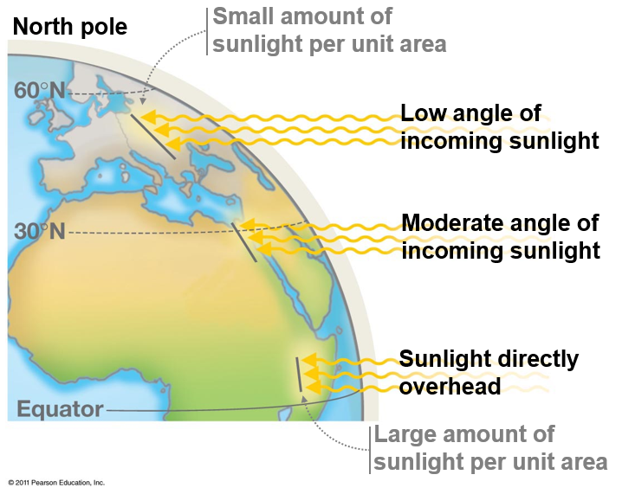
Factors that Cause the Ecosystems on Earth
Distribution of solar energy
Solar energy is greatest at the equator
Due to curvature of earth, sunlight is spread out over larger areas near the poles

Slide 7
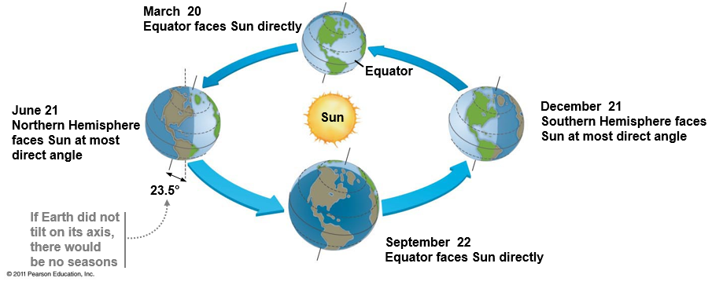
Factors that Cause the Ecosystems on Earth
Tilt of the earth on its axis as it rotates around the sun
June 21st = summer solstice, longest day of the year in northern hemisphere
December 21st = winter solstice, shortest day of the year in northern hemisphere

Slide 8
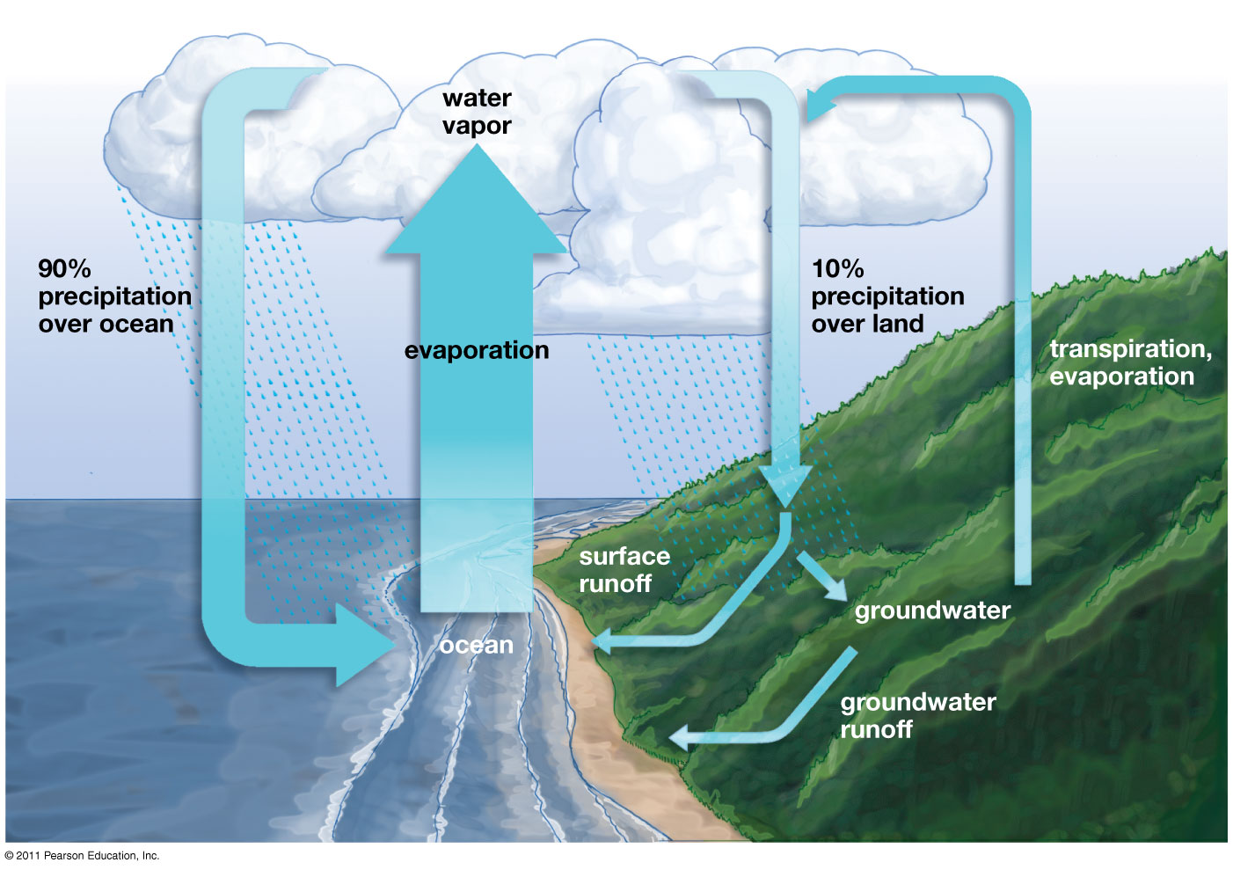
Factors that Cause the Ecosystems on Earth
Solar heat causes air to warm and rise.
Warm air holds more moisture than cold air
Rising air cools the farther it gets from the earths surface
Cooling air loses moisture causing rainfall.

Slide 9
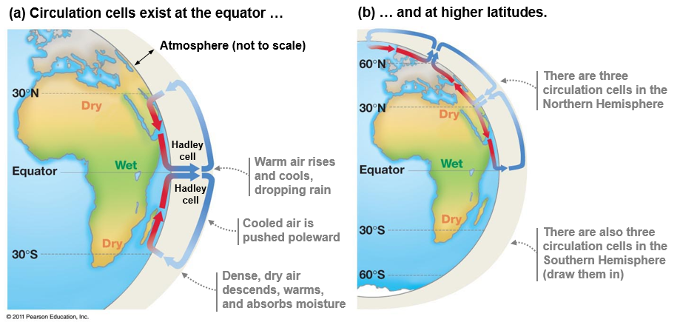
Factors that Cause the Ecosystems on Earth
Hadley cell: large scale atmospheric pattern where warm, wet air rises at the equator and cools at it moves poleward, with dry air descending at about 30° N and S latitude
Creates subtropical deserts, trade winds, hurricanes and jet streams

Slide 10
Precipitation Patterns on Earth
Nearly all deserts on earth are located around 30° N and S latitude

Slide 11
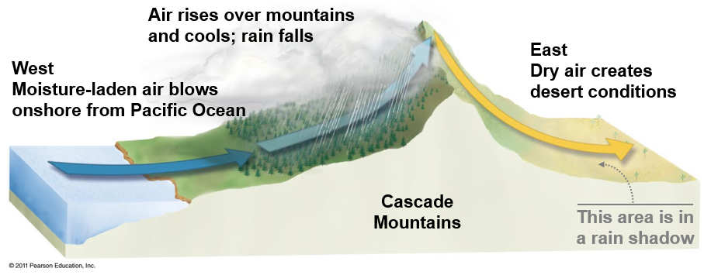
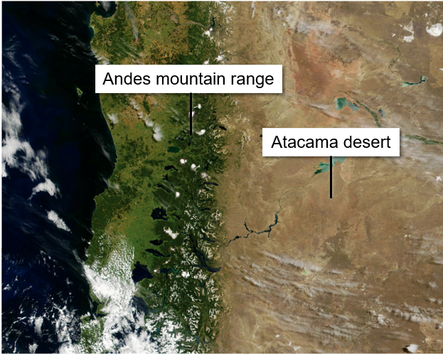
Factors that Cause the Ecosystems on Earth
Rain shadow effect: air from the ocean cools and drops moisture as it rises over coastal mountains causing dry conditions on the back side of mountains

Slide 12
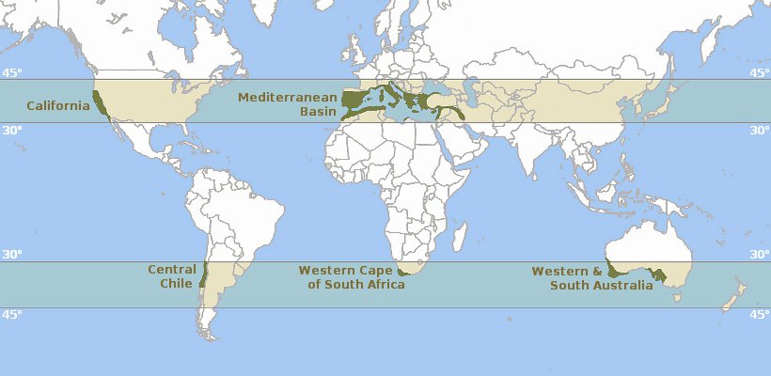
Mediterranean Climate
Chaparral biome
Wet, mild winters and hot, dry summers
Western sides of continents
Species adapted to drought, flood and fire

Slide 13
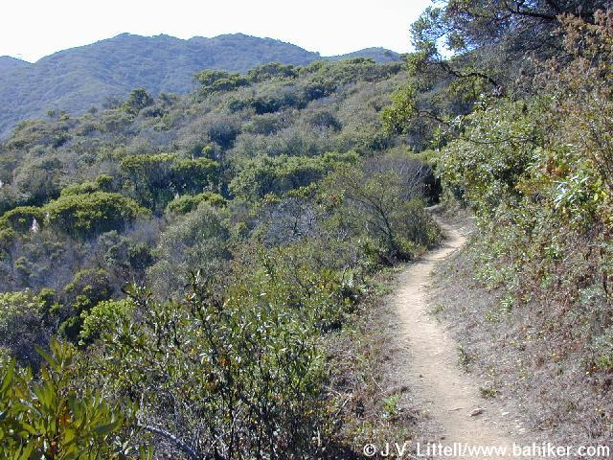
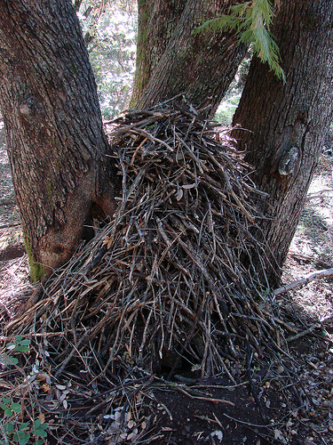
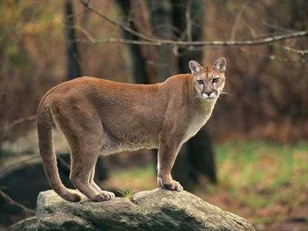
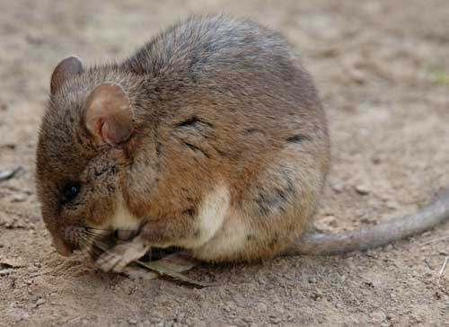
Local California Ecosystems
Chaparral
Summer drought tolerant plants
Larger, more woody species than CSS
Many evergreen species
Oaks, manzanita, chamise
Adaptations to infrequent fires
Small, hard leaves with waxy cuticle
Elevation typically between 500 – 4500ft above sea level

Slide 14
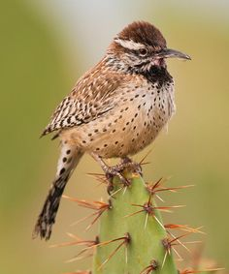
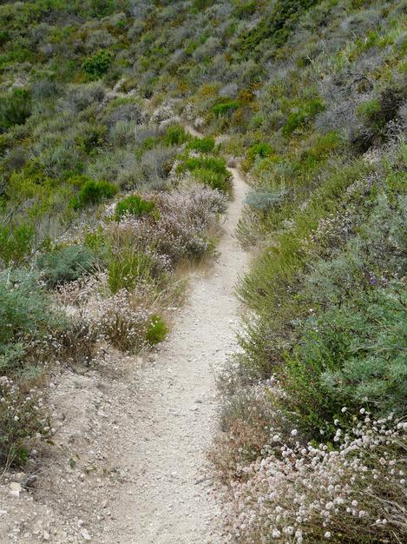
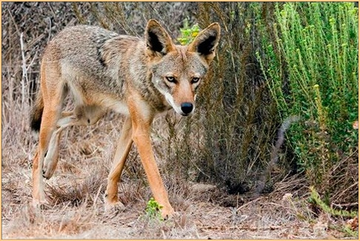
Local California Ecosystems
Coastal Sage Scrub (CSS)
Typically low lying shrub species
Also called soft chaparral
Ranges form sea level to about 1800ft
Temperature rarely drops below freezing
Many aromatic species
Sages and Artemisia

Slide 15
Biodiversity
Biological diversity or biodiversity: the variety of plants and animals, or other living things, in a particular area or region
Why is it important?
Extrinsic value: The value to humans, ecosystem services
Provisioning services: we need it for food, medicine or industrial uses
Cultural services: we like the way it looks, spiritual value
Regulating services: decomposition and pest control
Habitat services: produces oxygen (photosynthesis), nutrient cycling
Intrinsic value: The worth of an entity independent from external circumstances or its value to human
Value to biodiversity
Notes:
40% of all prescriptions are for medicines that originated from plants and animals.
80,000 species of edible plants known on Earth, but 90% of the world’s food comes from a mere 20 of these species.
Since 2000, 53 new species of primates have been described (IUCN 2008) including a new species of Brazilian monkey, Mura’s saddleback tamarin.

Slide 16
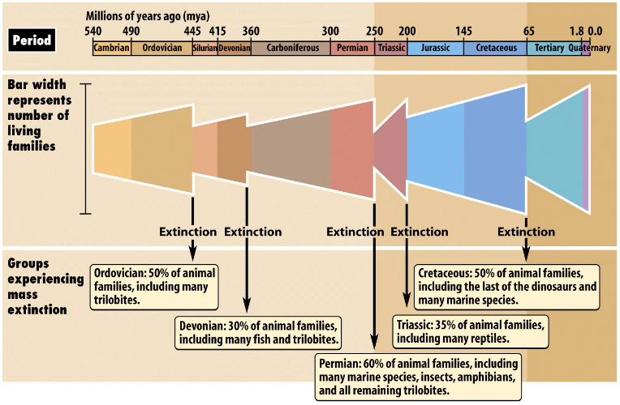
History of Mass Extinction Events
Five mass extinction events on earth
Humans are currently causing the sixth mass extinction event
Permian extinction event was the largest with a loss of 96% of all species
Cretaceous extinction led to the loss of the dinosaurs 65 mya

Slide 17
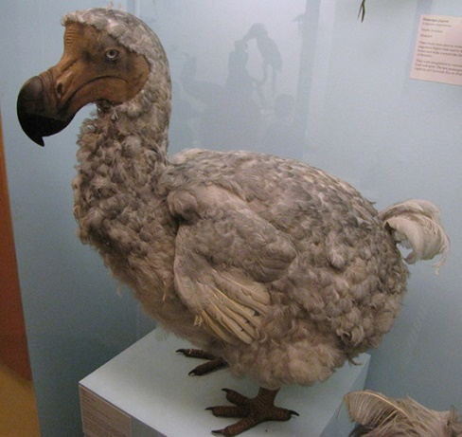
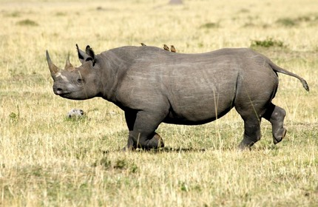
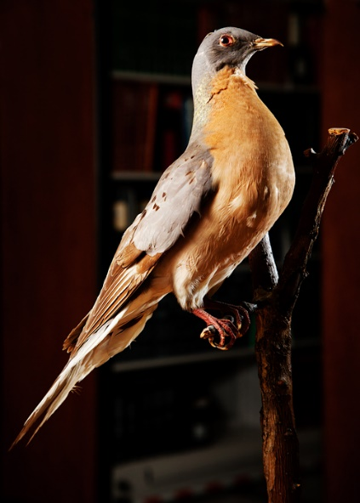
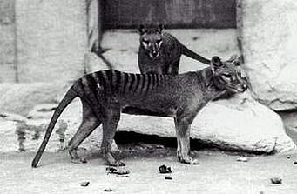
Loss of Biodiversity
Human caused mass extinction event
1,000 to 10,000 times greater than natural extinction rates
Six mass extinction since evolution of life
Worst since extinction of dinosaurs
Amphibians under the greatest threat
1/3 at risk of extinction
Indicator species
Thin skin makes them susceptible to toxins
Live in both aquatic and terrestrial environments
90% of primates are endangered
Palm oil and orangutans
Most marine mammals are threatened or endangered
Notes:
Human destruction and human influenced changes exceed conservation and preservation
Passenger pigeon: “One flock in 1866 in southern Ontario was described as being 1 mi (1.5 km) wide and 300 mi (500 km) long, took 14 hours to pass, and held in excess of 3.5 billion birds.”
Habitat loss (deforestation of east) and hunting
Last one died in 1914

Slide 18
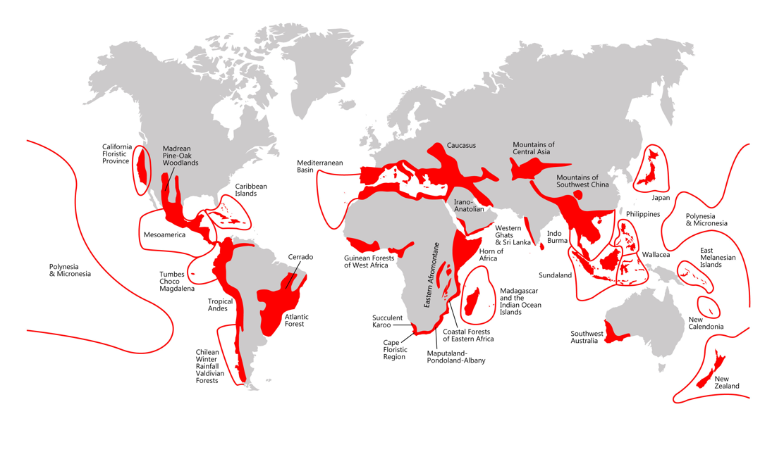
Biodiversity Hotspots
Requirements
At least 1500 endemic plant species
Endemic: species found only in a distinct geographic area
70% loss of original habitat
35 areas around the world
Support nearly 60% of all plant and animal species
California Floristic Province
Notes:
Endemic species: a species that is only found in a distinct geographic area

Slide 19
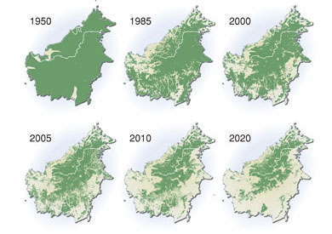
Human Impacts on Biodiversity
Habitat loss: the conversion or transformation of a natural area into wholly human occupied area of little or no use to wild species
Greatest threat to biodiversity
Mostly caused by expansion of agricultural land
85% of species listed as either threatened or endangered due to habitat loss
Palm tree plantations in Borneo

Slide 20
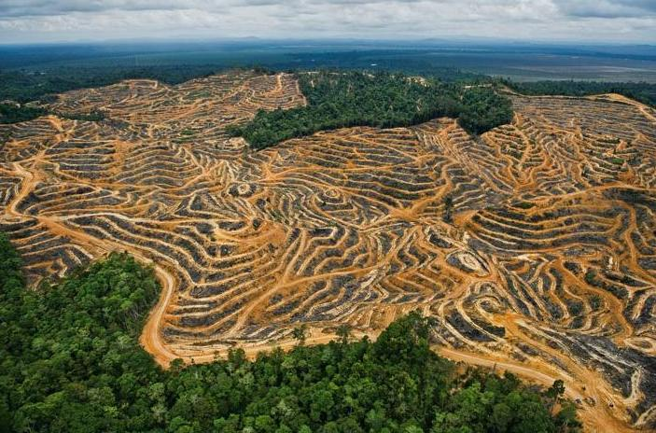
Human Impacts on Biodiversity
Deforestation: the clearing of forests and the conversion of the land for non-forests use
Slash and burn
Causes:
48% due to subsistence farming
32% due to commercial agriculture
14% due to logging
5% used as wood for fuel
Consequences:
Less oxygen
Less water
Land slides

Slide 21
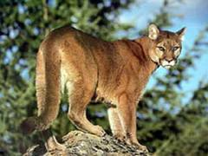
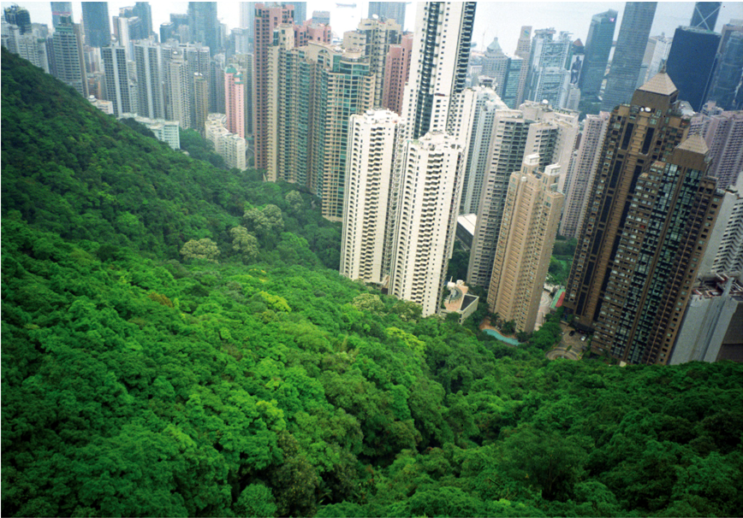
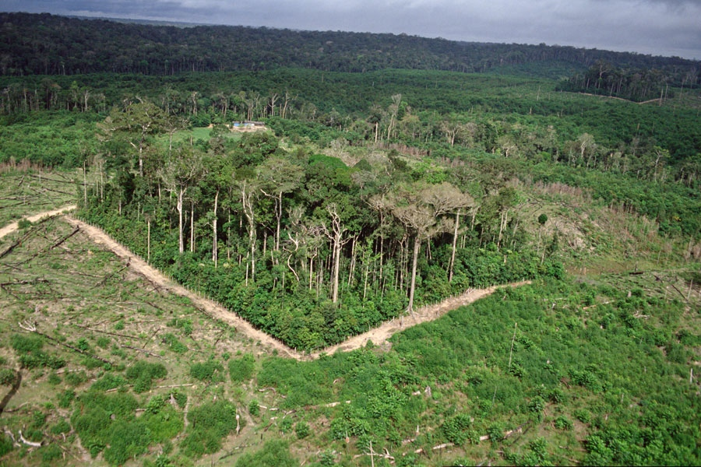
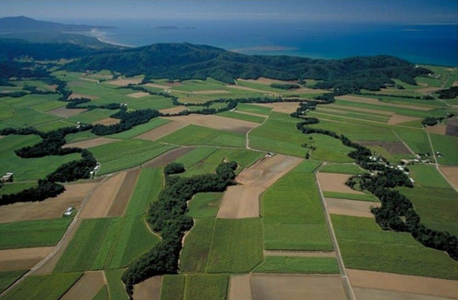
Human Impacts on Biodiversity
Habitat fragmentation: the disruption of extensive habitats into isolated and small patches
Smaller territories cannot sustain large carnivores
Urbanization: expansion of urban environments
Associated with habitat loss and fragmentation

Slide 22
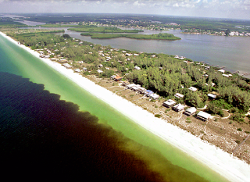
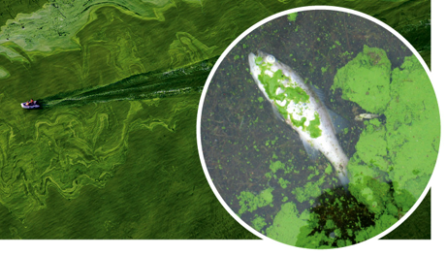
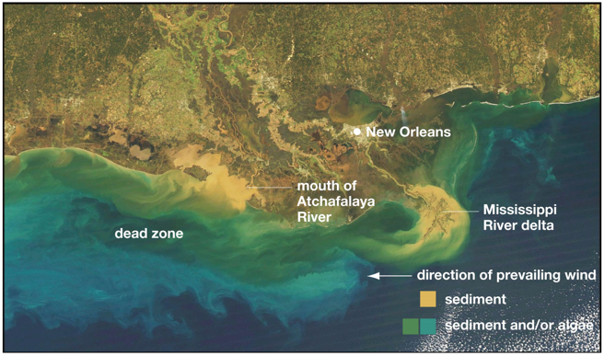
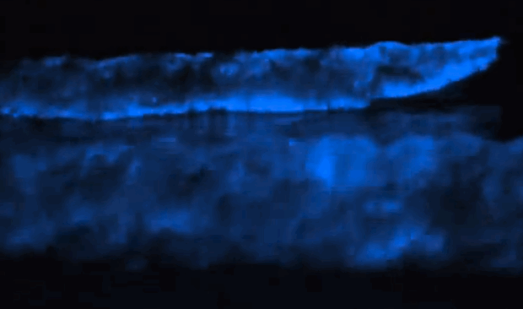
Human Impacts on Biodiversity
Eutrophication: excessive richness of nutrients in a lake or other body of water, frequently due to runoff from the land, which causes a dense growth of algae and bacteria resulting in the death of animal life from lack of oxygen.
Hypoxia: the depletion of oxygen in the water often resulting in dead zones
Notes:
Nitrogen and phosphorus

Slide 23
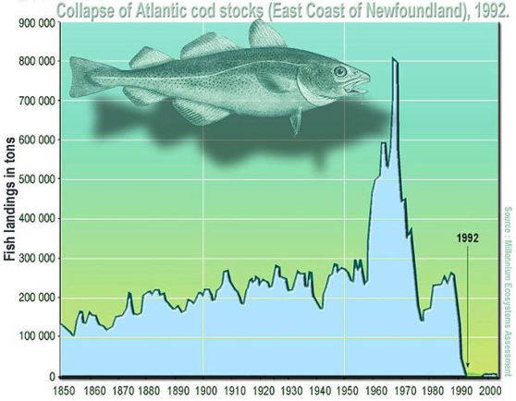
Overfishing
Overfishing: overexploitation of fish stocks in an unsustainable manner
30% of all commercial fish stocks are overfished
Factors that lead to overfishing:
International waters (>200 mi from shore) are unregulated resulting in open access fisheries
Poor fisheries management
Fish are caught by multiple countries making data collection difficult to impossible
Illegal fishing
Many catches are unreported
Subsidized fishing fleets result in 2 times more fleets than necessary
Notes:
Many of the Chinese boat owners rely on government money to build vessels and fuel their journeys to Senegal, a monthlong trip from crowded ports in China. Over all, government subsidies to the fishing industry reached nearly $22 billion between 2011 and 2015, nearly triple the amount spent during the previous four years, according to Zhang Hongzhou, a research fellow at Nanyang Technological University in Singapore.

Slide 24
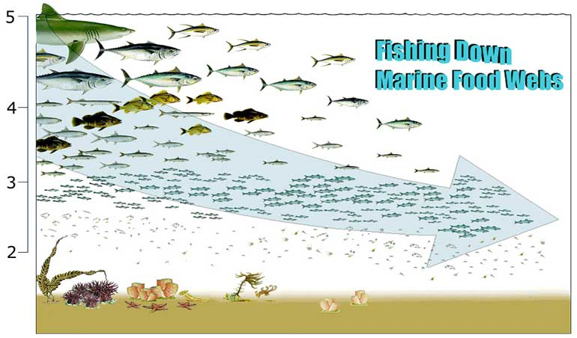
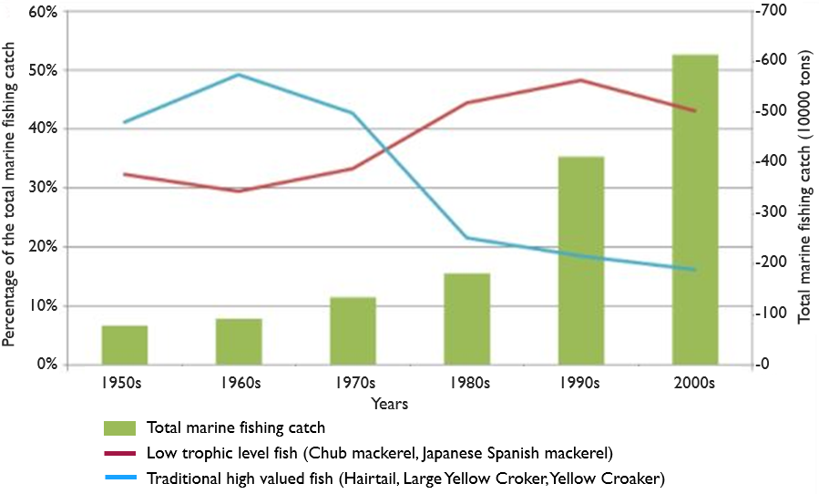
Overfishing
Fishing down the food web: process by which fisheries deplete large predatory fish then begin to catch smaller and smaller species
Trophic Level

Slide 25
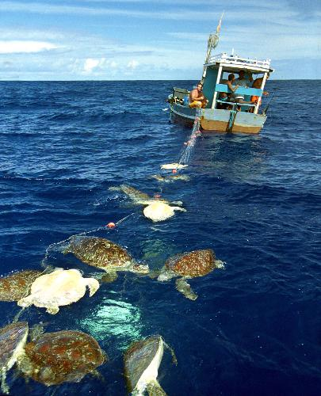
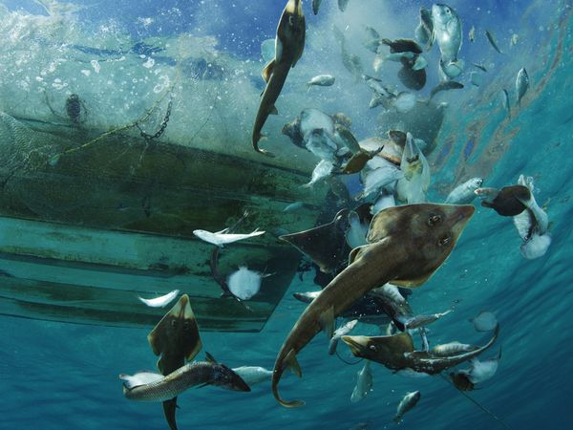
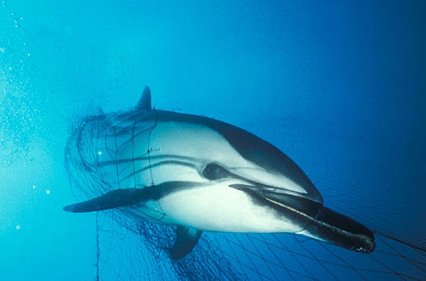
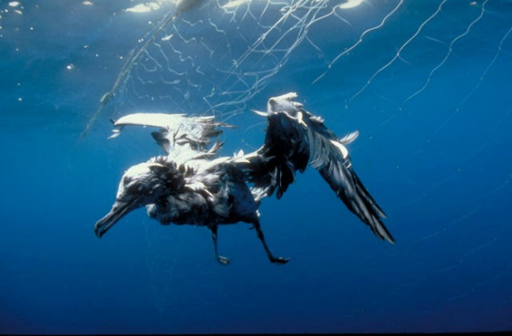
Human Impacts on Biodiversity
Bycatch: a fish or other species that is caught unintentionally
38.5 million tones of bycatch caught world-wide

Slide 26
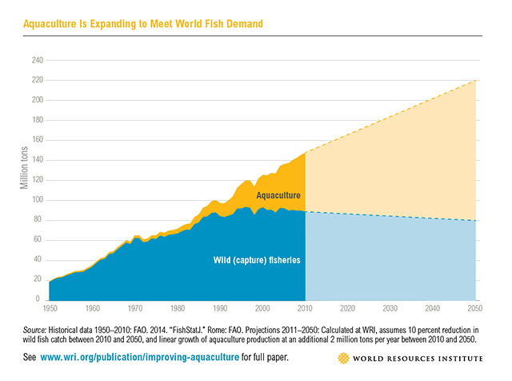
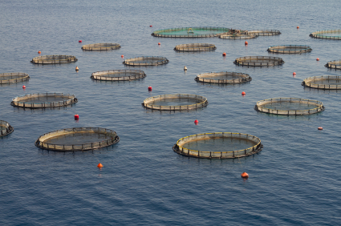
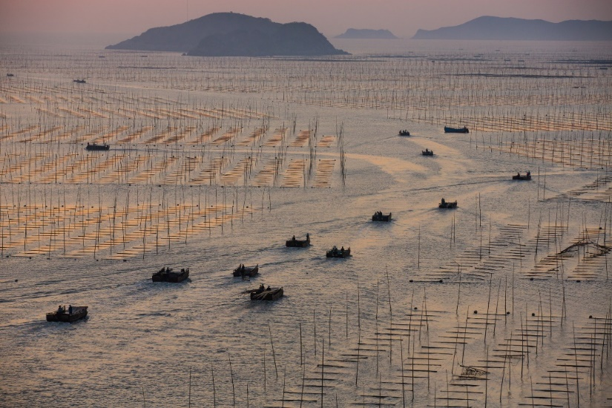
Aquaculture
Aquaculture: farming of aquatic organisms including fish, molluscs, crabs and algae
Accounts for more than half of all seafood consumed annually
Expected to exceed wild capture fisheries by 2050

Slide 27
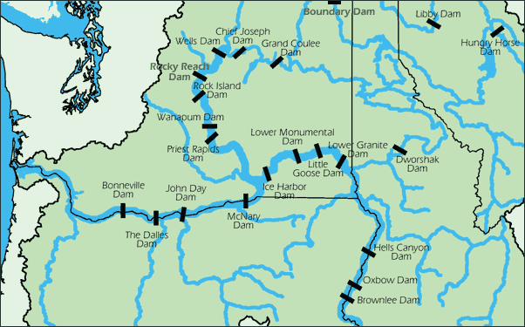
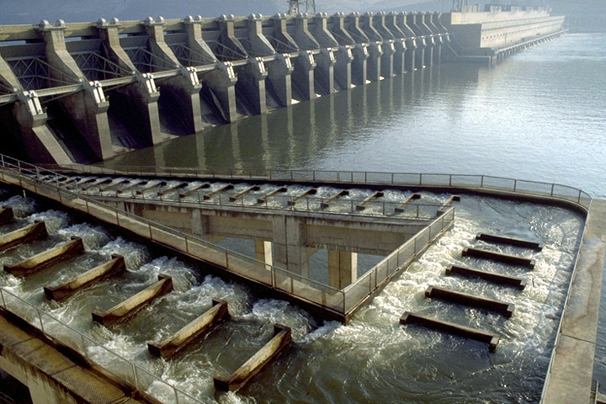
Human Impacts on Biodiversity
Hydroelectric dams alter natural water ways
Reduce natural nutrient-rich runoff
Impede fish spawning runs
Fish ladders

Slide 28
Human Impacts on Biodiversity
Climate change
97% of climate scientists agree that climate trends over the last century are extremely likely to be due to human activity (NASA, 2016)
Climate change predicted to cause widespread extinction, and migration, in plants and animals

Slide 29
Human Impacts on Biodiversity
Invasive species: a species that is non-native to and ecosystem and has caused or is likely to cause economic or environmental harm
Characteristics of Successful Invasive Species
Fast growth
Rapid reproduction
Tolerance to wide range of environmental conditions
High dispersal ability
Lack of natural predators
Rapid evolution
Notes:
Second greatest threat to biodiversity after habitat destruction
Linked to the decline of greater than 42% of the threatened and endangered species in the United States
Cost U.S. an estimated 120 billion dollars a year
Approximately 100 million acres (size of California) suffering from invasive plant infestations

Slide 30
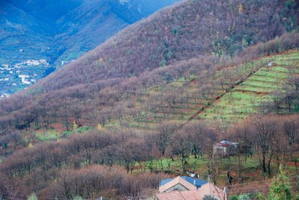
Negative Impacts of Invasive species
Change an entire habitat
Asian chestnut blight fungus nearly wiped out chestnut forests in Eastern U.S.
Alter ecosystem dynamics
Asian carp in Mississippi river basin
Loss of genetic diversity (genetic extinction)
Hybridization between native and invasive species
Spread of disease
Asian tiger mosquito
Notes:
Introduced around 1904 with imported Asian chestnut trees, wiped out nearly all American chestnut forests by 1950.

Slide 31
Invasive Species Introductions
Intentional introductions
Feral pigs, European starling
Unintentional introductions
Rats aboard ships, hitchhikers in cargo
Horticulture
Ornamental or crop plants that later escape
Ballast water
Many small marine organisms
Pet trade and aquarium release
Lion fish, pythons

Slide 32
Negative Impacts of Invasive species
Zebra Mussel
Can produce 5 million eggs in 5 years
Dense growth blocks pipes and damage boats and other structures
Consume majority of plankton leading to a collapse of the food web

Slide 33
Negative Impacts of Invasive species
Black Mustard
Allelopathic chemical
Prevents germination of native plants
Converts native habitats to grasslands
Spreads quickly after fire
Dormant fire-stimulated seed banks
One week after 2008 complex fire
Five months after 2008 complex fire

Slide 34
Preservation of Species
Endangered Species Act of 1973: a U.S. environmental law designed to protect and recover imperiled species and the ecosystems upon which they depend
Governed by U.S. Fish and Wildlife Service (FWS) and the Commerce Department’s National Marine Fisheries Service (NMFS)
Species designated as either threatened or endangered
Designates critical habitat
Develops a recovery plan
Notes:
Bald Eagle (increased from 417 to 11,040 pairs between 1963 and 2007); removed from list 2007
Whooping Crane (increased from 54 to 436 birds between 1967 and 2003)
Peregrine Falcon (increased from 324 to 1,700 pairs between 1975 and 2000); removed from list
Gray Wolf (populations increased dramatically in the Northern Rockies, Southwest, and Great Lakes)
Gray Whale (increased from 13,095 to 26,635 whales between 1968 and 1998); removed from list (Debated because whaling was banned before the ESA was set in place and that the ESA had nothing to do with the natural population increase since the cease of massive whaling [excluding Native American tribal whaling])
Grizzly bear (increased from about 271 to over 580 bears in the Yellowstone area between 1975 and 2005); removed from list 3/22/07
California’s Southern Sea Otter (increased from 1,789 in 1976 to 2,735 in 2005)
San Clemente Indian Paintbrush (increased from 500 plants in 1979 to more than 3,500 in 1997)
Red Wolf (increased from 17 in 1980 to 257 in 2003)
Black-Footed Ferret (increased from 18 in 1986 to 600 in 2006)

Slide 35
Preservation of Species
Captive breeding programs
Protection of species and their habitats
Seed banks and frozen zoos
Notes:
Captive breeding is the last resort
Svalbard Global Seed Vault - Norway

Slide 36
Preservation of Species
Protected Areas
Protection of critical habitat
National parks, preserves
Marine protected areas

Slide 37
Check Your Understanding
True or False: Temperature and soil are the two most important factors in determining habitat and biome type
True or False: Southern California consists of primarily the chaparral biome
True of False: Humans are currently causing the sixth great mass extinction event on earth

Slide 38
Check Your Understanding
Which of the following best describes the reason for the global distribution of deserts around 30° N and S Latitude?
a. The rain shadow effect
b. The tilt of the earth
c. The concentration of the sun’s energy at 30°
d. Hadley cells
e. Plate tectonics

Slide 39
Check Your Understanding
Which of the following are not one of the ways that humans are trying to preserve species?
a. Seed banks
b. Pet trade
c. Captive breeding
d. Protected habitats
e. All of the above are ways that humans work
preserve species

Slide 40
Check Your Understanding
What is an invasive species? What are the characteristics that make something a successful invader? Provide two ways that invasive species can be introduced to new environment.

