Slide 1
Diversity of Fishes
“Everyone is a genius. But if you judge a fish on its ability to climb a tree, it will live its whole life believing it is stupid”
–Albert Einstein
Chapter 34

Slide 2
Introduction to Fishes
“Fish”: poikilothermic, aquatic chordate with appendages developed as fins (when present), whose chief respiratory organ are gills and whose body is usually covered in scales
Paraphyletic group because of tetrapods
All fishes…
have distinct head region (eyes, mouth, etc.) and brain protected by braincase
Most fishes…
live in water
breathe with gills rather than lungs
are unable to regulate their body temperature
are covered in scales
have paired limbs in the form of fins
Notes:
Fish = plural for multiples of single species
Fishes = multiple fish from more than one species

Slide 3
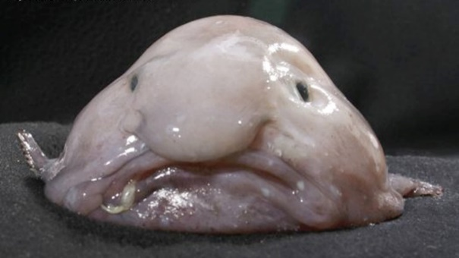
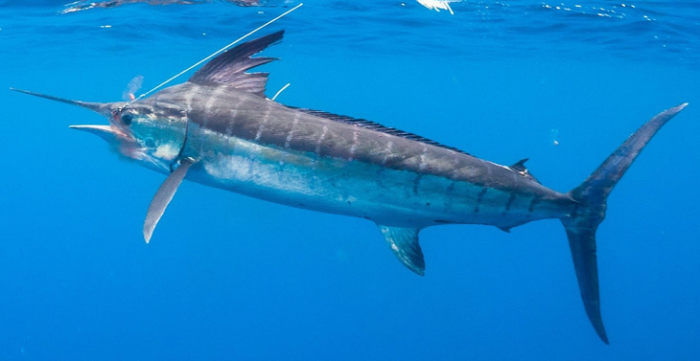
Diversity of Fishes
More fish species than birds, reptiles and mammals combined
27,900 species described
58% live in salt water, 41% in freshwater, and 1% move between salt and freshwater
Life span
Pygmy goby < 60 days Shape
Rockfish >200 years
Size
Minnow ≈ 0.3 in
Whale shark > 65ft

Slide 4
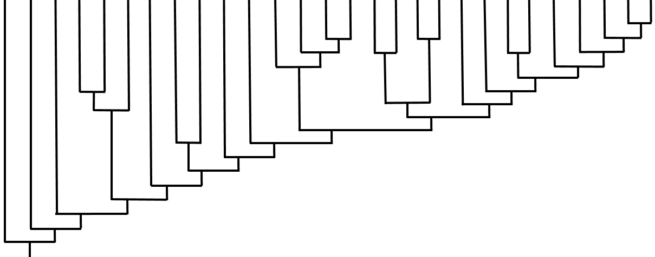
Osteoglossimorpha (Bony tongues)
Stomiiformes (Dragonfish, Hatchetfish)
Atheriniformes (Topsmelt, Grunion)
Chondrichthyes (Sharks, Skates, Rays)
Acipenseriformes (Sturgeon, Paddlefish)
Scopelomorpa (Lanternfish)
Tetradontiformes (Triggerfish, Pufferfish)
Pleuronectiformes (Flatfishes)
Cypriniformes (Minnows, Carp)
Scombriformes (Tuna, Mackerel)
Tetrapoda (Reptiles, Birds, Mammals)
Salmoniformes (Salmon, Trout)
Syngnathiformes (Pipefish, Seahorses)
Coelocanthiformes (Caelocanth)
Clupeimorpha (Anchovy, Sardine)
Gadiformes (Cod)
Elopomorpha (Eels, Bonefish)
Characiformes (Piranha)
Osmeriformes (Smelt)
Scorpaeniformes (Rock fish, Sculpin)
Petromyzontiformes (Lamprey)
Escoiformes (Pike)
Dipnoi (Lungfish)
Siluriformes (Catfish)
Perciformes (Perch and allies)
Myxiniformes (Hagfish)
Amiiformes (Bowfin)
Lepisosteiformes (Gars)
20
Osteriophysi
16
18
19
11
15
10
Stomiatii
17
9
12
Protacanthopterygii
13
14
Acanthopterygii
Holostei
Sarcopterygii
4
6
8
Synapomorphies: 1) Slime production 2) Ammocoetes larvae. 3) Jaws. 4) Cartilaginous skeleton 5) Ossified endoskeleton. 6) Lobed fins. 7) Rayed-fins. 8) Mobile pre-maxilla (jaw protrusion), uroneural bone. 9) Leptocephalus larvae. 10) Bony tongue. 11) Inner ear to gas bladder connection. 12) Weberian apparatus. 13) Adipose fin. 14) Spiny rays on first dorsal, ascending process, pectoral and pelvic girdle connection, pharyngeal dentition. 15) Fused jaw, bony plates. 16) Finlets. 17) Flattened body. 18) Jaw teeth. 19) Lateral pectoral fins, abdominal pelvic fins. 20) Bony plate/spines on cheek.
2
Teleostei
1
7
Actinopterygii
5
Osteichthyes
3
Gnathostomata

Slide 5
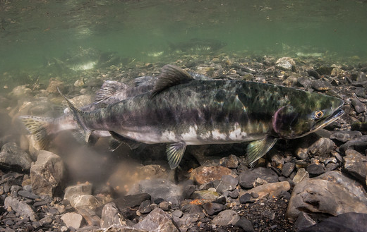
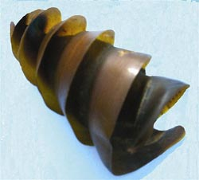
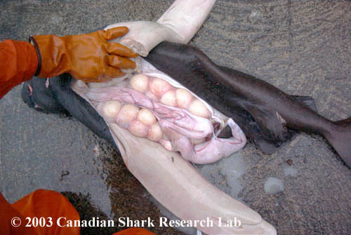
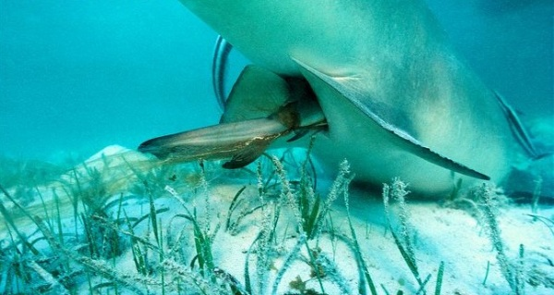
Modes of Reproduction
Ovuliparity: female lays unfertilized eggs, which are externally fertilized by the male
Most bony fish
___________ the mother deposits internally fertilized eggs that develop and hatch outside of mother’s body
Some bony fish and some sharks
Ovoviviparous: mother retains fertilized eggs within the oviduct, but ________ provide nourishment to the eggs
Few sharks
Viviparous: young develop within mother’s uterus and receive nourishment via the placenta, uterus or by eating other eggs, before being born (live birth)
Some sharks and fish

Slide 6
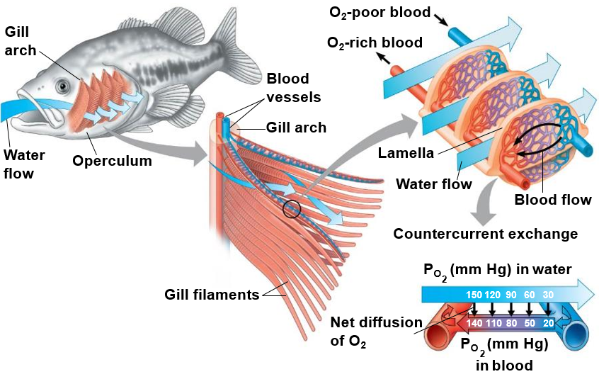
Respiration in Fishes
Countercurrent gas exchange: oxygen-poor blood runs _______________ to water high in oxygen content
Diffusion gradient for oxygen maintained along entire gill surface
Maximum efficiency in gas exchange

Slide 7
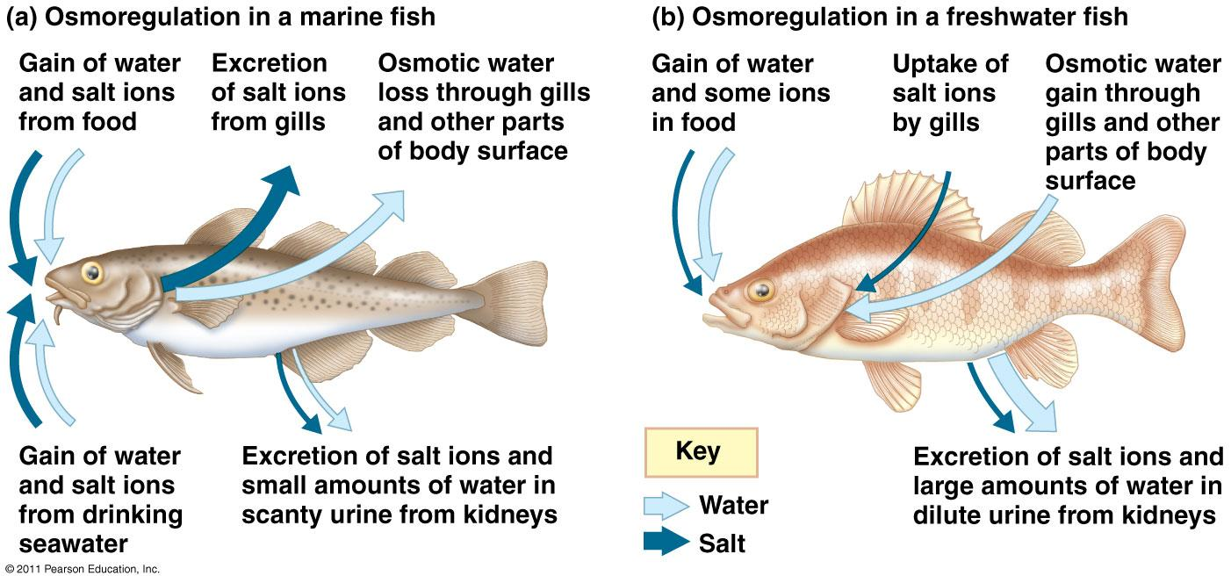
Osmoregulation in Fish
Osmoconformers: isotonic (same solute concentration) to surrounding water
Most marine invertebrates
__________________: actively regulate body osmolarity (solute concentration)
Most fish

Slide 8
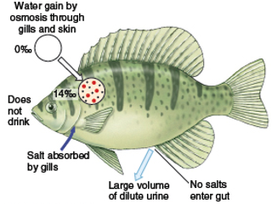
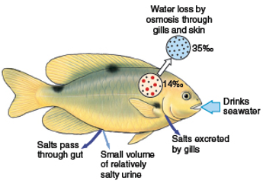
Osmoregulation in Fish
The cells of freshwater fish are __________ to the surrounding fresh water so freshwater fish are constantly gaining water and must excrete large volumes of water
The cells of marine fish are ________ to the surrounding salt water so marine fish are constantly losing water and must drink seawater to replace lost water
Freshwater fish
Marine fish

Slide 9
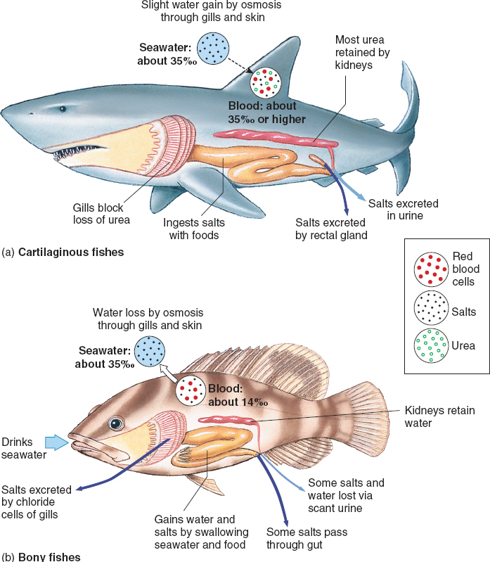
Osmoregulation in Fish
Sharks and other cartilaginous fishes concentrate urea in their blood which makes the solute concentration in their blood __________ to the surrounding seawater.
Excess salt secreted through specialized rectal gland
Marine bony fishes actively regulate their salt concentrations by excreting excess salts through their ______________

Slide 10
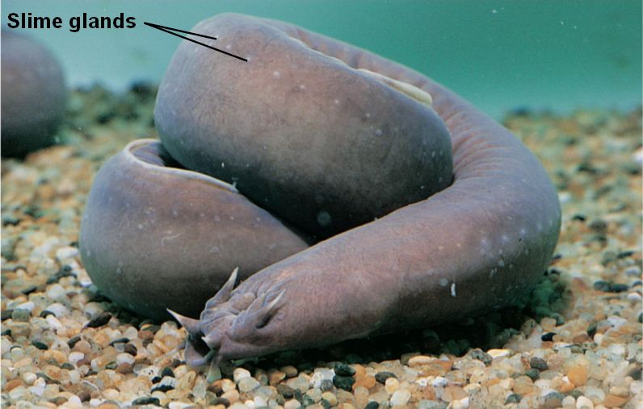
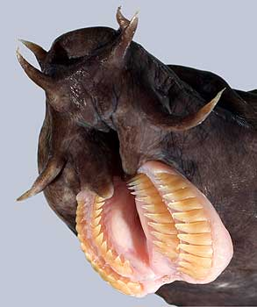
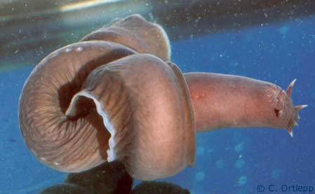
Superclass Agnatha, Order Myixiniformes
Hagfish
__________
Reduced vertebrae with cartilaginous braincase
Marine scavengers
Produce ________
Lack scales and paired appendages
Reduced brain, eyes, ears, and nasal opening
Tie themselves in a knot to release slime or provide leverage when feeding
Barbels

Slide 11
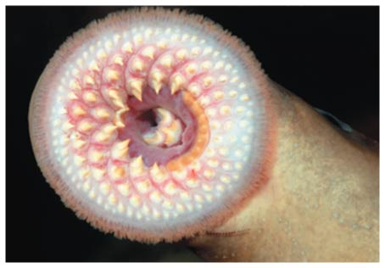
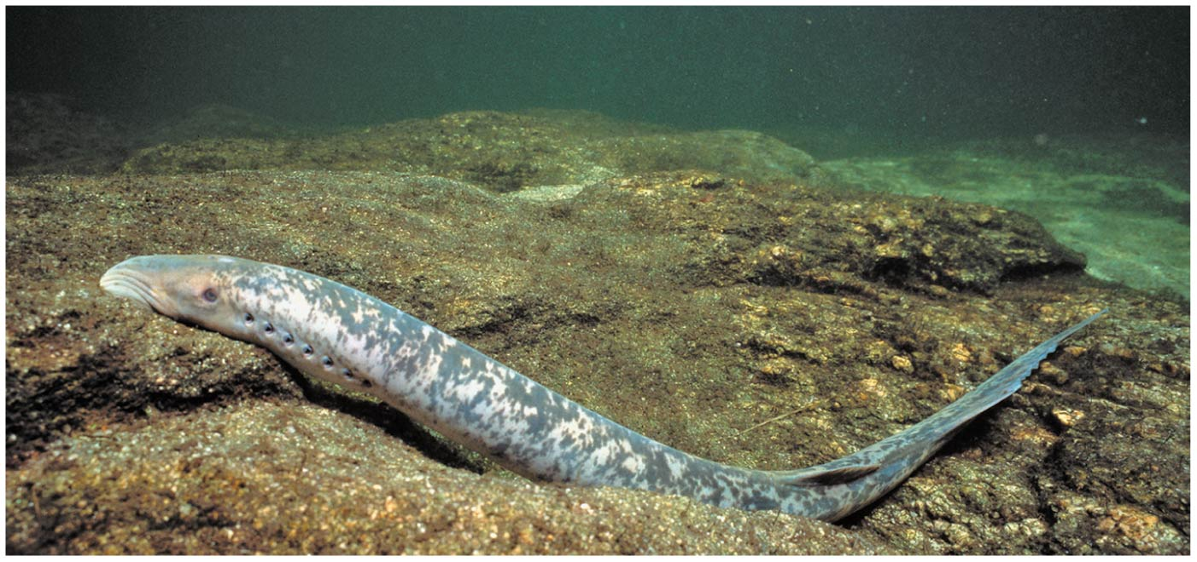
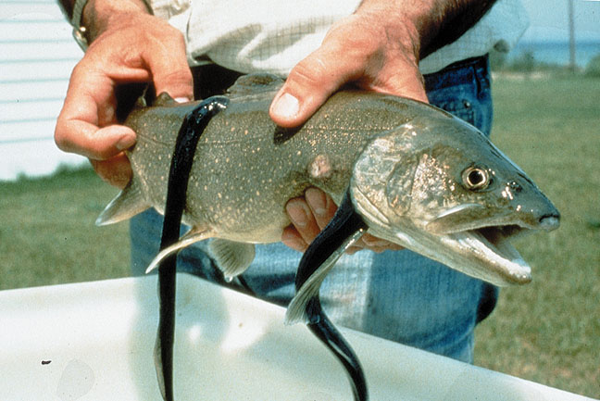
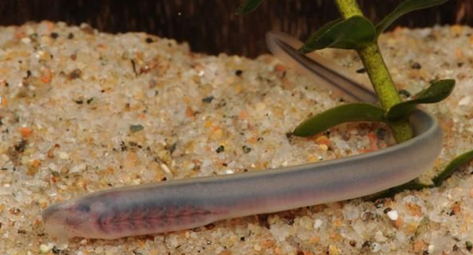
Superclass Agnatha, Order Petromyzontiformes
Lampreys
Jawless (Superclass Agnatha)
Rudimentary vertebrae and cartilaginous skeleton
Marine and freshwater
____________: migrates to fresh water to spawn
Ammocoetes larvae: filter feeders, buried in sediment
Most are parasitic
Lack scales and paired appendages

Slide 12
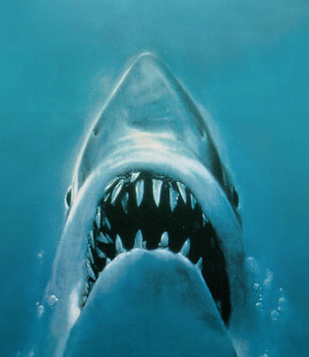
Evolution of Jaws
Jaws likely developed from gill arches used in filter feeding
Lead to the diversification of food types (carnivory and herbivory)
Allowed for active defense from predators
De-emphasis on armored plates
Development of paired appendages

Slide 13
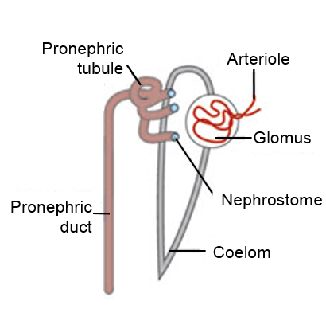
Evolution of Vertebrate Excretory System
______________: simple nephron which collects filtrate from coelom through ciliated nephrostomes before filtration in the pronephric duct
Found in jawless fish (Agnatha) and larval amphibians
Glomerulus (Glomus): cluster of capillaries

Slide 14
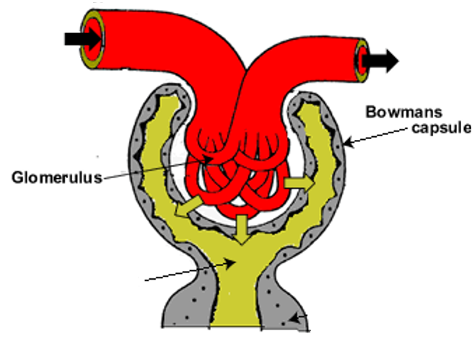
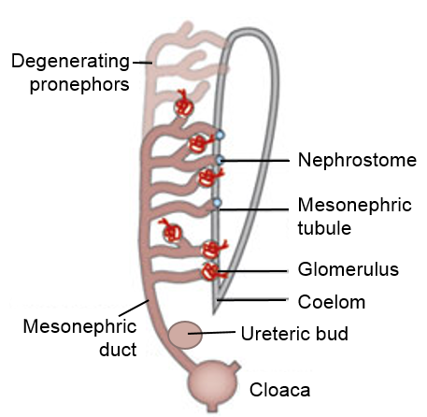
Evolution of Vertebrate Excretory System
Mesonephros: collection of mesonephric tubules which form capsules around glomeruli where filtration occurs
Found in fish, adult amphibians, and embryonic mammals
Develops into reproductive organs in male mammals
Ureteric bud develops into metaneophros (kidney in birds, reptiles and mammals)
Afferent arteriole
Efferent arteriole
Bowman’s
capsule
Glomerulus
Filtrate

Slide 15
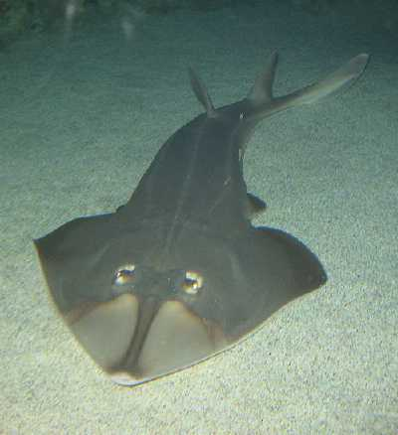
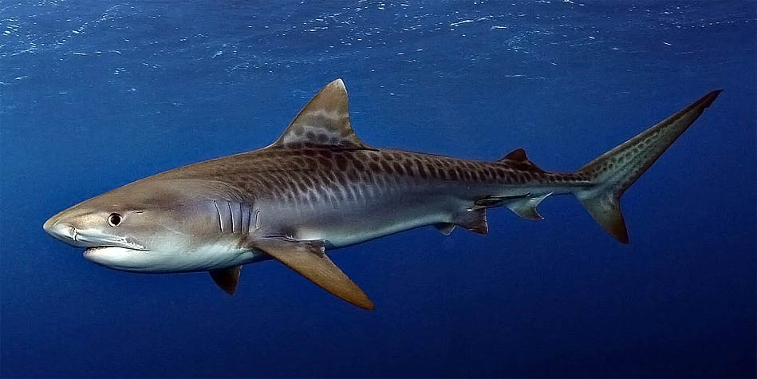
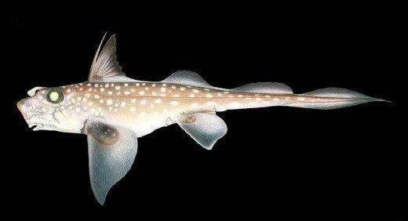
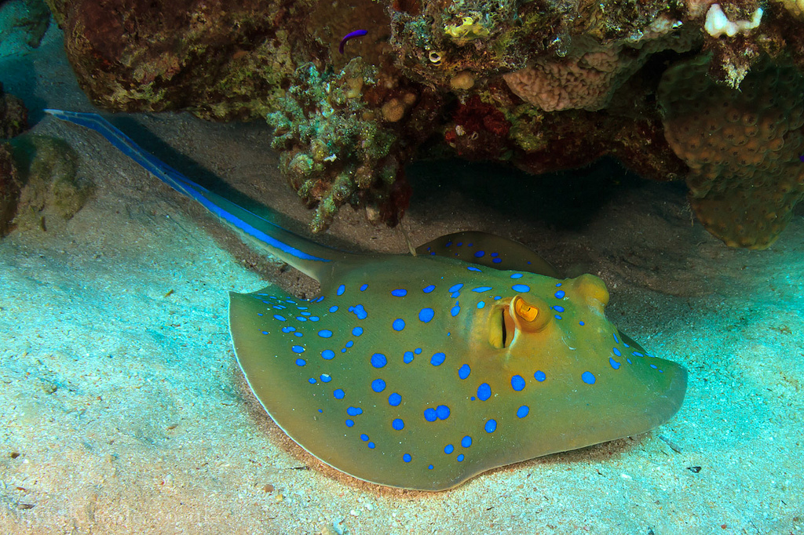
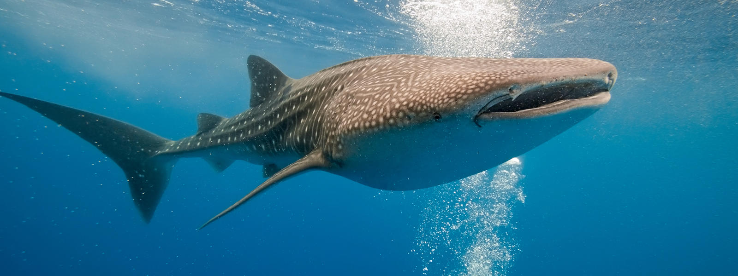
Class Chondrichthyes (kon-DRIK-thee-EEZ)
_______________ skeleton
Placoid scales
Teeth derived from placoid scales are not fused with jaw
Replaceable (every few days)
Large, buoyant livers
Lack gas bladder or lungs
___________ intestine
Highly developed sensory organs
Ampullae of Lorenzini
Internal fertilization
Claspers

Slide 16
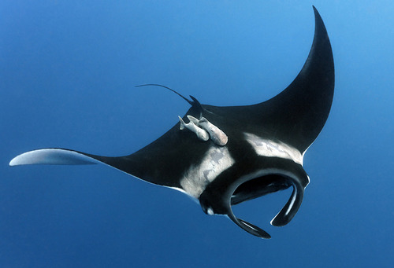
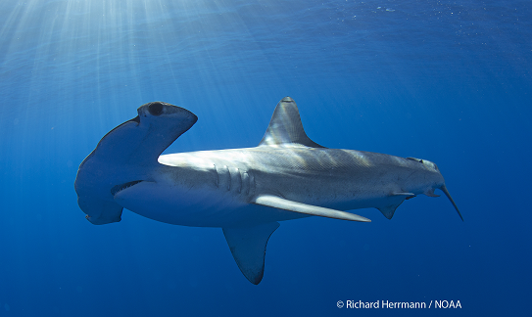
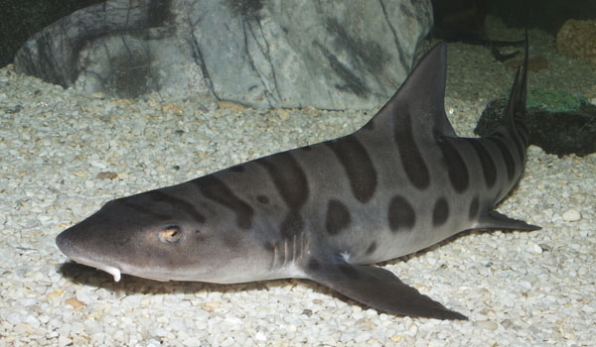
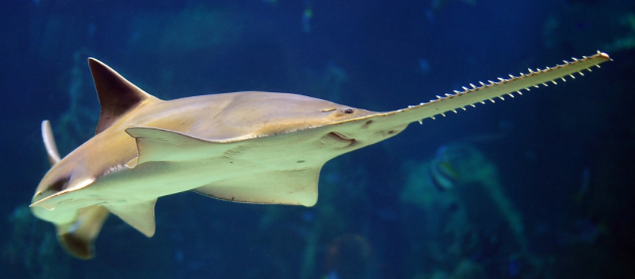
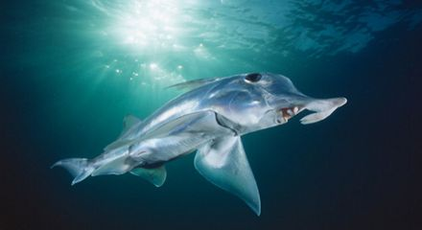
Class Chondrichthyes
Subclass Elasmobranchii
Sharks (8 orders, ~360 species)
Most are large (> 1m)
Most are active marine predators
Skates, Rays, Electric rays, Sawfish (4 orders, ~550 species)
Flattened bodies
Bottom dwelling predators
Subclass Holocephali
Chimaera (rat fish) (1 extant order, ~50 species)
Feed on benthic invertebrates in deep ocean

Slide 17
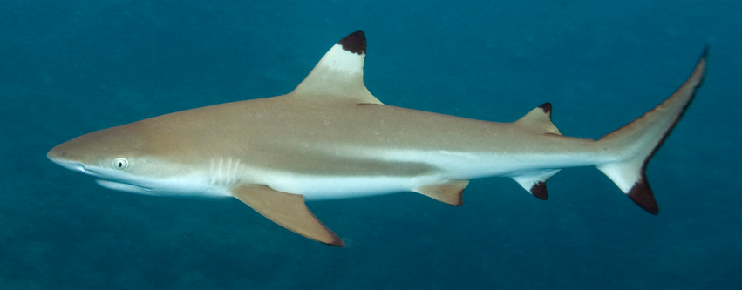
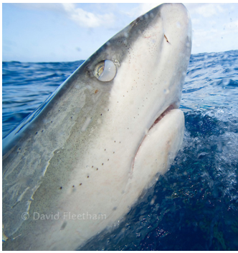
Class Chondrichthyes, Subclass Elasmobranchii
Sharks
Charcharhiniformes (210 species)
Tiger, Hammerhead, Blacktip
Two dorsal fins, an anal fin, and 5 gill openings
Nictitating membrane
Lamniformes (16 species)
Mako, Great white, Thresher, Basking
Elevated body temp
Two dorsal fins, an anal fin, and 5 gill openings
Nictitating membrane
Dorsal fins
Gill openings
Anal fin
Nictitating membrane

Slide 18
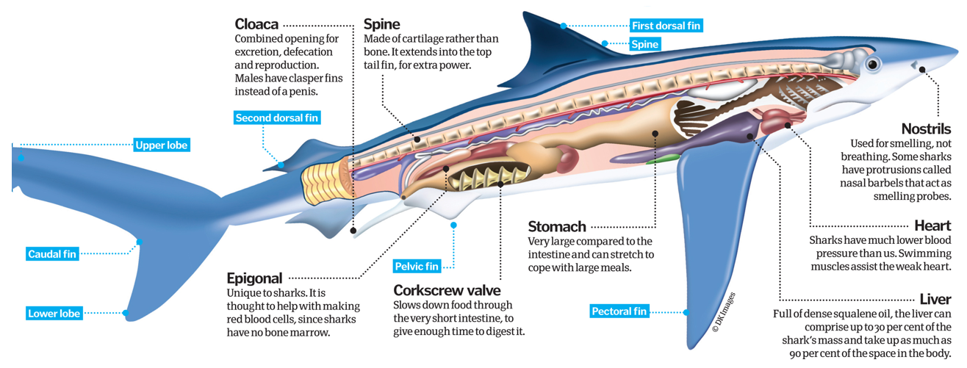
Anatomy of a Shark
Spiral valve

Slide 19
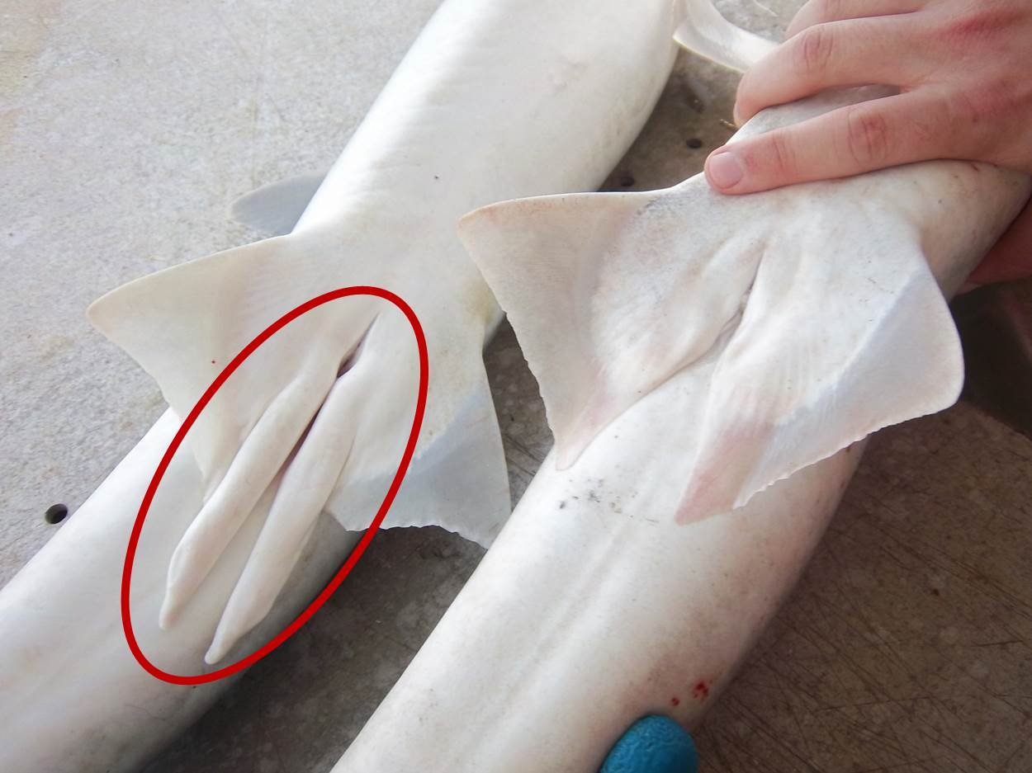
Chondrichthyes Reproduction
_______ of male shark
Cloaca of female shark

Slide 20
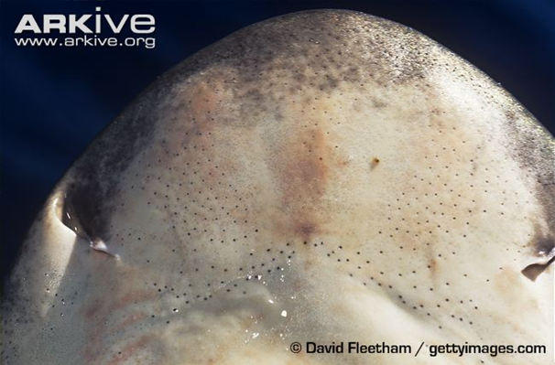
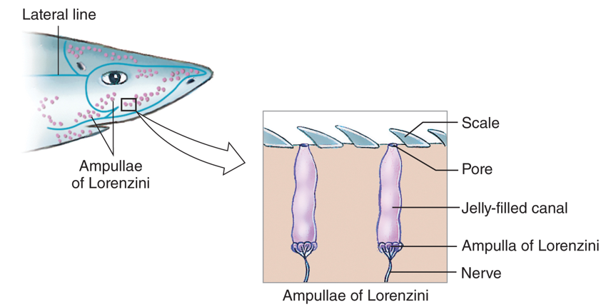
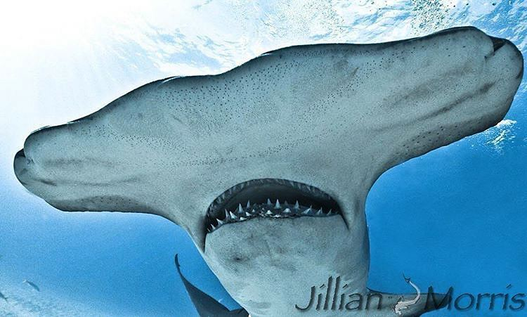
Ampullae of Lorenzini
Ampullae of Lorenzini: small, jelly filled pores that contain ______________, which can sense the electric fields produced by other fish
Ampullae of Lorenzini

Slide 21
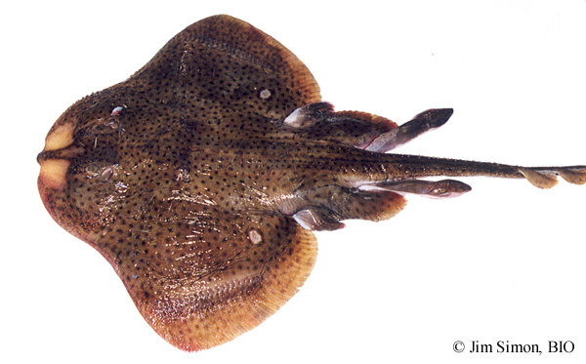
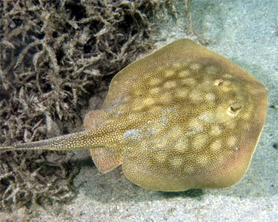
Class Chondrichthyes, Subclass Elasmobranchii
Order Rajiformes (Skates)
Thorns on back
________________
Two lobes on pelvic fin
Lay eggs (Oviparous)
Order Myliobatiformes (Rays)
No thorns on back
Stinging spine
One lobe on pelvic fin
Live birth (viviparous)
Thorns
Two lobes
Single lobe

Slide 22
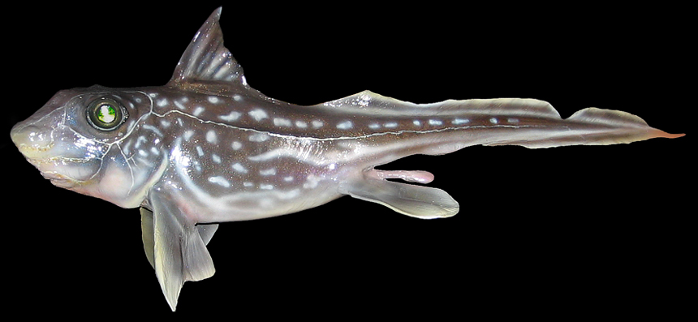
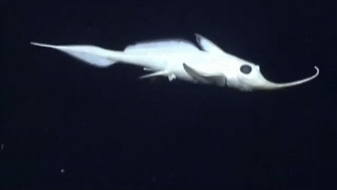
Class Chondrichthyes, Subclass Holocephali
Chimaera (ratfish)
Oviparous
Upper jaw attached to braincase
Teeth modified as crushing plates
Diet of benthic invertebrates
Poisonous spine before first dorsal fin
Move by flapping pectoral fins
_____________

Slide 23
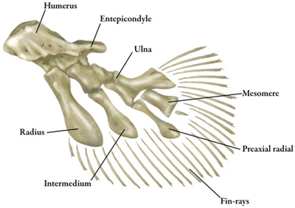
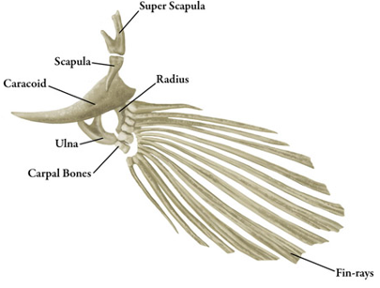
Osteichthyes (AH-stee-IK-thee-eez)
Bony fishes
Ossified (bony) endoskeleton
Pair of lungs or swim bladder
Bony fin rays
Ganoid, ctenoid, or cycloid scales (no placoid)
Operculum: bony gill cover
Divided into two classes
Class Sarcopterygii (sar-KOP-tuh-RIJ-ee-eye)
_______________ fishes
Pectoral and pelvic fins made of rod-shaped bones surrounded by muscle
Class Actinopterygii (ACK-tih-NOP-tuh-RIJ-ee-eye)
_______________ fishes
Elongated, flexible fin rays
Lobed fin
Rayed fin

Slide 24
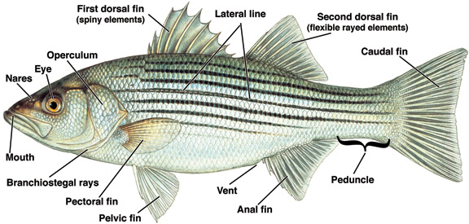
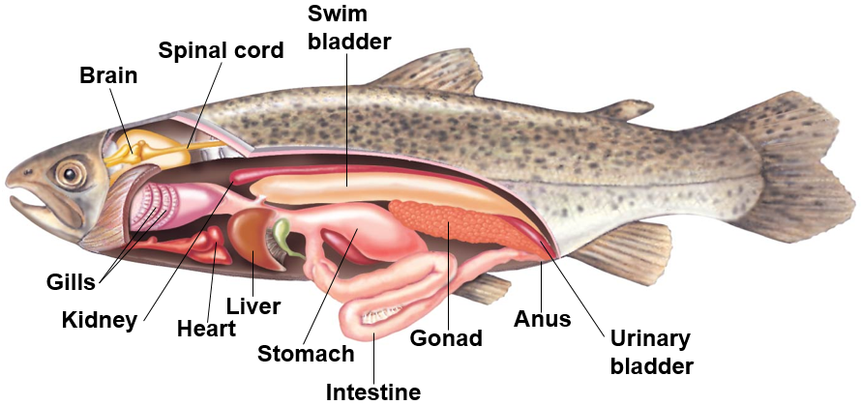
Basic Anatomy of a Bony Fish
________________: bony gill cover
Nares: nasal openings
Swim bladder (gas bladder): internal air filled organ that aids in buoyancy

Slide 25
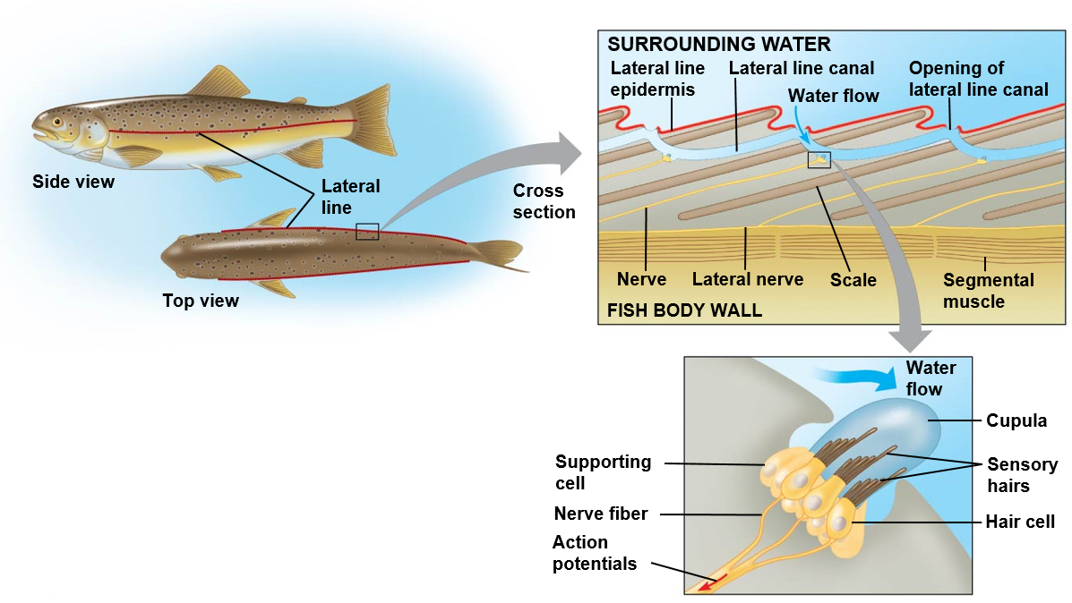
Lateral Line
Lateral line: sensory organ along the side of the body used to detect vibrations and movements

Slide 26
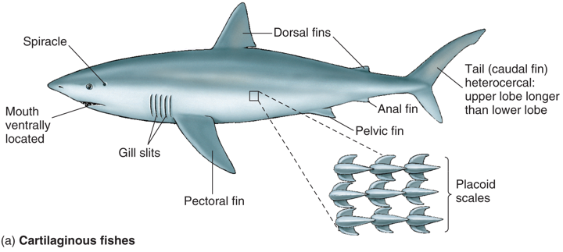
Differences Between Cartilaginous Fish and Bony Fish
Mouth ventrally located
5 to 7 gill slits
Placoid scales
Heterocercal caudal fin
Spiracle: respiratory opening
Large lipid-rich liver
Mouth at front of body (terminal)
Single gill cover (operculum)
Ctenoid or cycloid scales
Homocercal caudal fin
Swim bladder

Slide 27
Differences Between Cartilaginous Fish and Bony Fish
Cartilaginous fish have large, fleshy pectoral fins that provide lift, and a heterocercal tail that draws the head upward when swimming
Bony fish have a swim bladder to maintain buoyancy, which allows them to use their thin, rayed fins for maneuverability
Greater diversity of swimming styles in bony fishes

Slide 28
Class Sarcopterygii, Order Coelocantiformes
Coelocanths
Three lobed caudal fin
Fleshy operculum
Jointed skull
Viviparous
______________: electroreceptive organ located in the front of the braincase
Believed to have gone extinct 65mya
Re-discovered in 1938
Populations near Indonesia and South Africa

Slide 29
Class Sarcopterygii, Subclass Dipnoi
Lungfish
All freshwater fish
Lungs
Breathe air
Slender fins
Single, long tapered caudal fin
Omnivorous diet
Can survive dry conditions by estivating in mucus-lined burrow for up to 4 years!
Largest genome among vertebrates
Notes:
Estivation: reduced activity during warm summer months

Slide 30
Class Actinopterygii, Order Acipenseriformes
Sturgeons and Paddlefishes
Primitive characteristics
Mostly cartilaginous skeleton
Heterocercal tail
Spiral valve intestine
Lack of vertebral centrum
Marine, freshwater and anadromous
Caviar
Barbels
4 in Sturgeons
2 in Paddlefish
Lack scales
Notes:
Secondary evolution of cartilaginous skeleton
Draw heterocercal and homocercal tail on board
Long lived species declining due to verexploitation, dams and habitat destruction

Slide 31
Class Actinopterygii, Infraclass Holostei
Brackish waters
Highly vascularized swim bladder
Can breathe air
Veracious predators
Stalk prey
Order Amiiformes (Bowfins)
Single extant species
Gular plate
Swims via dorsal fin
Order Lepisosteiformes (Gars)
Ganoid scales
Heterocercal tail
Gular plate
Ganoid scales

Slide 32
Class Actinopterygii, Infraclass Teleostei
96% of all living fishes (38 orders and 426 families)
Occupy nearly all freshwater and marine habitats
Most diverse group of all vertebrates
Significant variation in body plans, foraging and reproductive behaviors
Only herbivorous fishes
Diverged in the Mesozoic Era
Uroneural bones
Homocercal caudal fin
Mobile pre-maxilla bone
________________
Notes:
“Perfect bone” refers to the reduction in bone mass but not strength

Slide 33
Class Actinopterygii, Superorder Elopomorpha
Leptocephalus larvae: flat, ribbon-shaped, transparent larvae
Large size
Long life
Order Anguilliformes
True eels
Elongated fish with dorsal and anal fins fused with caudal fin
Order Albuliformes
Bone fish
Hard, bony scales
Order Elopiformes
Tarpon

Slide 34
Class Actinopterygii, Superorder Osteoglossomorpha
Bony tongues
Teeth on the tongue bite against bones on the roof of the mouth
Mostly tropical
Arapaima and Arowana
Some of the largest fresh water fishes
Elephant fish
Produces and detects weak electrical fields
Large brain

Slide 35
Class Actinopterygii, Superorder Clupeimorpha
Anchovies and Sardines
Inner ear to gas bladder connection
Improves hearing of low frequency sounds
Most are marine, open water schooling species
Filter feeders
Important commercial fish
____________ for many predators including marine mammals, seabirds, and large predatory fish like tuna and marlin

Slide 36
Class Actinopterygii, Superorder Osteriophysi
Minnows, Catfish, Knifefish, Piranha
Dominant freshwater fish species
_________ apparatus: set of bones that connect the inner ear to the gas bladder
Improved hearing
Response to alarm signals of conspecifics
Brain
Semicircular canals
Weberian ossicles
Vertebrae
Ribs
Swim bladder

Slide 37
Class Actinopterygii, Superorder Osteriophysi
Cypriniformes: Minnows, Carp, Shiners
2nd largest order of fish
Early pharyngeal dentition
Invasive species in many freshwater habitats
Characiformes: Piranha, Tetras
Mostly tropical
Mouth teeth and replacement dentition
Adipose fin
Siluriformes: Catfish
Barbels
No scales

Slide 38
Class Actinopterygii, Superorder Protacanthopterygi
Order Salmoniformes: Salmon and Trout
Freshwater, anadromous
Adipose fin
Ecologically and commercially important species
Reduced populations
Alteration to river systems (Dams)
Overfishing
Order Escoiformes: Pike
Fins far back on body
Freshwater
Voracious predators
Cannibalistic
Adipose fin

Slide 39
Class Actinopterygii, Superorder Stomiatii
Order Osmeriformes: Smelt
Small, silvery, elongate fishes
Single soft rayed dorsal fin
Freshwater, marine, diadromous
Delta smelt and Candlefish
Order Stomiiformes: Dragonfish, hatchetfish
Deep sea
_________________
Photophores

Slide 40
Class Actinopterygii, Superorder Scopelomorpha
Order Myctophiformes: Lanternfish
Deep sea fishes
Laterally compressed, with large eyes
Bioluminescence
Photophores
Majority of deep sea biomass (65%)
Diel ________________
From ~ 10,000ft deep to ~ 30ft deep
Important food source for marine predators
High lipid content
Photophores

Slide 41
Class: Actinopterygii, Superorder: Acanthopterygii
Spiny-rayed fishes
Spiny rays on first dorsal fin, pelvic and anal fin
Two dorsal fins (1st spiny, 2nd soft)
Ascending process of premaxilla
Improved jaw protrusion
Pharyngeal dentition
Specialized depending on food type
Spiny fin rays
Soft fin rays
Ascending process

Slide 42
Class: Actinopterygii, Superorder: Acanthopterygii
Pelvic girdle attached to pectoral girdle
Pelvic fin with anterior spine and 5 soft rays
Ctenoid scales
Pectoral girdle
Pelvic girdle
Spine

Slide 43
Superorder: Acanthopterygii, Order Gadiformes
Cod, Haddock, Pollock
Benthic marine
Nocturnally active
Barbels
Three dorsal fins, two anal fins
Commercially important
Fish and chips!
Populations declines due to overfishing

Slide 44
Superorder: Acanthopterygii, Order Syngathiformes
Pipefish, Seahorses, Seadragons
Fused jaws form long snout
Pivot feeding (Super fast!)
Plates of body armor
Lack pelvic fins
Prehensile tail
_____ carry eggs in pouch or on tail

Slide 45
Superorder: Acanthopterygii, Order Scombriformes
Tuna, Mackerel, Bonito
Large, fast marine predators
Most are schooling
Open ocean (pelagic)
Two dorsal fins and strong caudal fin
Finlets behind dorsal and anal fins
Regional ____________
Non-protrusable jaw
Commercially important food
Populations declining
Overfishing
Finlets

Slide 46
Endothermy in Fish
Some tuna, billfish, and sharks
Countercurrent heat exchange
Maintains elevated swim muscle temperature
Heat producing organs
Evolutionary advantages:
Expansion of thermal range
Stabilize temperature of internal tissue
Increased metabolic rates
Increased neural processing and vision

Slide 47
Superorder: Acanthopterygii, Order Perciformes
Wrasses, Bass, Cichlids, and Perch
Largest vertebrate order
Contains ~ 40% of all fish species
Abdominal pelvic fins and lateral pectoral fins
Pelvic fins with one spine and five soft rays
Ctenoid scales
Male
Female
Lateral Pectoral fin
Abdominal pelvic fin

Slide 48
Superorder: Acanthopterygii, Order Scorpeniformes
Rockfish and Sculpin
Bony ridge/spines on cheek
Most have spines on head
Round pectoral and caudal fins
Carnivorous
Live near bottom
Long lived
Spines on cheek

Slide 49
Superorder: Acanthopterygii, Order Plueronectiformes
Flatfishes (flounders, soles, halibut)
Bilaterally symmetric larvae metamorphose into flat formed adults
Left-eyed or right-eyed
Benthic carnivores
Camouflaged
Commercially important

Slide 50
Superorder: Acanthopterygii, Order Tetraodontiformes
Triggerfish, Pufferfish, Mola Mola
Teeth in the outer jaws
Derived from jaw bone (not true teeth)
Four in some pufferfish
Mostly tropical reefs
Often eat animals inaccessible to other fishes
Sponges, sea jellies, sea urchins, corals
Mola mola’s can have >300,000,000 eggs!

Slide 51
Superorder: Acanthopterygii, Order Antheriniformes
Silversides (Topsmelt, Grunion)
Two separate dorsal fins are common
Single spine on anal fin
Weak or absent lateral line
Surface-dwelling fish
______________ in grunion
Two dorsal fins

Slide 52
Check Your Understanding
True or False: Sharks are the only fish with a cartilaginous skeleton
True or False: Water moves across the gills moving in the opposite direction of the blood flow
True of False: All fish use gills to breath

Slide 53
Check Your Understanding
Which of the following reproductive strategies involve the mother depositing unfertilized eggs, which are then fertilized externally by the male?
a. Ovulparity
b. Oviparity
c. Ovoviviparous
d. Viviparious

Slide 54
Check Your Understanding
Which of the following superorders are characterized by the presence of a webarian apparatus?
a. Acanthopterygii
b. Protocanthopterygi
c. Elopomorpha
d. Osteriophysi
e. Clupeimorpha

Slide 55
Check Your Understanding
Which of the following are not one of the derived traits found in the superorder Acanthopterygii?
a. Ascending process
b. Spiny rays on dorsal fin
c. Ear to gas bladder connection
d. Pelvic girdle attached to pectoral girdle

