Slide 1
Circulation and Respiration
“Man is the most insane species. He worships an invisible God and destroys a visible Nature. Unaware that this Nature he’s destroying is this God he’s worshipping.”
- Hubert Reeves
"I will love you as long as my heart still beats and my brain still brains."
- Homer Simpson
Chapter 30

Slide 2
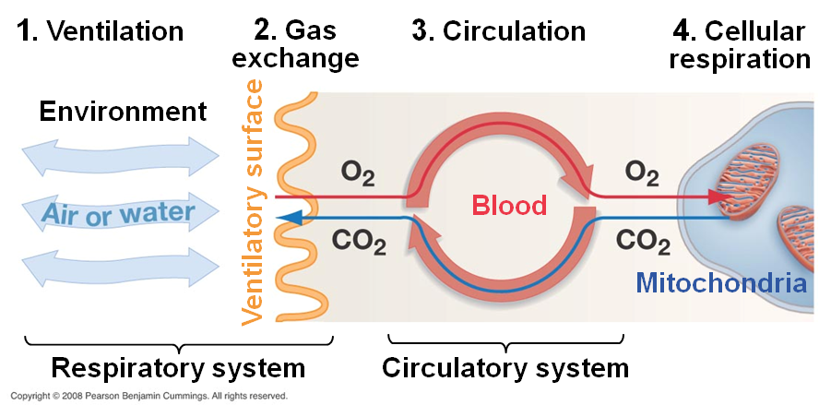
Respiratory and Circulatory Systems

Slide 3
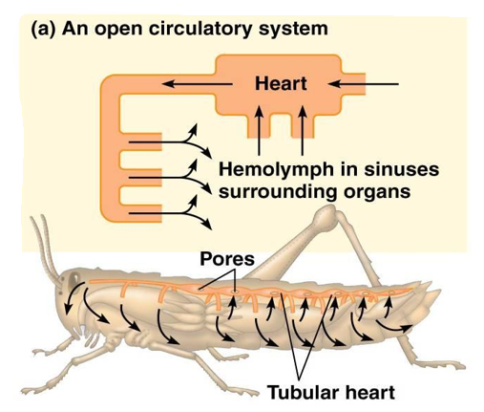
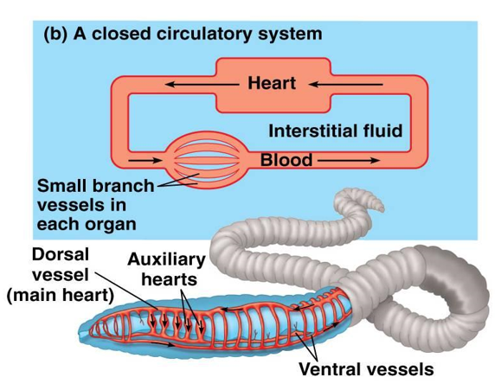
Different Circulatory Systems
Open circulatory system: __________ bathes organs directly then diffuse back into heart through sinuses
Closed circulatory system: ________ transported through vessels into capillaries where diffusion of gases and nutrients occurs

Slide 4
Different Circulatory Systems
Open Circulatory System
Closed Circulatory System
Arthropods and mollusks
Less efficient
Lack of capillaries
Hemolymph transports nutrients and wastes
Tissues and cells _______ in hemolymph
Slow, uncontrolled blood flow
Vertebrates and annelids
More efficient
____________ present
Blood transports gases, nutrients and wastes
Fast, __________ blood flow

Slide 5
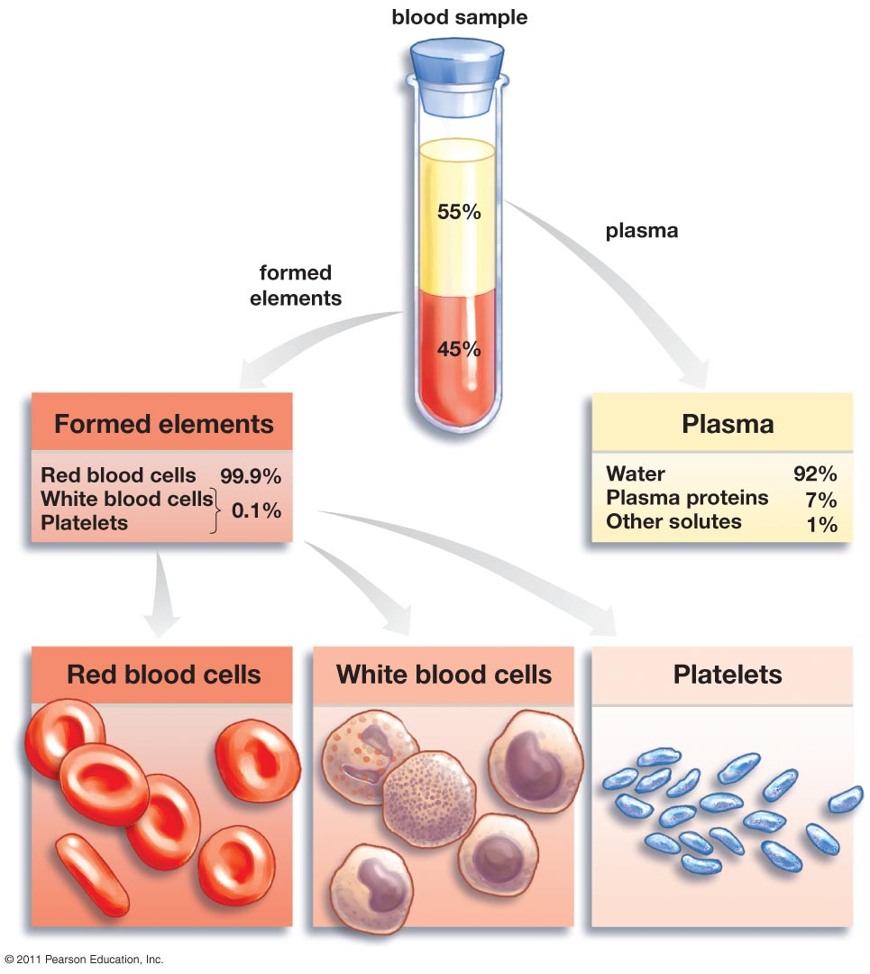
What’s in the Blood?
Formed elements (45% of blood)
Red blood cells (erythrocytes): oxygen transport
Hemoglobin: oxygen binding protein
Lack ___________________________________
White blood cells (leukocytes): immune response to disease and invaders
Platelets: cell fragments that aid in _____________
Plasma (55% of blood)
Liquid portion of blood that holds blood cells in suspension
Ions and proteins regulate osmotic and pH balance

Slide 6
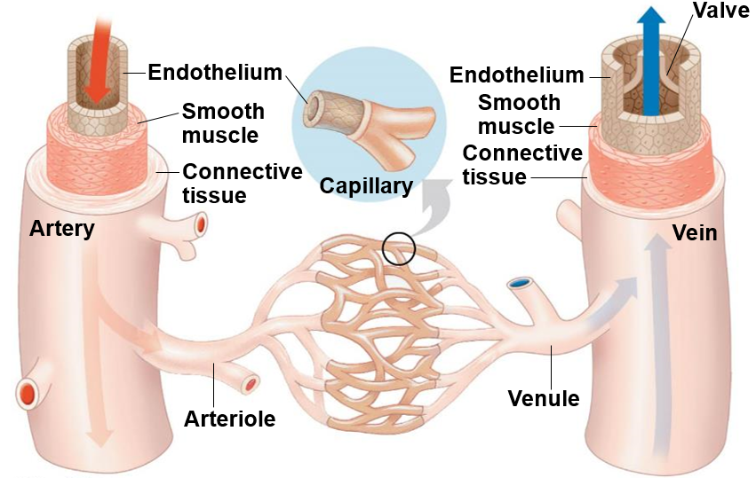
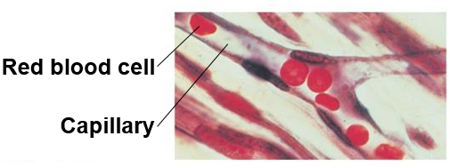
Blood Vessels
Blood vessel tissues: endothelium, smooth muscle, connective tissue
Veins (venules): vessels carrying blood back to the heart
Valves
Capillaries: thinly walled vessels where gas, nutrient and waste ______________. Lack smooth muscle
Arteries (arterioles): vessels with _________ that carry blood away from the heart

Slide 7
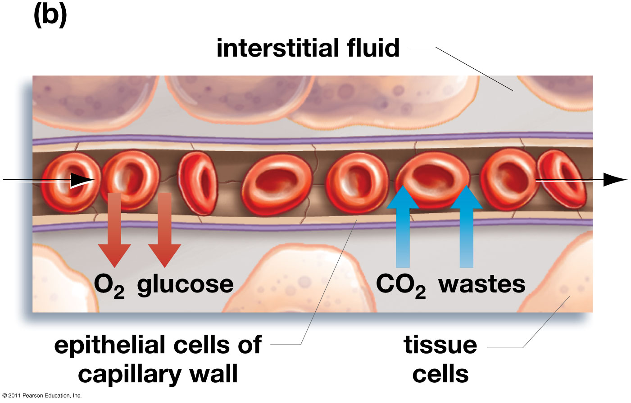
Exchange at Capillaries
Capillaries are so small that RBCs pass through single-file
Gases, nutrients and waste move via diffusion

Slide 8
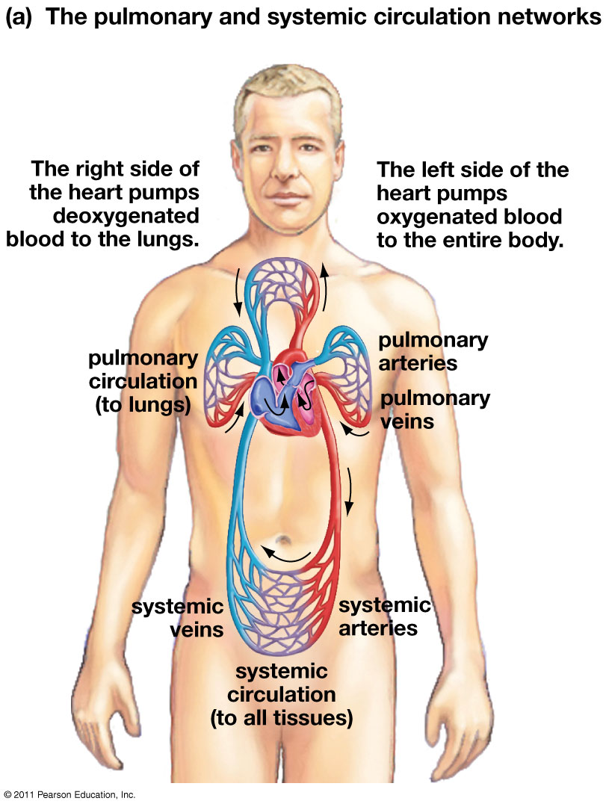
Vertebrate Circulatory System
Cardiovascular system: organ system that circulates blood through a network of vessels, transporting nutrients, gases and hormones to cells throughout the body
Heart: hollow muscular organ that pumps blood through circulatory system by rhythmic contraction
________: chambers that receive blood entering heart
____________: chambers that pump blood out of the heart
Pulmonary circuit: circuit of blood flow between the ____________________
Systemic circuit: circuit of blood flow between the _______________________

Slide 9
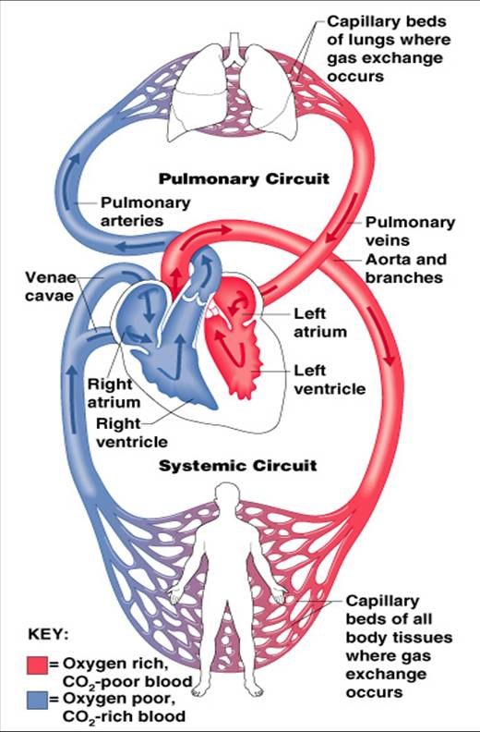

Slide 10
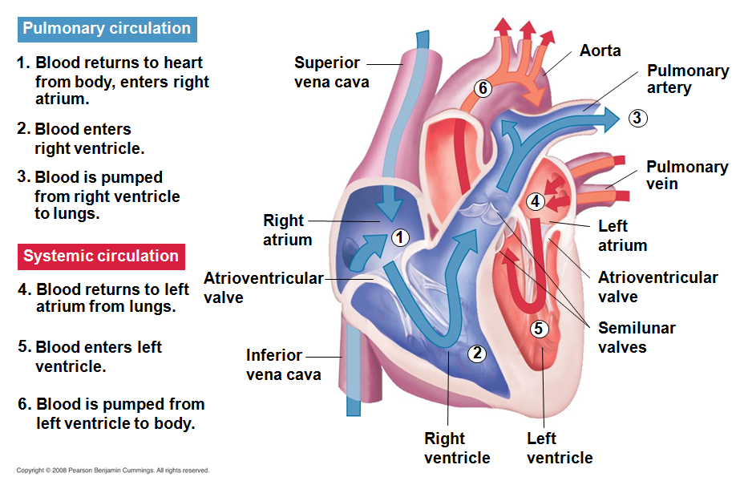
Circulation of Blood Through the Heart

Slide 11
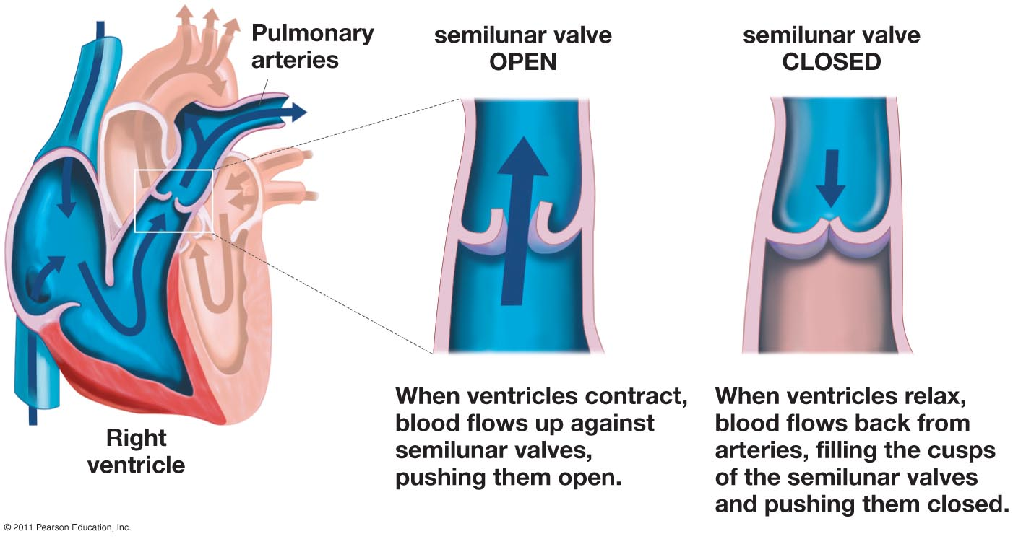
Heart Valves
Semilunar valve: valve between ventricles and aorta or pulmonary artery
Atrioventricular valve: valve between ____________________

Slide 12
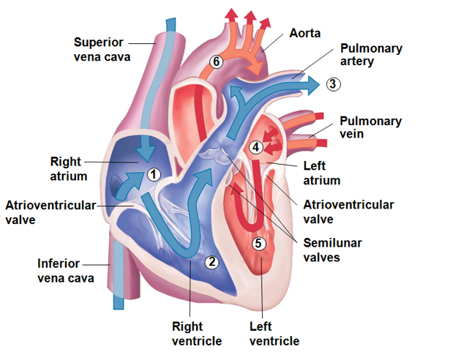
Path of Blood Through The Heart
Superior and Inferior Vena Cava
Right Atria
Atrioventricular (AV) Valve
Right Ventricle
Semilunar Valve
Pulmonary Arteries
Lungs (CO₂ out, O₂ in)
Pulmonary Veins
Left Atria
Atrioventricular (AV) Valve Left Ventricle
Semilunar Valve
Aorta
Body (O₂ out, CO₂ in)

Slide 13
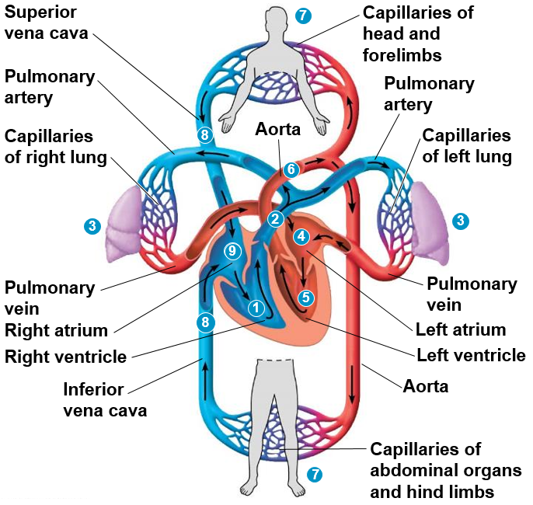
Cardiovascular System in Humans
Right ventricle pumps blood through semi-lunar valve
Pulmonary arteries carry oxygen-poor blood to lungs
Oxygen is uploaded and carbon dioxide is unloaded in the capillary beds within the lungs
Pulmonary veins carry oxygen-rich blood into the left atria
Blood moves through the atrioventricular valve into the left ventricle
Oxygen rich blood is pumped through the semi-lunar valve into the aorta, where it is carried through arteries and arterioles to the capillary beds in the body
Oxygen is unloaded and carbon dioxide is loaded in the capillary beds in the body
Oxygen-poor blood is carried through the venules and veins into the right atrium through the inferior and superior vena cava
Oxygen-poor blood moves to the right ventricle through the atrioventricular valve

Slide 14
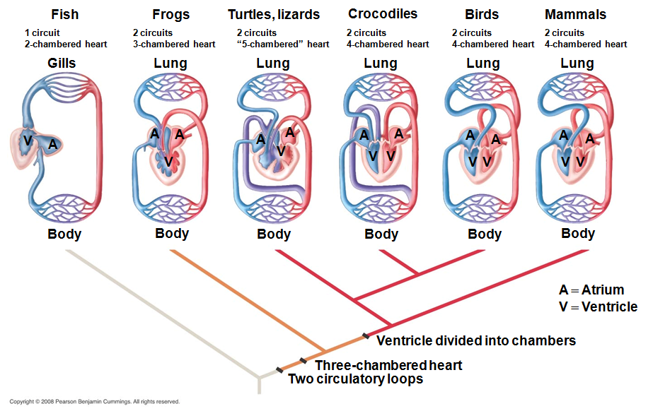
Comparative Anatomy of Vertebrate Hearts

Slide 15
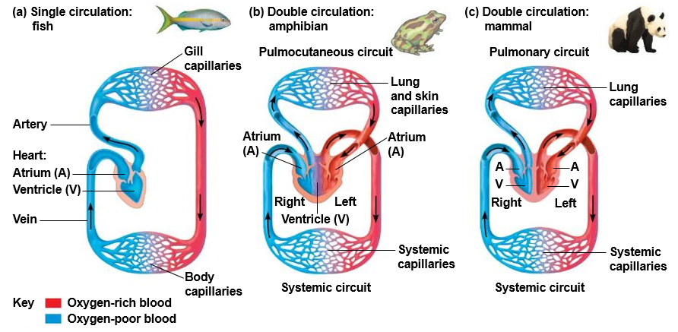
Vertebrate Circulatory Systems

Slide 16
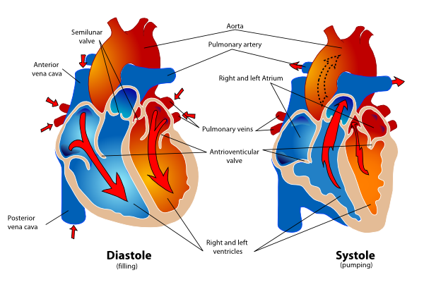
Cardiac Cycle
Diastole: period of heart ____________ when the heart fills with blood
Systole: period of heart _____________ when blood is forced out of the heart

Slide 17
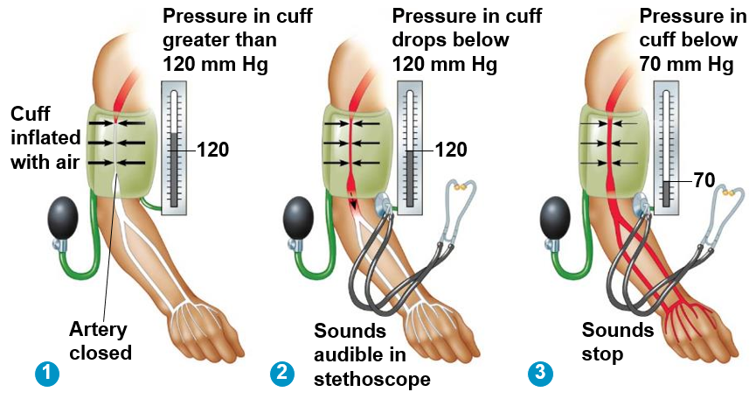
Blood Pressure
Pressure from cuff ________ artery
Cuff is deflated allowing blood to pulse into arm. __________ pressure is measured.
Cuff deflates to point that pulse can no longer be heard or felt. ________ pressure is measured.

Slide 18
Cardiac Cycle
Heart rate: ____________ of cardiac cycle
Usually expressed as beats per minute (BPM)

Slide 19
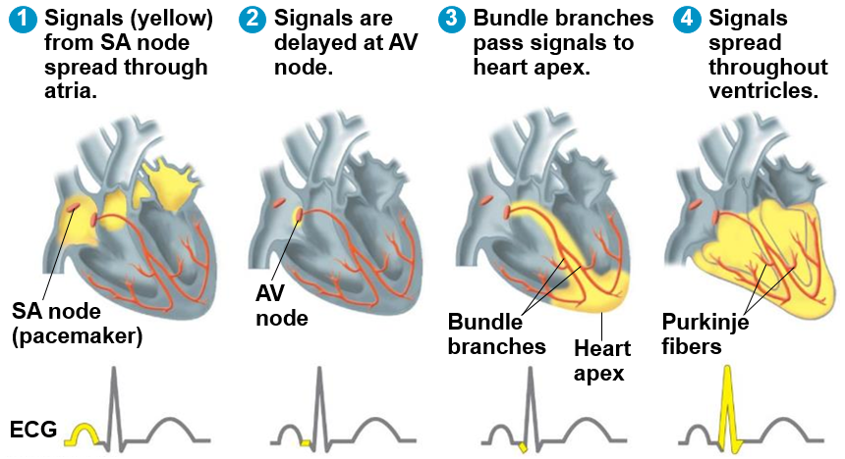
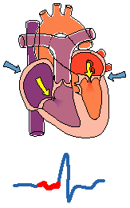
Control of Heart Rhythm
Sinoatrial node (pacemaker): controls ____________ at which cardiac muscles contract.
Atrioventricular node: relay point that _____________ for filling of ventricles

Slide 20
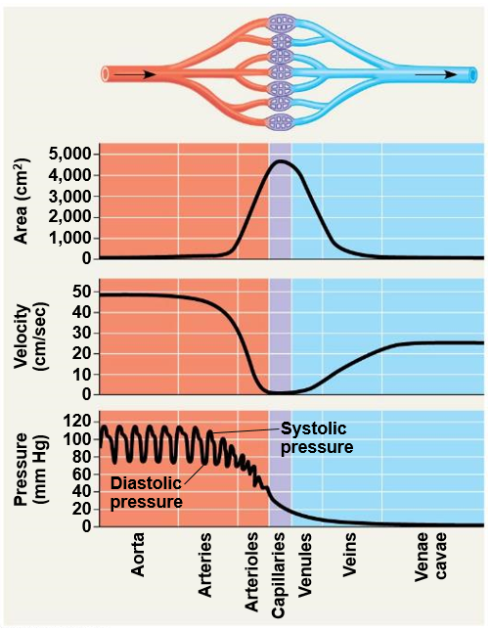
Blood Pressure
First lets interpret the figure to the right
Interpretation:
Blood pressure and velocity decreases in the arterioles and capillaries
Blood flow is slowest in capillaries where exchange of gases, nutrients and waste occurs
Blood flow (velocity) increases in venules and veins

Slide 21
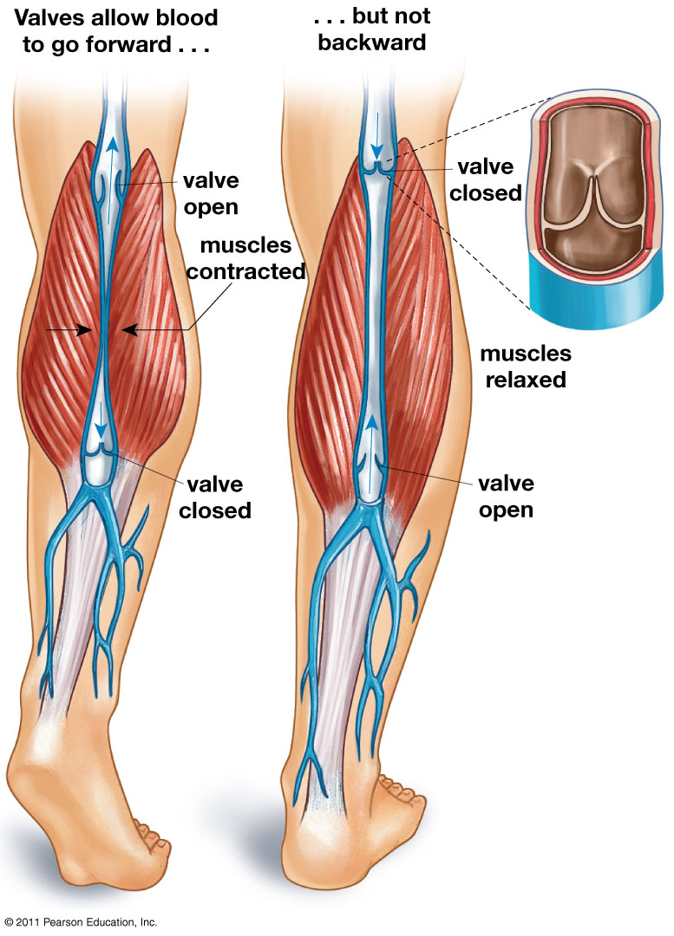
Returning the Blood to the Heart
Valves in the veins of extremities help transport blood back to the heart
Contractile muscles squeeze veins to help push blood back to the heart

Slide 22
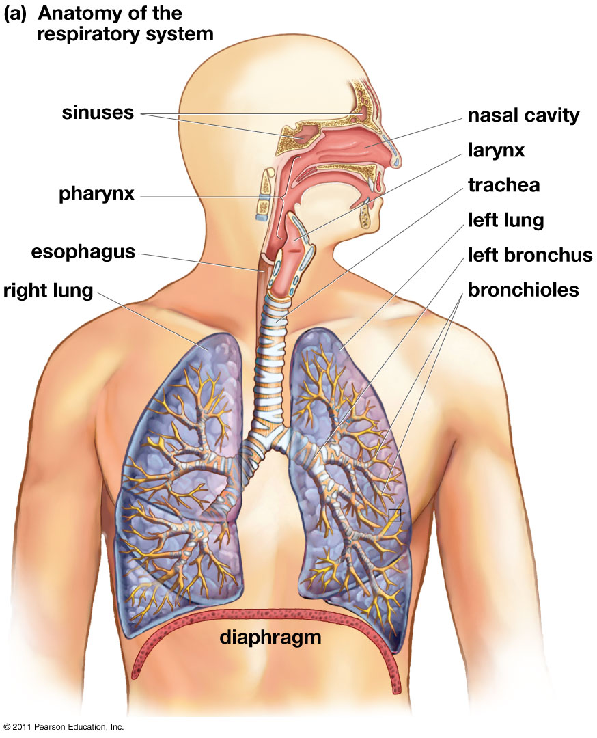
The Respiratory System
Nasal Cavity
Pharynx
Larynx
Trachea
Bronchi
Bronchioles
_____________: sheet of skeletal muscle that extends along the bottom of the rib cage
Expands and contracts to force air into and out of lungs

Slide 23
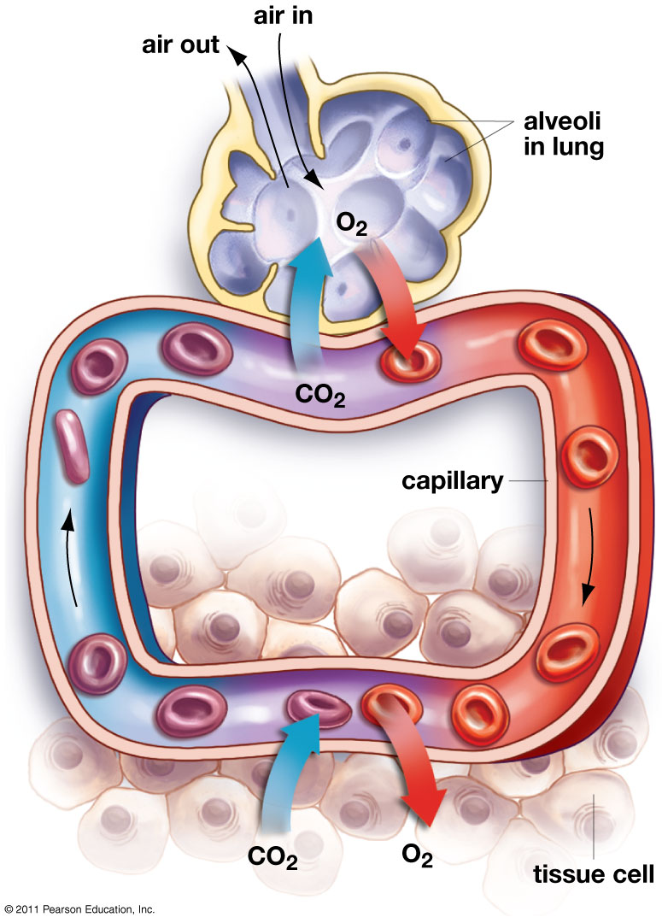
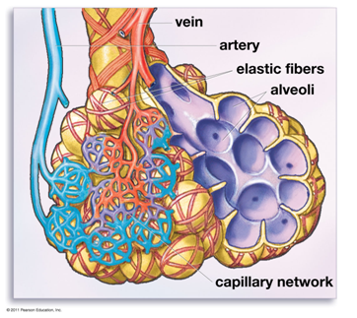
Structure of the Alveoli

Slide 24
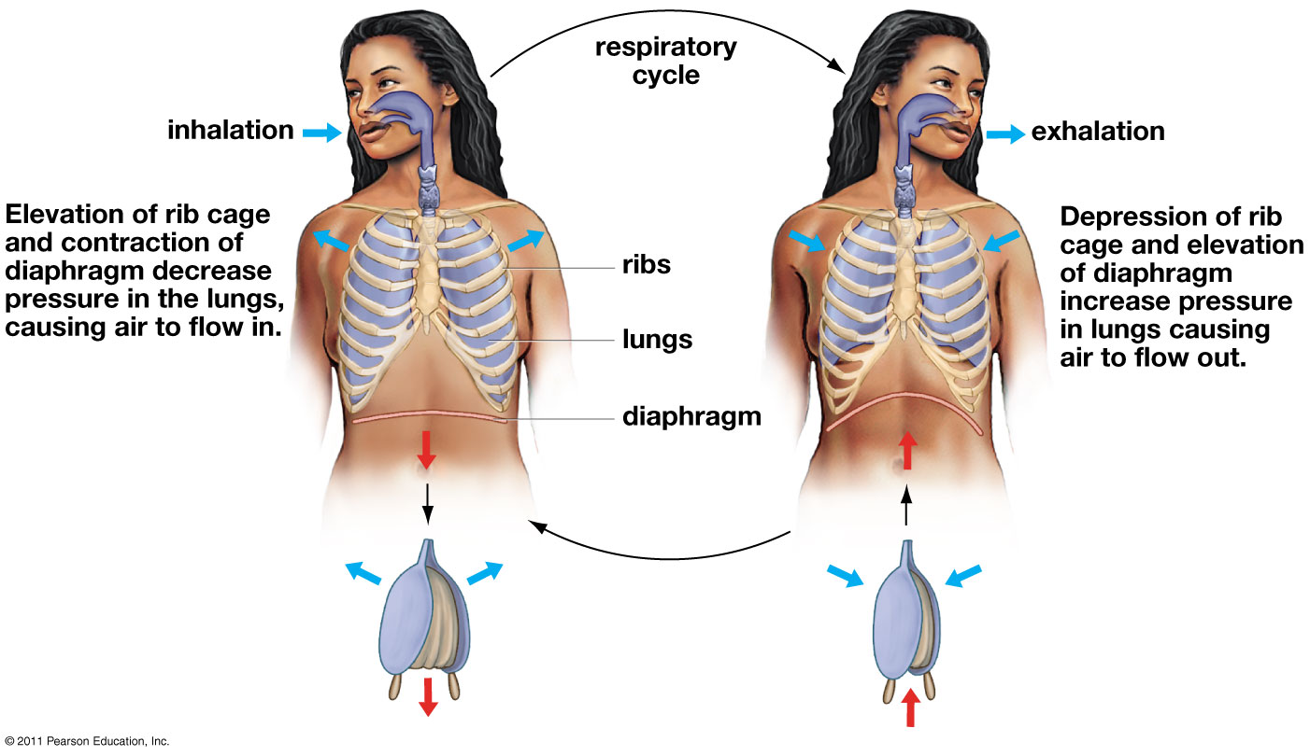
Respiratory Cycle

Slide 25
Breathing Control
Occurs in medulla oblongata and pons
Monitors blood pH
Exercise = more O₂ needed and more CO₂ produced
___________ signals for increase in depth and rate of breathing
Hyperventilation: when ventilation of CO₂ exceeds body’s production of CO₂

Slide 26
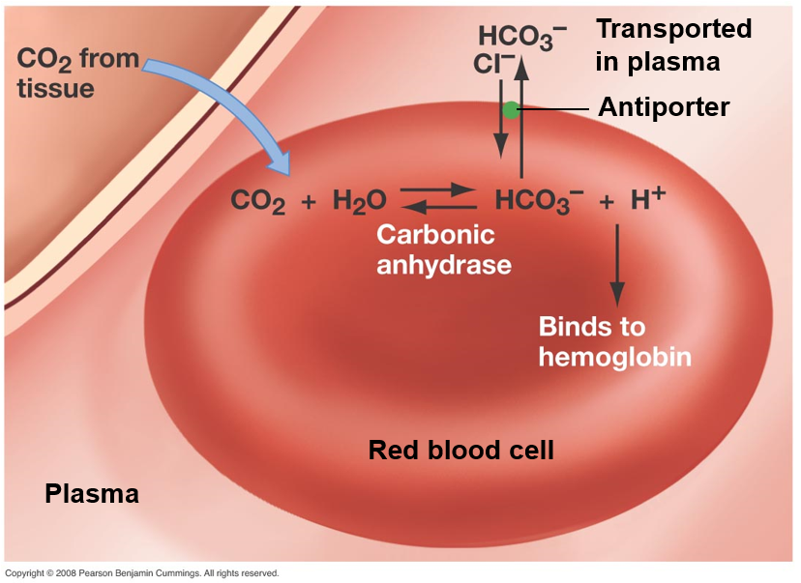
Carbon Dioxide Transport
Carbon dioxide transported from tissue by erythrocyte
7% transported as carbon dioxide in blood
23% of carbon dioxide and most of the hydrogen ions are attached to hemoglobin
70% transported as bicarbonate in plasma
Hydrogen ions make blood more acidic
CO₂ + H₂O → H₂CO₃ → H⁺ + HCO⁻
(Carbonic acid)
(Bicarbonate)

Slide 27
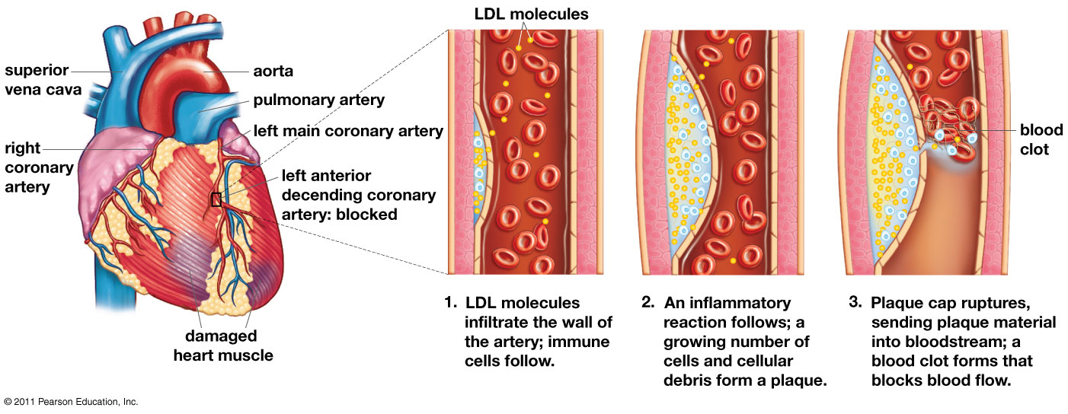
Heart Attack
_____________ arteries: arteries that supply the heart with blood
Low-density lipoproteins (LDLs): carry cholesterol from the liver and small intestine to outlying tissues

Slide 28
Cardiovascular Disease
Kills more than 750,000 people in U.S annually
Hypertension: high ___________________
Heart attack: damage or death of cardiac muscle due to blockage of coronary artery
Stroke: death of nervous tissue due to lack of O2
_____________________: hardening of arteries by accumulation of fatty deposits (plaque)
Low-density lipoproteins (LDL)
High-density lipoproteins (HDL)
Plaque
Notes:
Low-density lipoproteins: delivers lipids to cells for membrane production
High-density lipoproteins: returns excess cholesterol to liver
High LDL to HDL ratio = atherosclerosis

Slide 29
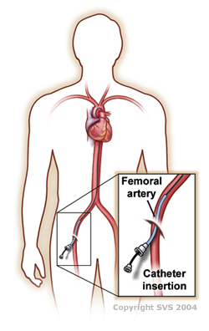
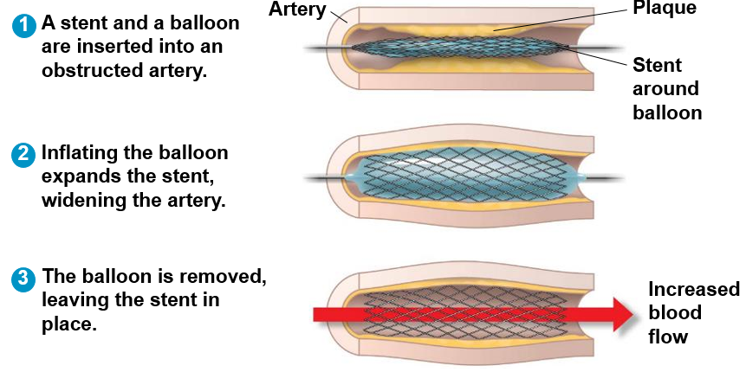
Treatments for Cardiovascular Disease
Angiogram
Angioplasty
Stents

Slide 30
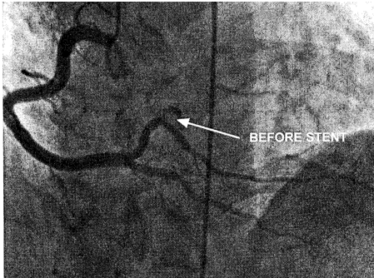
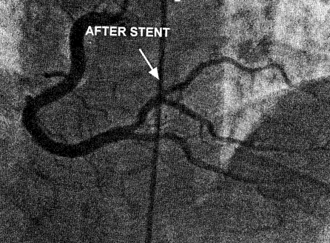
Treatments for Cardiovascular Disease

Slide 31
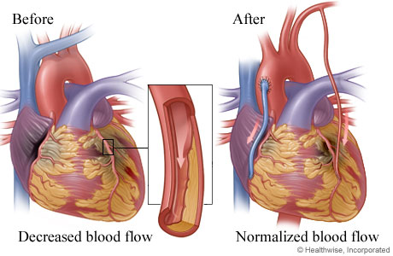
Cardiovascular Surgery
Bypass Surgery
Uses artery from leg to bypass blockage of coronary artery
Coronary artery: artery supplying blood to the heart
Coronary artery

Slide 32
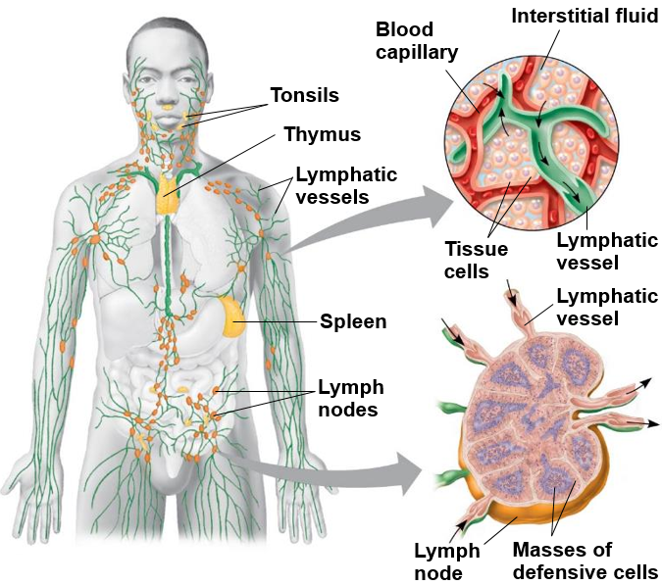
Lymphatic System
Lymphatic system: system of vessels and nodes that returns interstitial fluid, proteins, and cells back to the blood.
Separate from circulatory system
_______: fluid of lymphatic system
Lymph nodes: lymphatic organs that filter lymph and contain __________ cells that fight disease

Slide 33
Check Your Understanding
True or False: An open circulatory system delivers blood to tissue through capillaries
True or False: Veins carry deoxygenated blood, while arteries carry oxygenated blood
True or False: Your breathing rate is controlled by the pH level in your blood

Slide 34
Check Your Understanding
Which of the following is false concerning the an closed circulatory system?
a. Capillaries present
b. More efficient than open circulatory system
c. Blood transfers gases, nutrients and wastes
d. Slow blood flow

Slide 35
Check Your Understanding
Oxygenated blood from the lungs empties into which chamber of the heart?
a. Left ventricle
b. Right atrium
c. Right ventricle
d. Left atrium
e. Aorta

Slide 36
Check Your Understanding
Describe how breathing rate is controlled? Why do you breath into a paper bag when hyperventilating?

Slide 37
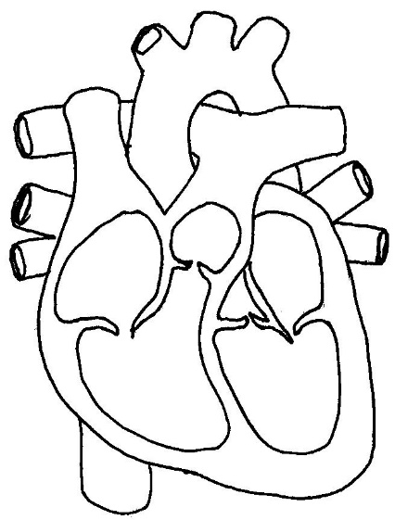
Check Your Understanding
Draw the direction of blood flow through the heart, and name all the heart chambers and major vessels entering and leaving the heart.

