Slide 1
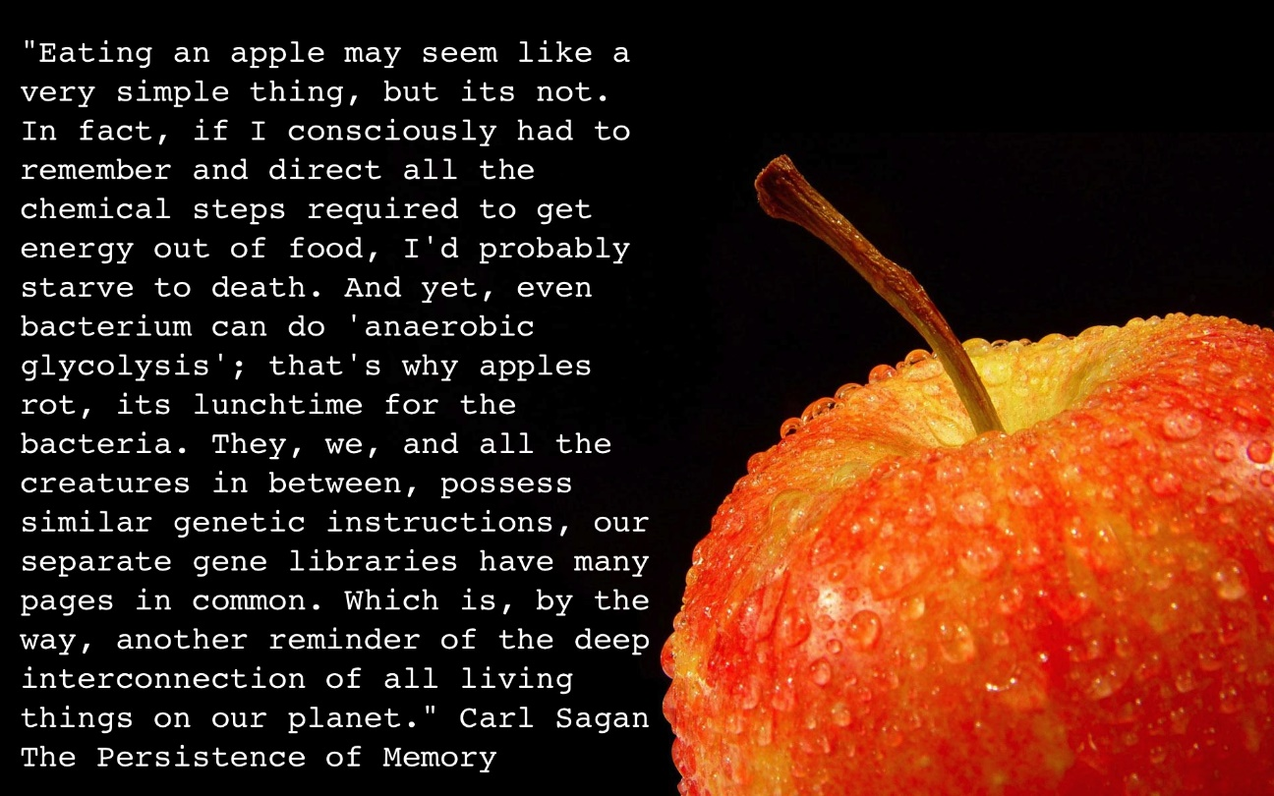
Cellular Respiration and Thermoregulation
Chapter 4
Notes:
Why do we need to breathe? What do we need the oxygen for, and where does the carbon dioxide come from that we exhale?
How do we lose weight?

Slide 2
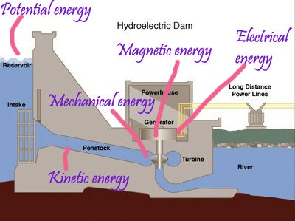
What is energy?
Energy: the capacity to bring about movement against an opposing force; ability to do work
Forms of Energy
Potential energy: stored energy
  Chemical energy
  Ex. Hydroelectric dam, food
Kinetic energy: energy in motion
  Running, biking, flying, etc.…
Notes:
Mechanical energy = wound up spring
Chemical energy = energy held in chemical bonds, food or coal, gasoline
Potential energy = water behind a dam, ions on one side of a cell membrane
Kinetic energy = water through the turbines of the dam, transferring to electric energy
Gasoline engine is powered by the energy released from breaking down carbon and hydrogen bonds stored within gasoline. CO2, water and heat are by products

Slide 3
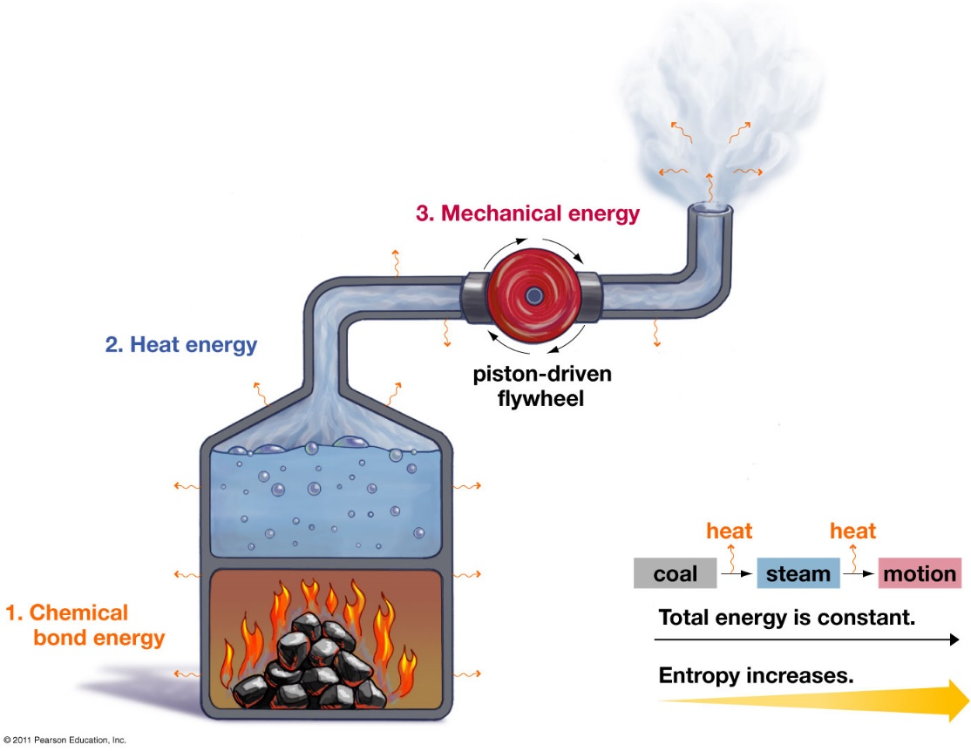
Thermodynamics
First Law of Thermodynamics: energy can not be created or destroyed, only transformed
  Excess energy released as heat
Second Law of Thermodynamics: energy moves from order to disorder
  Entropy: the amount of disorder
Notes:
How can things like plants and animals grow and become more organized?
Entropy acts on the universe as a whole
Small localized changes (increases in order) produce heat

Slide 4
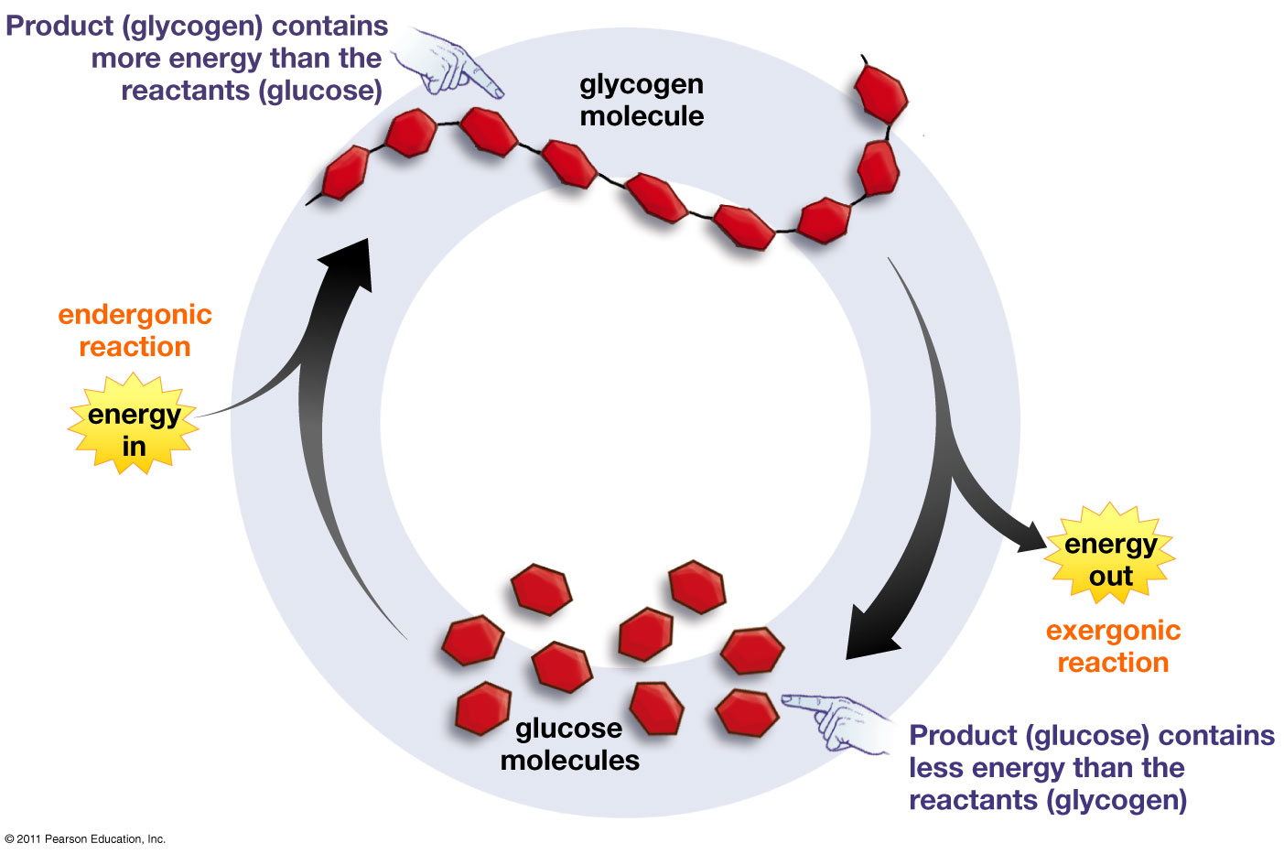
Exergonic and Endergonic Reactions
Exergonic reactions: reactants contain more energy than the products
  Energy released
  Ex: Cellular respiration
Endergonic reactions: products contain more energy than reactants
  Energy required
  Ex: Photosynthesis

Slide 5
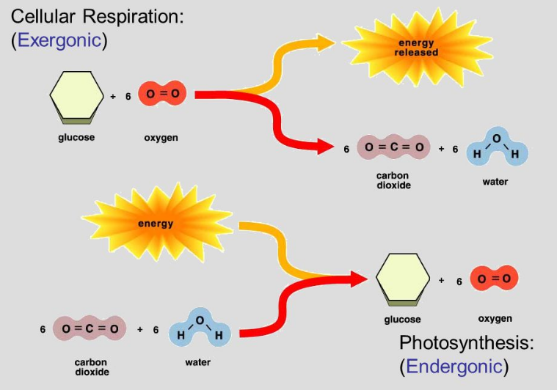
Exergonic and Endergonic Reactions
Cellular respiration: process by which all living things extract energy stored in the chemical bonds of molecules and use it to fuel cellular processes.
Photosynthesis: conversion of solar energy to chemical energy

Slide 6
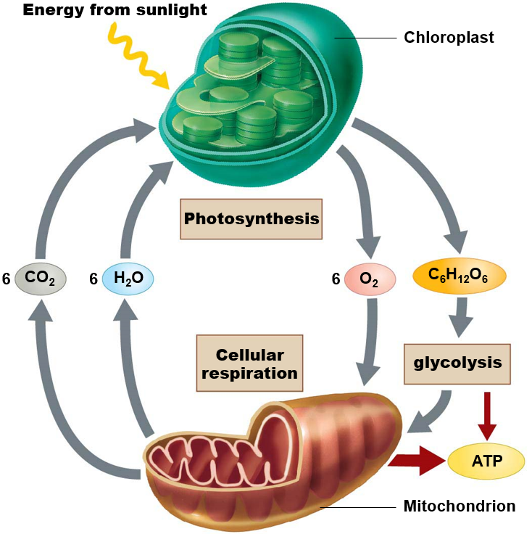

Cellular Respiration and Photosynthesis
Photosynthesis
6H₂O + 6CO₂ C₆H₁₂O₆ + 6O₂
Water + Carbon dioxide Glucose + Oxygen
Cellular Respiration
C₆H₁₂O₆ + 6O₂ 6CO₂ + 6H₂O + 36ATP + Heat
Glucose + Oxygen Carbon dioxide + Water + 36ATP + Heat
Light energy
Notes:
Audio transcript: It is important that we understand the relationship between photosynthesis and cellular respiration because these two processes drive life on Earth. This lecture is on cellular respiration and we will have our next lecture on photosynthesis. The key here is that the products of one reaction are the reactants for the other reaction. Photosynthesis produces glucose and oxygen which is then used by mitochondria to make ATP, a form of cellular energy. The carbon dioxide and water released as by products of cellular respiration are used by chloroplast to make glucose, with oxygen as a by product.

Slide 7
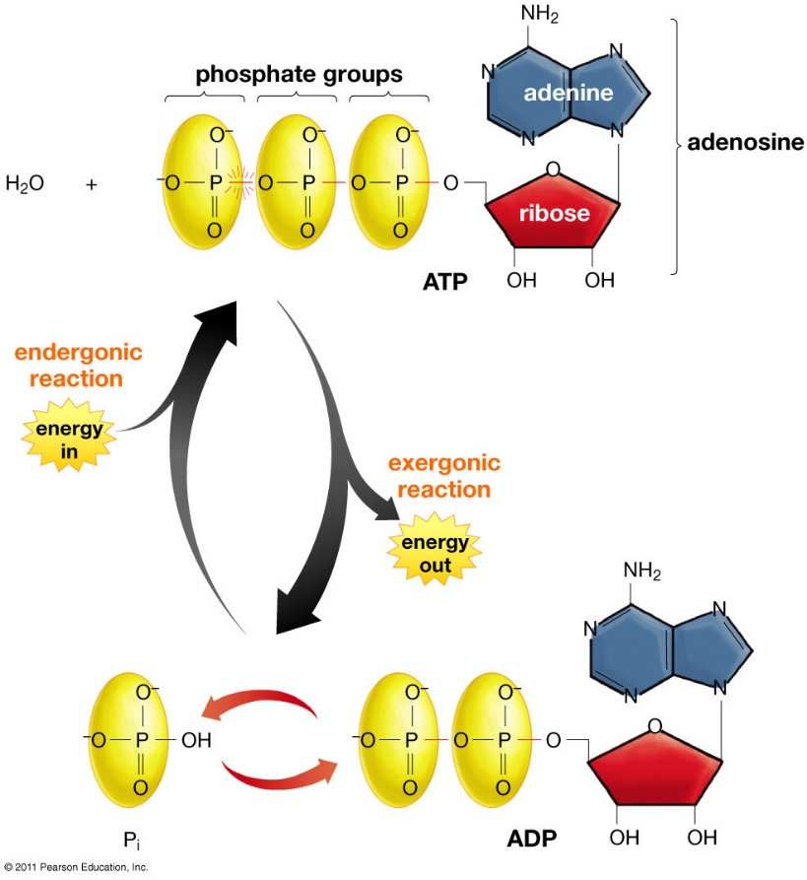
The Molecular Unit of Currency
Adenosine triphosphate (ATP)
  Energy transfer molecule
Adenosine diphosphate (ADP)
Phosphorylation: addition of a phosphate group to a molecule
Most important energy transfer molecule in living things!
Notes:
Audio transcript: ATP or adenosine triphosphate is a form of energy that cells can use. The energy in ATP is stored in the chemical bond between the last two phosphate groups. When that bond is broken, energy is released, and ATP becomes ADP, or adenosine diphosphate. A reaction that releases energy is known as an exergonic reaction. The beauty of ADP is that it can converted back to ATP with the addition of a phosphate group in a process known as phosphorylation. ATP is like a rechargeable battery and can recycled tens of thousands of times a day, and that is why we consider it the most important energy transfer molecule in living things. All life uses ATP, from bacteria to humans

Slide 8
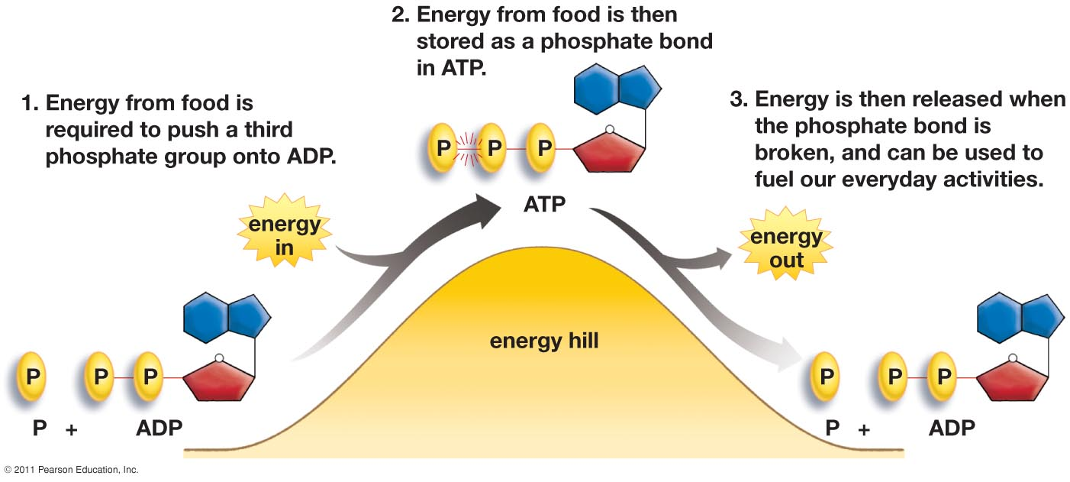
Energizing ATP
Adenosine triphosphate (ATP) and Adenosine diphosphate (ADP)
Notes:
Audio transcript: We know that energy can not be created or destroyed, only transformed, and it wouldn’t make sense to use energy from ATP to make ATP because that would be inefficient. So where does the energy come from to make ATP? It comes from the chemical bonds in our food. When we breakdown the molecules in our food, energy is released. The energy released from those broken bonds is then transferred to the bond between the last two phosphate groups in ATP, recharging the battery.

Slide 9
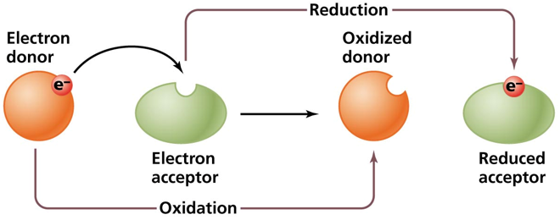
Oxidation Reduction Reactions
Oxidation: the process of losing electrons
Reduction: the process of gaining electrons
Reduction in charge
Oxidation and Reduction reactions are always linked
Redox reaction: the transfer of electrons from one molecule to another
Notes:
Audio transcript: During the processes of cellular respiration and photosynthesis, energy is often transferred between molecules. In many cases energy is in the form of an electron. Some molecules give up their electrons and some molecules gain electrons. The process of losing electrons is known as oxidation, whereas the process of gaining electrons is known as reduction. I always remember that when an atom or molecule gains an electron its overall charge is now reduced. Think about the ionic bonding we learned about earlier. All oxidation reactions are coupled with a reduction reaction that’s why we call them redox reactions.

Slide 10
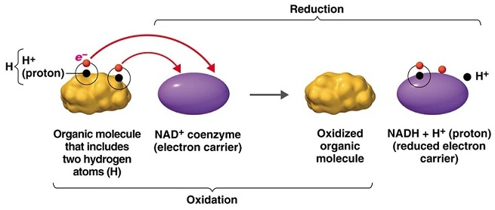
Oxidation and Reduction of NAD⁺
Nicotinamide adenine dinucleotide (NAD+): transfers electrons from hydrogen atoms
Notes:
Audio transcript: One of the redox reaction we are going to see a lot of in cellular respiration is with NAD+. NAD+ is considered an electron carrier because it gains electrons (reduction) in one part of the process, then releases those electrons in a later stage of the process (oxidation). NAD+ is transferring the energy stored in the electrons from one stage of cellular respiration to another stage of cellular respiration.

Slide 11
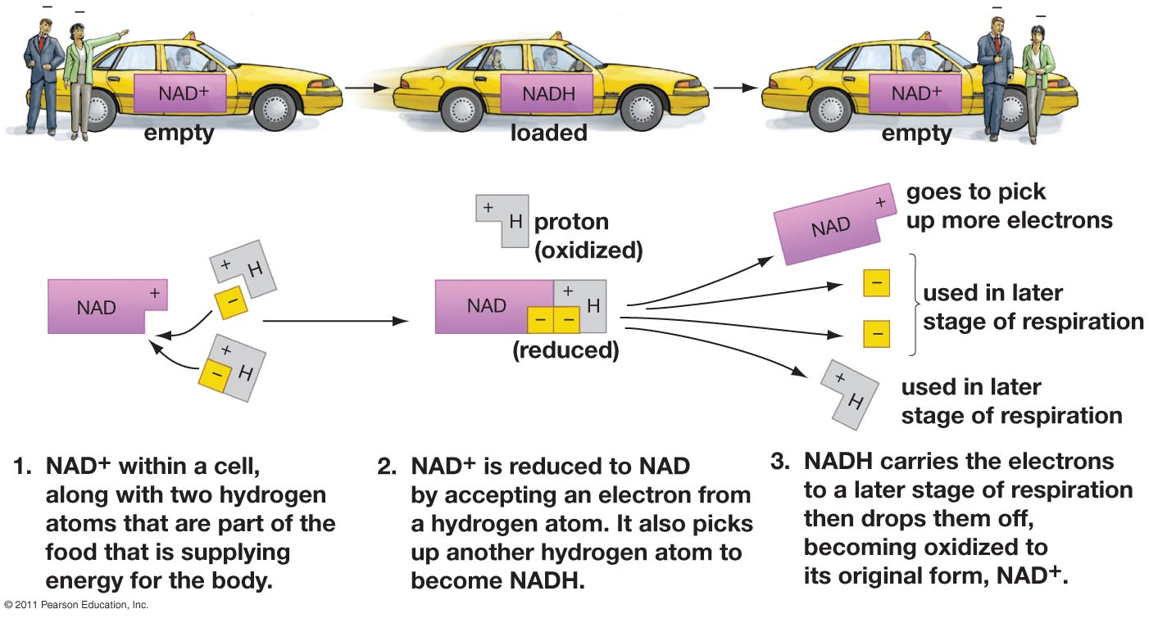
Energy’s Taxi Service: NAD⁺
Notes:
Audio transcript: When NAD+ gains an electron and bonds with a hydrogen atom it becomes NADH. NADH is like a loaded taxicab that is then going to transport the electrons to another stage of the cellular respiration process.

Slide 12
Case Study
Part 1 – The Symptoms
Imagine you work in a medical examiner’s office in a major metropolitan city. As Chief Medical Officer, you investigate suspicious deaths and provide toxicology services to the county. In the past five days, seven people have died, all with similar symptoms. It is your job to examine the data and determine the cause of death for these victims.
The first victim was a 12-year old girl. Her parents said that she was awake in the middle of the night complaining of a stuffy nose and sore throat. They gave her extra strength Tylenol and sent her back to bed. At 7 am the next morning, the parents discovered the girl had collapsed on the bathroom floor. An ambulance rushed the girl to a nearby hospital but she was pronounced dead on arrival.
The same day, paramedics found a second victim unconscious on his kitchen floor, after what they thought was an apparent heart attack. Sadly, the victim's brother and fiancée also collapsed later that night while the family was gathered to mourn his passing. Both had taken Tylenol to help cope with their loss but later collapsed and died.
Notes:
Read the Case Study and come up with a hypothesis about what you think may be killing these people.

Slide 13
Case Study
In the next four days, four other similar deaths were reported, all in the same neighborhood and all with similar symptoms.
Are these seven deaths related? What is causing these people to die? It is your job to answer these questions before more deaths are reported.
Symptoms exhibited by most patients:
Dizziness
Confusion
Headache
Shortness of breath
Are there similarities or connections between these seven deaths? What questions would you want to ask the families?
Notes:
Read the Case Study and come up with a hypothesis about what you think may be killing these people.

Slide 14
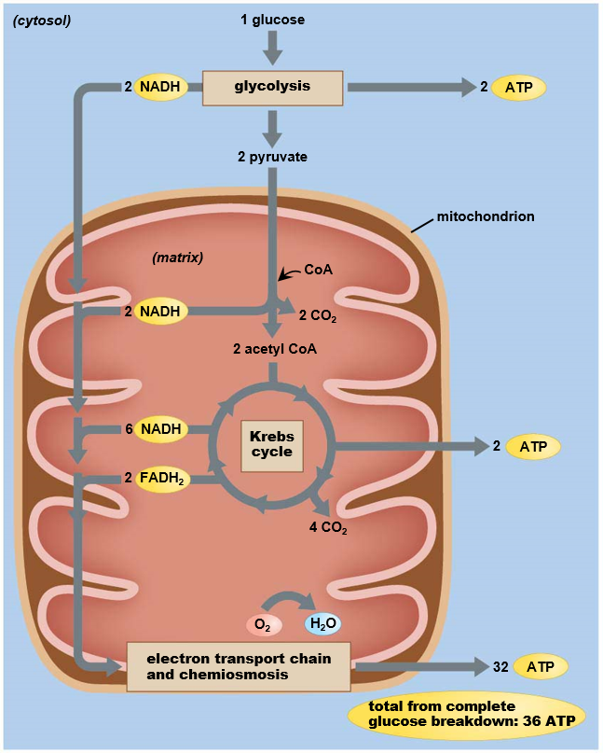
Cellular Respiration
Four part process that converts a single glucose molecule to 36 ATP
1. Glycolysis
  2 ATP
2. Transition Phase
  No ATP produced
3. Krebs cycle
  2 ATP
4. Electron transport chain
  32 ATP
Notes:
Audi transcript: There are four stages to the cellular respiration process, and we will be looking at each stage in detail. Of the four stages, glycolysis is the first stage and it is the only one of the stages that occurs outside of the mitochondria. The remaining stages occur inside of the mitochondria. The key point of this slide is that the different stages produce different amounts of ATP, with the final stage, the electron transport chain, producing the most. All together, one glucose molecule yields 36 molecules of ATP.

Slide 15
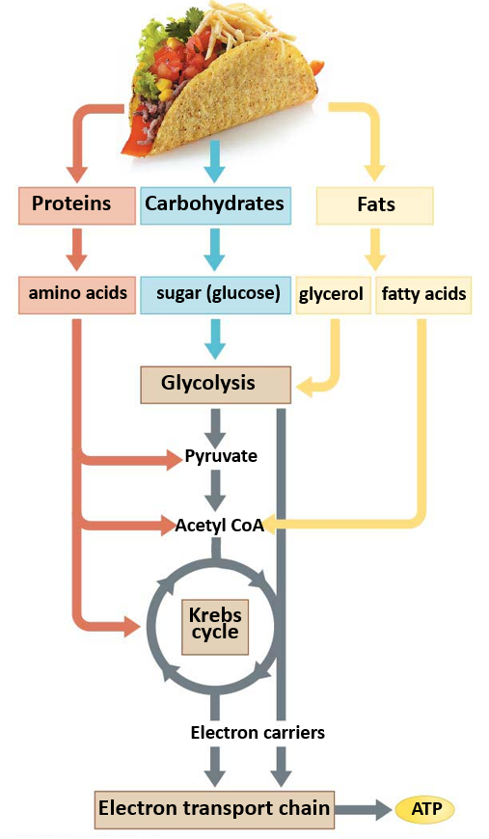
Macromolecules and Energy
Why do we have to eat food?
Through the cellular respiration process, stored energy in chemical bonds of sugar and other macromolecules is captured and converted into the bonds of ATP.
Used in the production of tissue or excreted as waste
Notes:
Energy and molecules for cellular respiration come from food. We will follow glucose through the process because it is the main molecule involved in cellular respiration, but other macromolecules also play a key role.

Slide 16
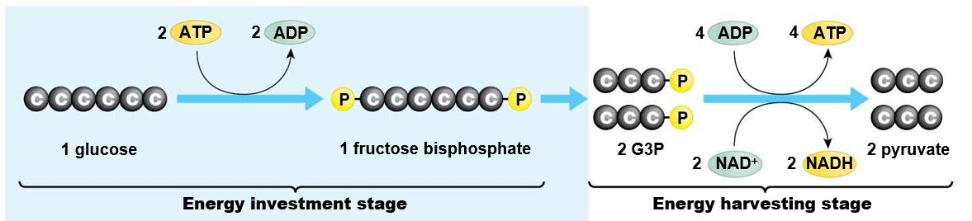
Glycolysis
Breakdown of 1 glucose molecule into 2 pyruvate molecules
Present in all living things
Takes place in the cytosol (outside of mitochondria)
Two stages
  Energy investment stage: requires 2 ATP
  Energy harvesting stage: produced 4 ATP and 2 NADH
Notes:
Audio transcript: Glycolysis means the splitting of sugar (glycol=sugar, lysis=splitting), and that’s what occurs in this stage. In the first part of glycolysis, energy from ATP is actually required to break the six carbons in glucose into two three carbon molecules. Those two three-carbon molecules are reconfigured, and energy is released. That energy is captured in 2 NAD+ making 2 NADH, and 4 ADP making 4 ATP. Since 4 ATP were produced but 2 were used in the initial step, we say that glycolysis really only yields 2 ATP.
Glycolysis takes place in all living things and is the only form of energy extraction in many small organisms like bacteria. Many small organisms don’t require lots of energy, so the energy produced through glycolysis is enough to support them.

Slide 17
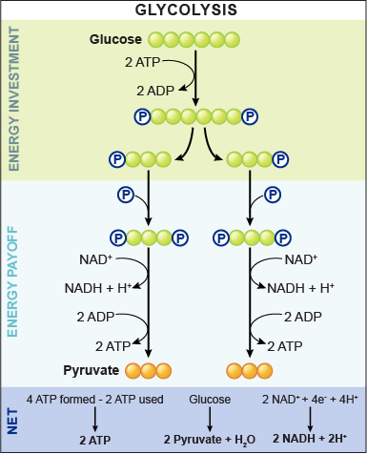
Glycolysis
1. 2 ATP are used to attach two phosphate groups to the 6-carbon glucose molecule
2. 6-carbon glucose split into two 3-carbon molecules
3. Phosphate added with energy from NAD+ oxidation
  Two NADH molecules produced
4. Phosphate groups lost to ADP
  Four ATP produced
5. Pyruvate end product
1
2
3
4
5
Notes:
Here is just another look at the steps of glycolysis. All I really want you to know for all of the stages of cellular respiration is what goes in and what comes out of each stage. In this stage, glucose begins the stages and glycolysis ends with 2 pyruvate molecules, 2 ATP, and 2 NADH.

Slide 18
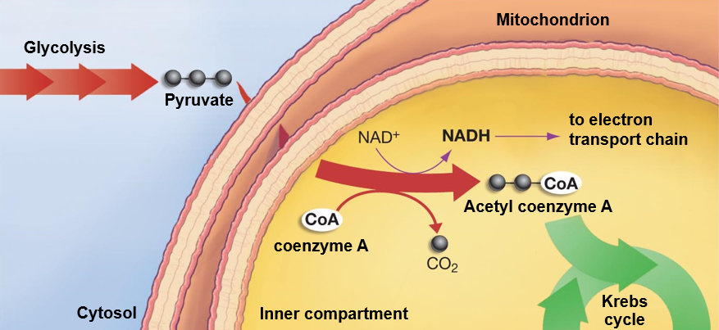
Transition Phase
Coenzyme A (acetyl CoA) added to pyruvate, Acetyl Coenzyme A produced
  Carbon dioxide byproduct
One NADH molecule produced from each pyruvate molecule
Takes place in the inner compartment of mitochondria
Notes:
Audio transcript: The transition phase occurs in the mitochondria after the pyruvate produced in glycolysis moves through the mitochondrial membrane. Here coenzyme A combines with pyruvate to form acetyl coenzyme A. One NADH molecule and one carbon dioxide molecule are produced for each pyruvate. Since there are two pyruvate per glucose molecule, we say that the transition phase produces two NADH per glucose. The carbon dioxide released during this stage makes up some of the carbon dioxide that you exhale.

Slide 19
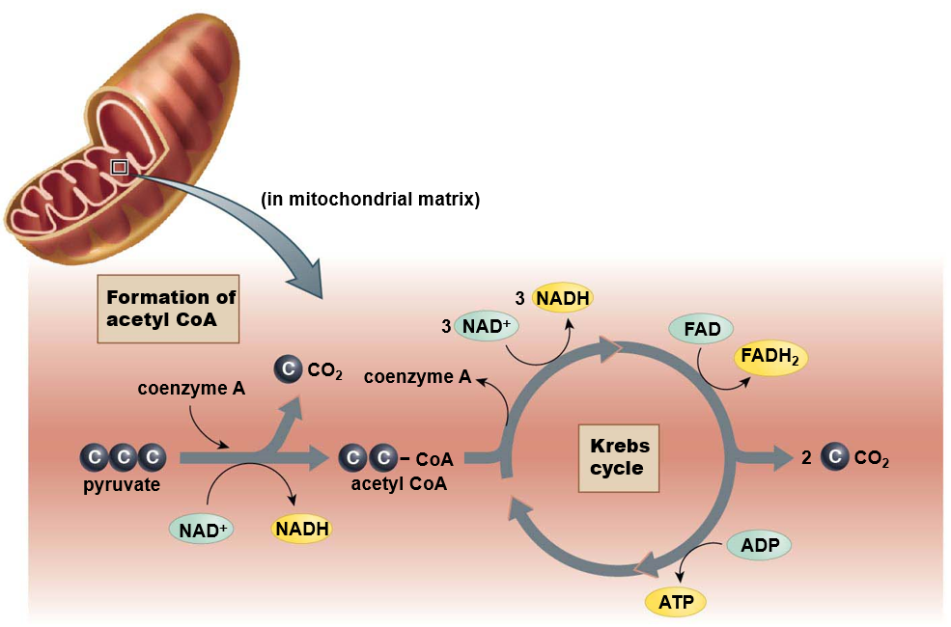
Krebs Cycle
Takes place in the inner compartment of mitochondria
One glucose molecule
= 2 pyruvate
= Two cycles
  4 CO₂
  6 NADH
  2 ATP
  2 FADH₂
Notes:
Audio transcript: The Krebs Cycle is process that continues to breakdown the carbons that originated in glucose, while capturing the energy released from those chemical bonds when the molecules are broken down or rearranged. As one Acetyl Coenzyme A molecule move through the Krebs Cycle, it produces 3 NADH, 1 FADH2, which is an electron carrier just like NADH, and 1 ATP. Since we started with 1 glucose which split in glycolysis and then converted pyruvate to Acetyl Coenzyme A in the transition phase, 1 glucose molecule is equal to two cycles through the Krebs Cycle, so one glucose molecule is equal to 4 NADH, 2 FADH2, and 2 ATP. Carbon dioxide is released by the Krebs Cycle which makes up the air we exhale.

Slide 20
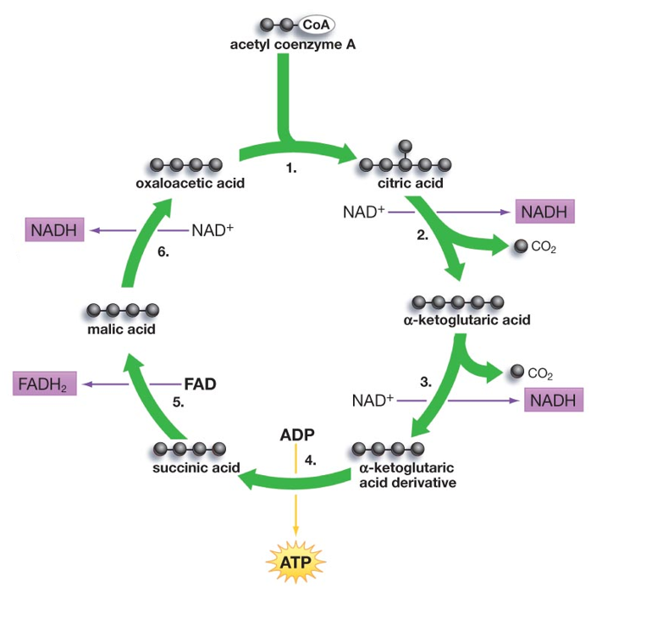
Krebs Cycle
6) 4C malic acid oxidized by NAD⁺ to form oxaloacetic acid
  1 NADH
1) Acetyl CoA combines with 4C oxaloacetic acid to form 6C citric acid
5) 4C succinic acid oxidized by FAD to form malic acid
  1 FADH₂
2) 6C Citric acid oxidized to form 5C α-ketoglutaric acid
  1 NADH
  1 CO₂
3) 5C α-ketoglutaric acid loses carbon, becomes 4C α-ketoglutaric acid derivative
  1 NADH
  1 CO₂
4) 4C α-ketoglutaric acid
derivative spilt to make
4C succinic acid
      1 ATP
Notes:
You don’t need to know this level of detail. I just wanted to show you that succinic acid is one of the molecules produced in the Krebs Cycle. Remember succinic acid and its apparent healing properties?

Slide 21
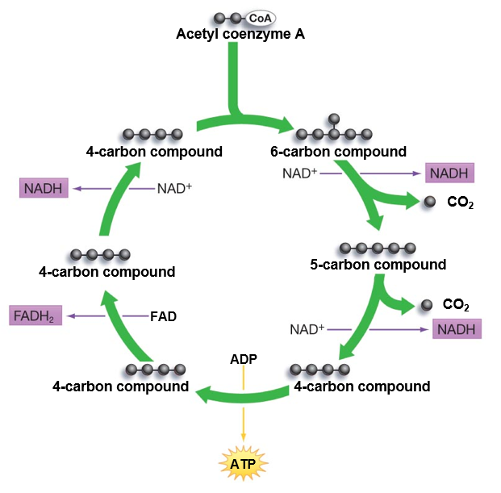
Krebs Cycle
1. Acetyl coenzyme-A combines with 4-carbon compound forming 6-carbon compound
2. 6-carbon compound loses electrons (oxidation) to NAD⁺ forming NADH, and two carbon dioxide molecules are released
3. 4-carbon compound rearranges and releases energy used to create ATP molecule
4. Newly arranged 4-carbon compound is oxidized by FAD forming FADH₂
5. 4-carbon compound is oxidized by NAD⁺ forming NADH. 4-carbon compound is transformed into original 4-carbon compound and the cycle continues
1
5
2
4
3
Notes:
Audio transcript: I just have this slide to show you how the carbon molecules are broken down and rearranged throughout the Krebs Cycle. Acetyl Coenzyme A enters the Krebs cycle and combines with an existing 4 carbon molecule. The newly formed six carbon molecule breaks down and rearranges, releasing energy in the form of electrons. Those electrons are captured by the electron carriers NAD+ and FAD to form NADH and FADH2 respectively.

Slide 22
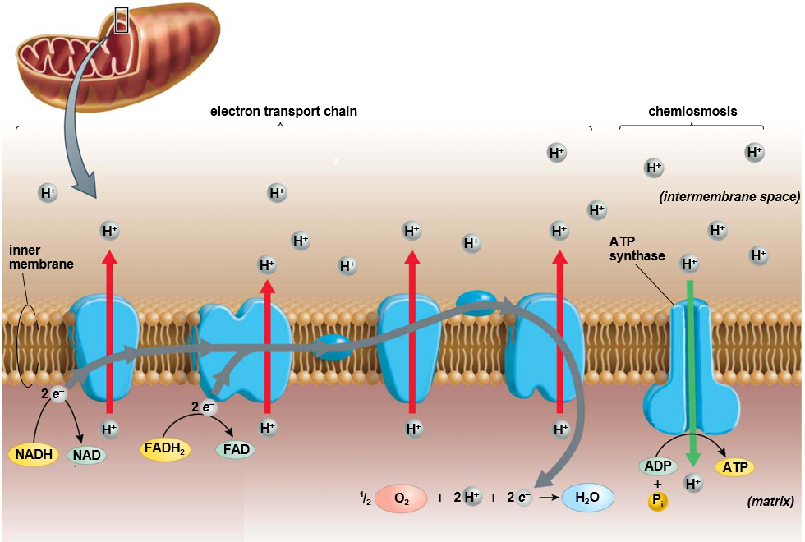
Electron Transport Chain
Electron Transport Chain: energy from electrons (e⁻) used to push H⁺ ions from inner compartment to outer compartment against concentration and electrical gradient
Inner membrane of mitochondria
Oxygen is the final electron acceptor
Chemiosmosis: movement of ions across semi-permeable membrane, down their electrochemical gradient
ATP synthase: enzyme uses energy from H⁺ ions to spin, which adds a phosphate to ADP making ATP
Notes:
Audio transcript: The final stage of cellular respiration is where the most ATP is produced. The electron transport chain and chemiosmosis occur in the inner membrane of the mitochondria, where transport membranes pass hydrogen ions through the inner mitochondrial membrane. At the start of the electron transport chain, NADH and FADH2 donate their high energy electrons to the membrane proteins. Those electrons move from one membrane protein to another powering these hydrogen pumps as they pump of hydrogen ions through the membrane. After the electron moves through the hydrogen pumps (membrane proteins), oxygen captures the electron at the end of the electron transport chain and then combines with two hydrogen atoms to become water. This is why we breath oxygen because it is the final electron acceptor.
The hydrogen ions are actively transported from a region of low concentration to a region of high concentration through the inner mitochondrial membrane. The high concentration of hydrogen ions on one side of the membrane creates a concentration gradient which is a form of potential energy. Once the concentration gradient is established, the hydrogens move down their concentration gradient through a specialized enzyme called ATP-Synthase which uses the energy of the falling hydrogen ion to add a phosphate to an ADP molecule (phosphorylation).
ATP synthase can add a phosphate to ADP making ATP 100 revolutions/sec!

Slide 23
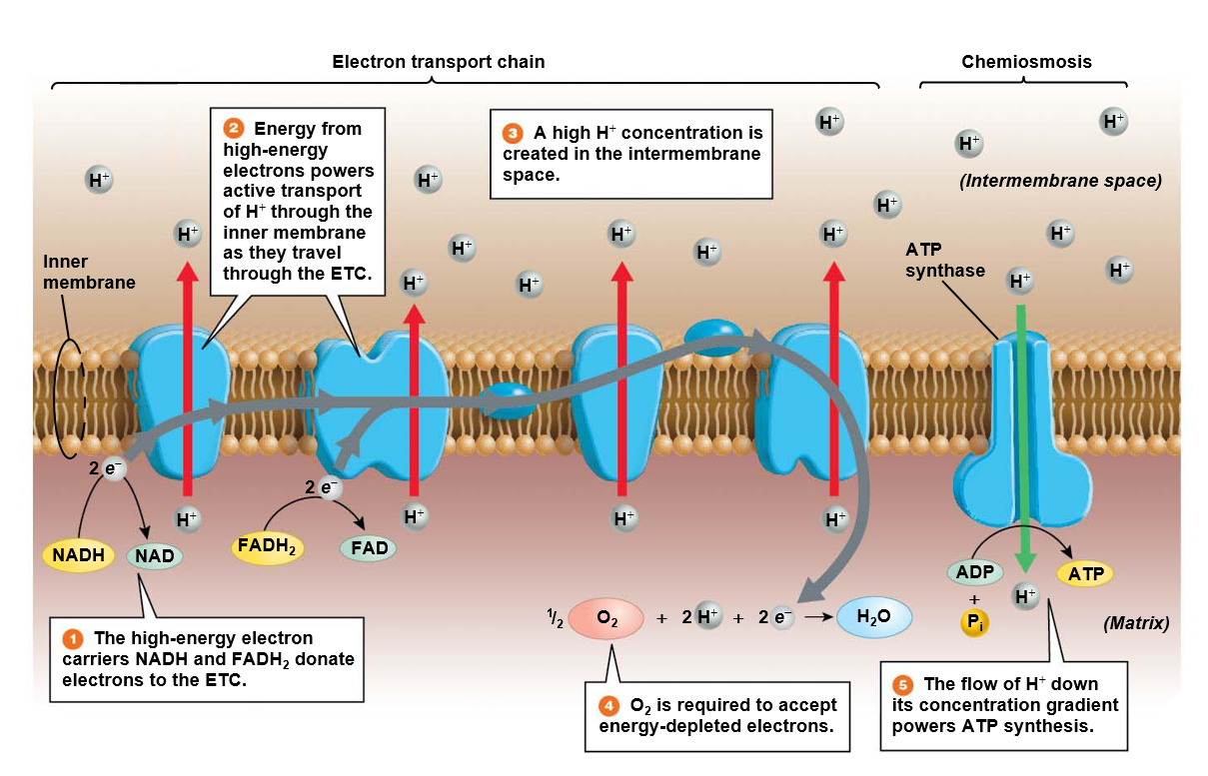
Notes:
Audio transcript: The electron transport chain uses active transport to pump hydrogen ions against their concentration gradient to create a high concentration of hydrogen ions on one side of the membrane. The hydrogen ions then move down their concentration gradient through a specialized membrane protein (ATP-synthase) in a process known as facilitated diffusion.

Slide 24
Check Your Understanding
CO₂
CO₂
CO₂
CO₂
6-Carbon compound
4-Carbon compound
4-Carbon compound
H⁺
H⁺
H⁺
H⁺
H⁺
H⁺
H⁺
H⁺
H⁺
H⁺
H⁺
H⁺
CoA
H⁺
H⁺
H⁺
H⁺
H⁺
H⁺
8
H⁺
H⁺
H⁺
H⁺
H⁺
H⁺
__ATP
H⁺
H⁺
H⁺
H⁺
H⁺
H⁺
H⁺
H⁺
H⁺
H⁺
H⁺
H⁺
H⁺
H⁺
H⁺
H⁺
H⁺
H⁺
CoA
__NADH
__FADH₂
8
__ATP
CO₂
e-
__NADH
CO₂
e-
CoA
6-Carbon compound
4-Carbon compound
4-Carbon compound
H⁺
e-
__NADH
__NADH
__FADH₂
H⁺
H⁺
H⁺
H⁺
H⁺
H⁺
ADP
+ P
8
CoA
__ATP
___ + 2H⁺ = H₂O
8
__ATP
CO₂
CO₂
__NADH
__FADH₂
Notes:
We usually fill this worksheet in in lecture, but you can just click though it to fill in the missing components.

Slide 25
Check Your Understanding
Glycolysis
Transition Phase
CO₂
CO₂
CO₂
Electron transport chain
Chemiosmosis
CO₂
6-Carbon compound
4-Carbon compound
4-Carbon compound
H⁺
H⁺
H⁺
H⁺
H⁺
H⁺
H⁺
H⁺
H⁺
H⁺
H⁺
H⁺
CoA
H⁺
H⁺
H⁺
H⁺
H⁺
H⁺
Krebs Cycle
8
H⁺
H⁺
H⁺
H⁺
H⁺
H⁺
__ATP
Pyruvate
1
H⁺
H⁺
H⁺
H⁺
H⁺
H⁺
H⁺
H⁺
Acetyl Co-enzyme A
H⁺
H⁺
H⁺
H⁺
H⁺
H⁺
H⁺
H⁺
H⁺
H⁺
3
CoA
__NADH
1
__FADH₂
8
2
__ATP
CO₂
e-
2
e-
Glucose
__NADH
CO₂
2
CoA
6-Carbon compound
4-Carbon compound
4-Carbon compound
H⁺
e-
__NADH
__NADH
10
2
__FADH₂
H⁺
H⁺
H⁺
H⁺
H⁺
ADP
+ P
H⁺
8
__ATP
CoA
32
½ O₂
___ + 2H⁺ = H₂O
Pyruvate
Acetyl Co-enzyme A
Krebs Cycle
8
__ATP
1
CO₂
ATP Synthase
CO₂
3
__NADH
1
__FADH₂
Notes:
We usually fill this worksheet in in lecture, but you can just click though it to fill in the missing components.

Slide 26
Cellular Respiration Review
Step | Location | Input | Output | Electron Carriers | ATP
Glycolysis | Cytosol | Glucose | Pyruvate | Energy captured in 2 NADH | 2 ATP
Transition Phase | Inner compartment of mitochondrion | Pyruvate, Coenzyme-A, | Acetyl-Coenzyme-A, CO₂ | Energy captured in 2 NADH | -
Krebs Cycle | Inner compartment of mitochondrion | Acetyl Coenzyme-A | CO₂ | Energy captured in 6 NADH, 2 FADH₂ | 2 ATP
Electron Transport Chain | Inner membrane of mitochondrion | Oxygen (O₂) | H₂O | Energy released from 10 NADH, 2 FADH₂ | 32 ATP
Notes:
I usually do this table on the board because it summarizes the different stages of cellular respiration. For the exam, you will need to know the location of each stage, the inputs and outputs of each stage, and the amount of electron carriers and ATP produced in each stage.

Slide 27
Case Study
Part 11 – Autopsy Report
Immediate cause of death was hypoxia (suffocation or lack of oxygen)
Tissue sections from the heart, lung, kidney, and liver all show massive cell death
Staining with specific dyes showed major mitochondrial damage within the affected tissue
Oxygen levels in the patients blood were approximately 110 mm Hg (normal range is 75 – 100 mm Hg)
Recalling your knowledge of the function of organelles, what function of the cells was interrupted in these patients? Could this loss of function lead to the death of these individuals? Why or why not?
Given the data in the autopsy, were there any reports that seemed inconsistent with the immediate cause of death?
Notes:
More on the case study.

Slide 28
Case Study
Part III – Subcellular Metabolite Analysis
Detailed analysis of the damaged cells showed that the ATP levels in the mitochondria were very low. Levels or pyruvates and acetyl coenzyme A (CoA) were normal. You begin to suspect a malfunction of a specific cellular metabolic pathway and so you request a more detailed analysis of the sub-cellular components of the affected cells from the autopsy. The levels of the key metabolites are reported below.
Average metabolite levels
Metabolite | Average Patient Levels | Normal Levels
Glucose | 99 µM | 100 µM
Pyruvate | 27 µM | 25 µM
NAD+ | 10 µM | 75 µM
NADH | 400 µM | 50 µM

Slide 29
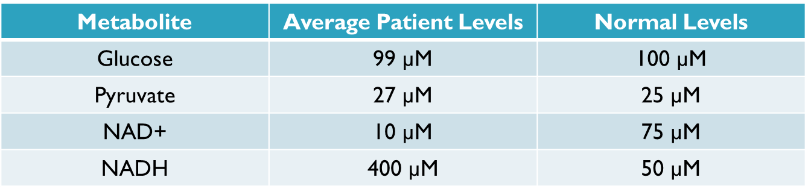
Case Study
Part III – cont.
For each metabolite listed in the table, describe its role in cellular respiration? Are they substrates or products? What is their main function?
Are there any abnormalities in the levels of these metabolites in the victims? Develop a hypothesis about which pathway may be affected based on these abnormalities?
Explain the reasoning for your hypothesis with your neighbor.

Slide 30
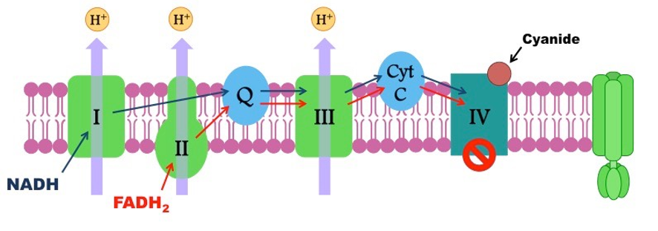
Case Study
Results
  The Tylenol was laced with cyanide. Cyanide binds to the last membrane protein in the electron transport chain preventing the electron from binding with oxygen, causing the electron transport chain to shut down. If the electron transport chain doesn’t function, then very little ATP is produced, and the cells can’t function.

Slide 31
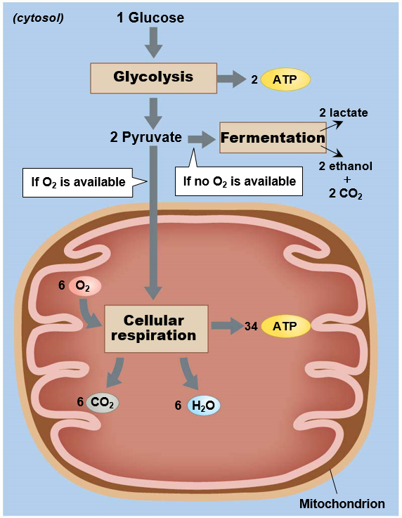
Aerobic and Anaerobic Pathways
Anaerobic: without the use of oxygen
  Glycolysis
  Fermentation
Aerobic: with the use of oxygen
  Cellular respiration
Notes:
Since cellular respiration requires oxygen it is considered an aerobic process, but ATP can still be produced in the absence of oxygen through an anerobic pathways known as fermentation.

Slide 32
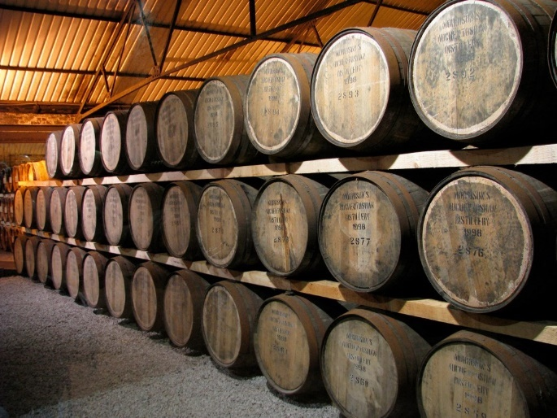
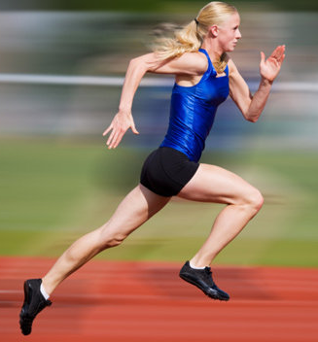
Anaerobic Pathway
Fermentation: metabolic pathway that regenerates NAD+ from NADH and allows for glycolysis to continue making ATP in the absence of oxygen
Alcohol fermentation
  Yeast in anaerobic environment
Lactic acid fermentation
  Occurs in animals when ATP use exceeds oxygen uptake

Slide 33
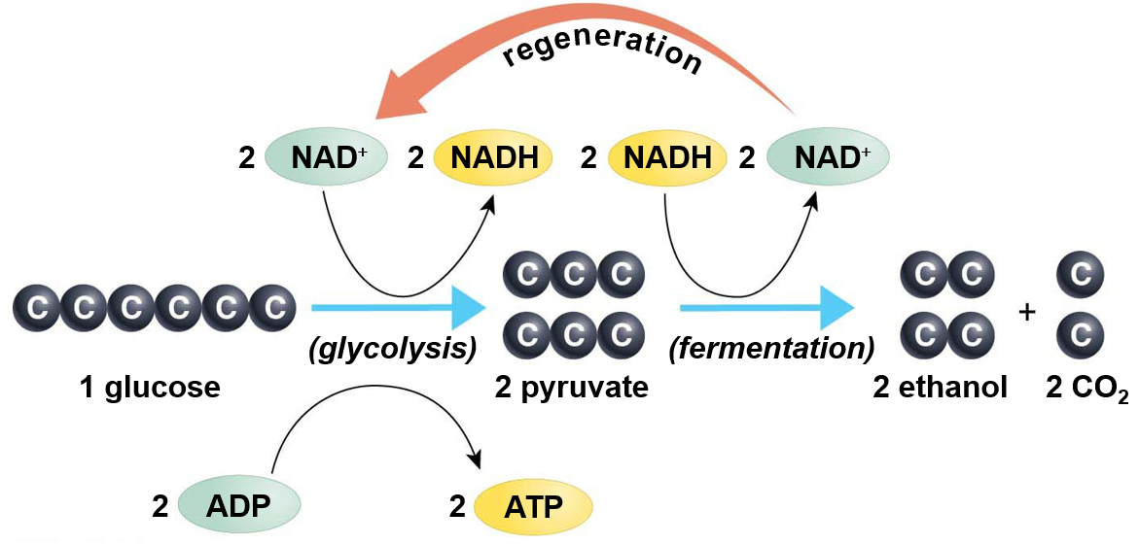
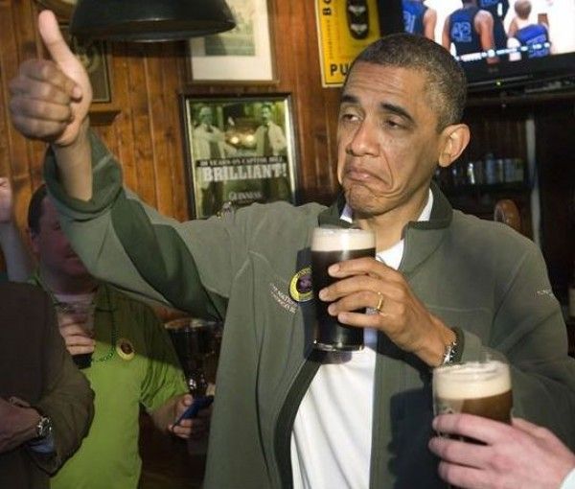
Alcohol Fermentation
Ethanol (drinking alcohol) is produced when acetaldehyde (pyruvate derivative) accepts electrons from NADH
Notes:
Alcohol fermentation occurs when yeast (fungus) grows in an anaerobic environment (bread dough or barrel of grape juice) and uses glycolysis to make energy, converting pyruvate to acetaldehyde. Acetaldehyde accepts electrons from NADH making ethanol as a by product. CO2 by product causes bread to rise and bubbles in champagne or beer.

Slide 34
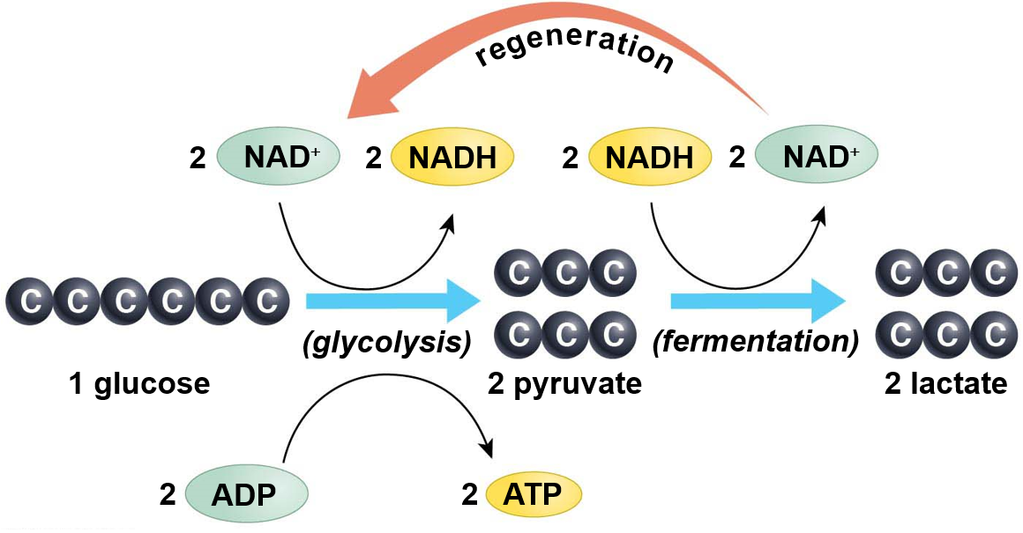
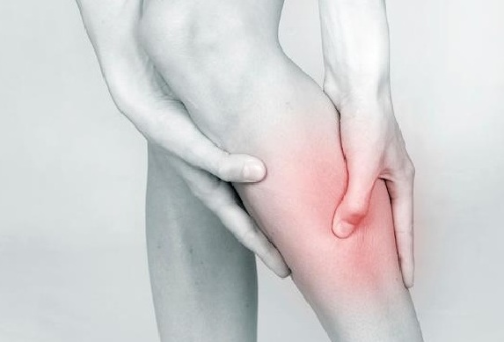
Lactic Acid Fermentation
Lactic acid is produced when pyruvate accepts electrons from NADH
Occurs when oxygen delivery to cells is lagging
  Causes burning in muscles
Notes:
Fermentation is an alternative mode of energy production when oxygen supplies temporarily run out. Lactic acid fermentation occurs when energetic output (long sprint) exceeds lungs ability to uptake oxygen

Slide 35
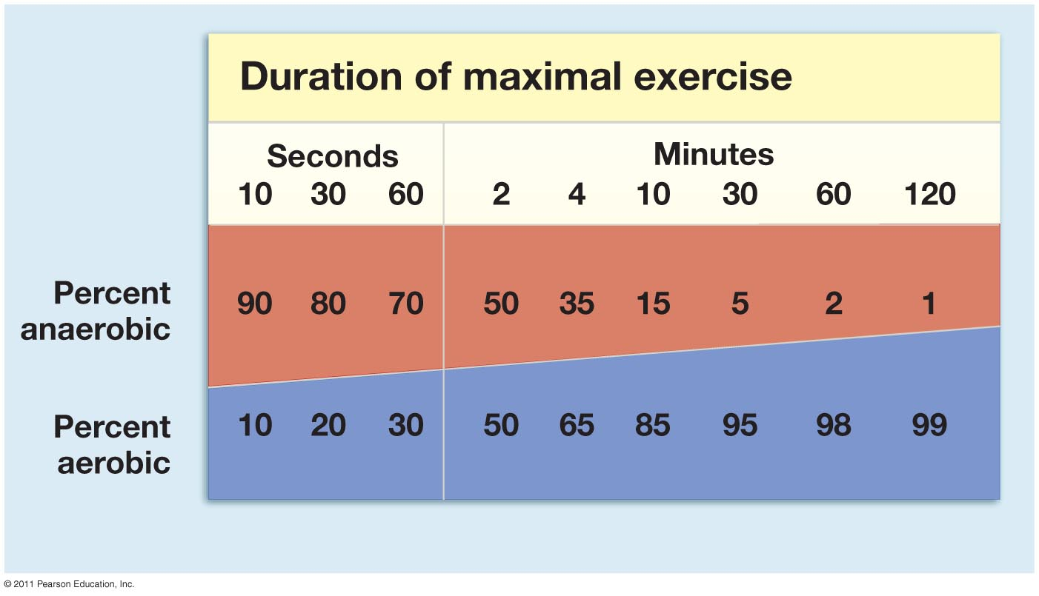
Anaerobic and Aerobic Contributions
Energy from anaerobic respiration is used for short bursts of activity
Notes:
If you were to start running right now, there wouldn’t be enough oxygen in your blood to accept all the electrons at the end of the electron transport chain as your body tries to make ATP to power your running. Your body takes about a minute before it starts breathing fast enough and deep enough to get oxygen to all your cells. For the first minute or so your body relies on fermentation (anaerobic) until your breathing can catch up and get oxygen to your cells.

Slide 36
Check Your Understanding
1. True or False: When NAD+ accepts an electron from a hydrogen it has been reduced
2. True or False: Oxygen is required to make ATP
3. True or False: Cellular respiration is considered an endergonic reaction because it releases energy

Slide 37
Check Your Understanding
3. Which of the following steps produce the most electron carriers?
a. Glycolysis
b. Transition phase
c. Krebs cycle
d. Electron transport chain

Slide 38
Check Your Understanding
4. How much ATP is produced as one glucose molecule moves through the Krebs cycle?
a. 1 ATP
b. 2 ATP
c. 4 ATP
d. 32 ATP

Slide 39
Check Your Understanding
5. Which of the following best describes the function of the electron transport chain?
a. Transfer electrons on to NAD⁺ to make NADH
b. Breakdown glucose into pyruvate
c. Use energy from electrons to power the active transport of hydrogen ions
d. Use the energy from electrons to attach phosphate groups to ADP

Slide 40
Check Your Understanding
6. Which of the following best describes oxygens role in the cellular respiration?
a. Byproduct of the Krebs cycle and transition phase
b. Used to break down the glucose molecule
c. Accepts the electron at the end of the electron transport chain
d. Donates a phosphate group to ATP

Slide 41
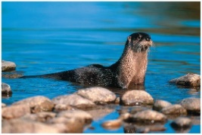
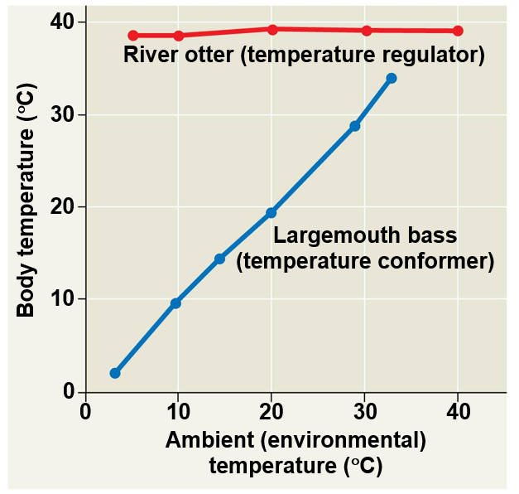
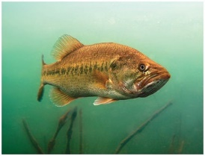
Homeostasis
Homeostasis: a physiological state where internal conditions are stable and constant
Regulators: use internal mechanisms to control external fluctuations
Conformers: allow internal conditions to change in response to external fluctuations
Notes:
Audio transcript: Animals strive to maintain relatively constant internal environments, because it allows for more efficient chemical reactions and physiological processes. Some animals are considered regulators because the actively regulate their internal temperature to keep it relatively constant. Other animals are considered conformers because they allow they body temperature to change with the temperature of the environment.

Slide 42
Thermoregulation
Thermoregulation: Process by which animals maintain their body temperature within a normal range
Endothermic: body temperature maintained by metabolic heat
  Birds, mammals, and some insects
Ectothermic: body temperature controlled by external sources
  Most reptile, fish, and invertebrates
Poikilotherm: animals whose body temperature fluctuates with the environment.
Homeotherm: animals with a relatively constant body temperature
Notes:
Animals can either maintain their own body temperature using their own metabolic heat generated though cellular respiration (endotherms), or they can allow their body temperature to be controlled by the temperature of the external environment (ectotherms). Some animals maintain a constant body temperature (homeotherms) while others allow their body temperature to fluctuate (poikilotherm).

Slide 43
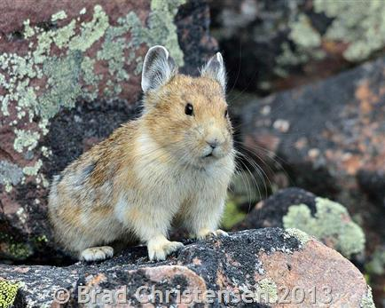
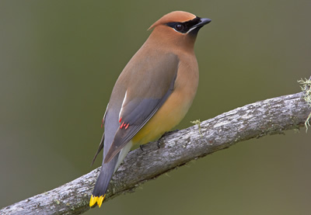
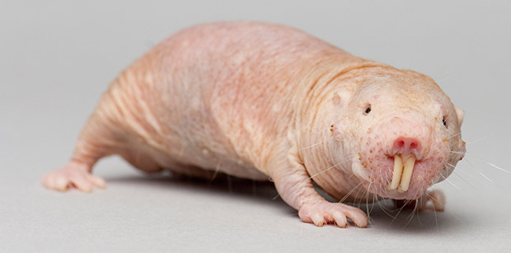
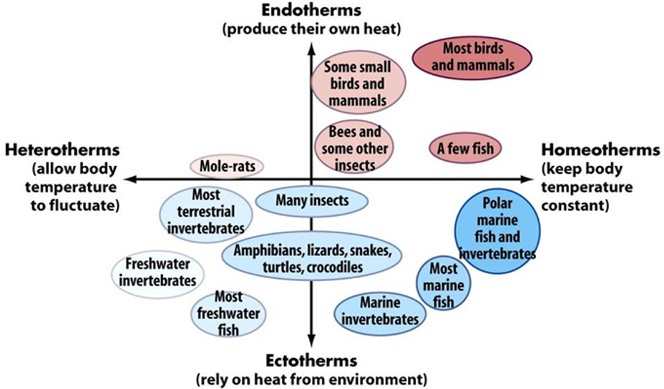
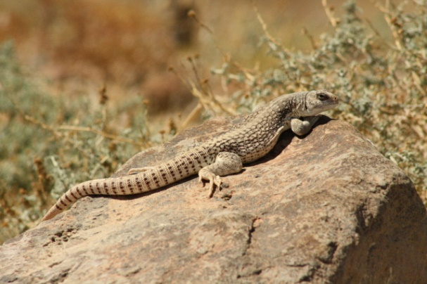
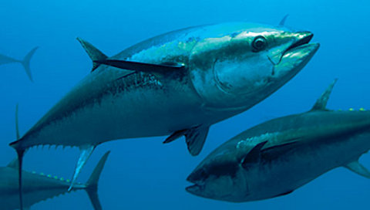
Variation in Thermoregulatory Strategies
Poikilotherms
Notes:
Birds and mammals are considered endothermic homeotherms, whereas most reptiles and amphibians are considered ectothermic poikilotherms.

Slide 44
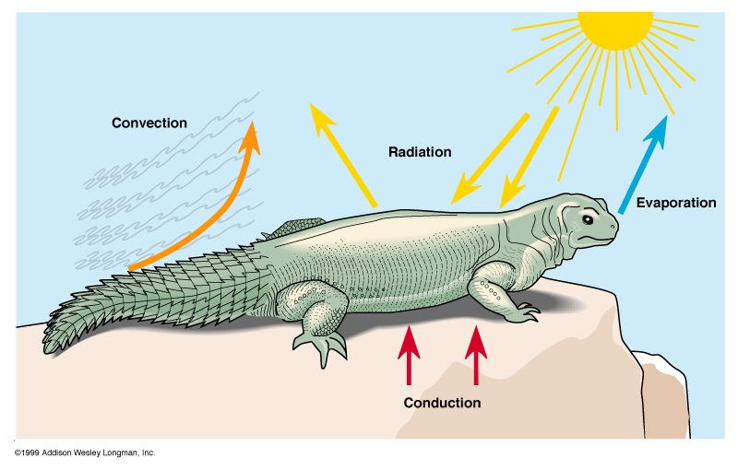
Heat Exchange with Environment
Conduction - direct transfer of heat
Convection - transfer of heat by the movement of air or water across a surface
Radiation - emission of electromagnetic waves
Evaporation - loss of heat from changing a liquid into a gas
Notes:
Heat can be gained or lost through different mechanisms.

Slide 45
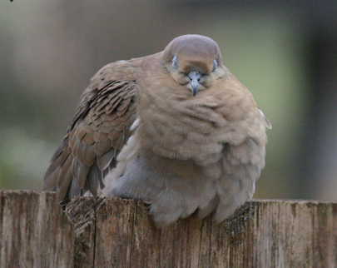
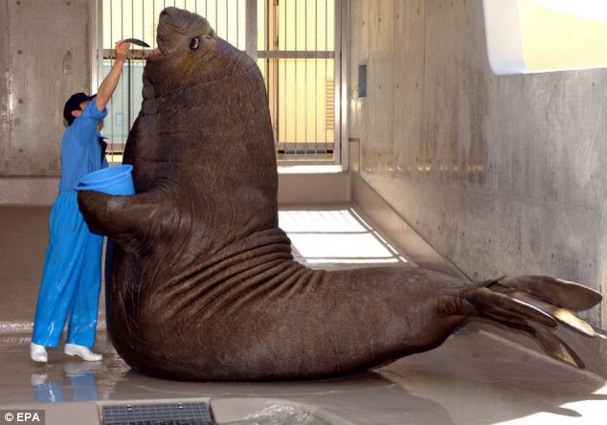
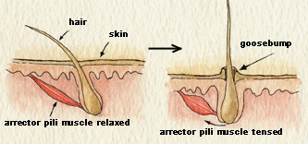
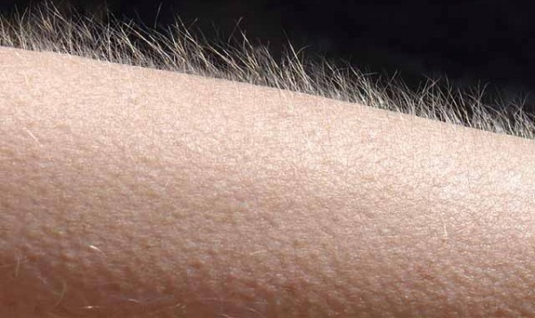
Adaptations for Thermoregulation
Insulation
  Hair
  Feathers
  Fat (blubber)

Slide 46
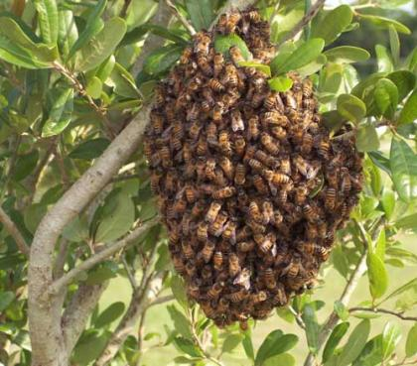
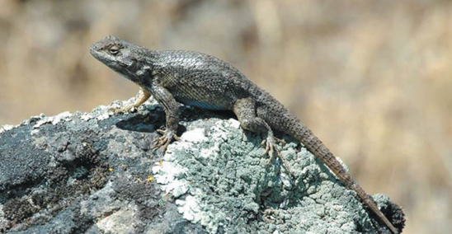
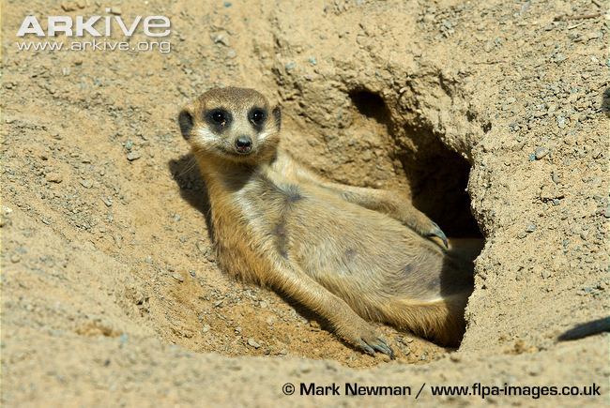
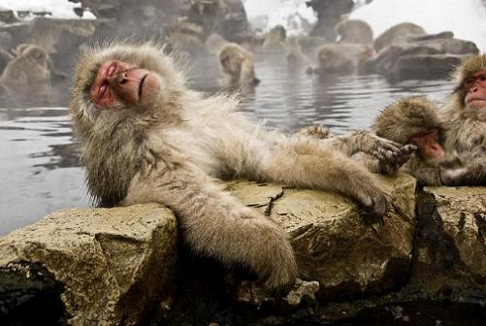
Adaptations for Thermoregulation
Behavior Responses
  Basking
  Huddling
  Burrowing
  Hot tubbin’

Slide 47
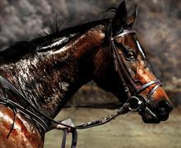


Adaptations for Thermoregulation
Evaporative heat loss
  Sweating
  Panting
  Defecating

Slide 48



Energy Conservation
Torpor: physiological state of decreased activity and metabolism
  Hibernation: long term torpor and a decreased body temperature in response to winter cold and food scarcity
  Estivation: decreased metabolic rate and activity during hot summer months
Notes:
Metabolic rates can be 20 times lower during hibernation

Slide 49



Adaptations for Thermoregulation
Vasodilation: the widening of superficial blood vessels
  Increases heat transfer
Vasoconstriction: decreasing the diameter of superficial blood vessels

Slide 50


Adaptations for Thermoregulation
Counter-current heat exchange
Warm blood in arteries from animals core comes in close contact with veins returning from extremities
Blood in arteries remains slightly warmer than blood in veins resulting in heat transfer
Returning blood almost as warm as arterial blood
Notes:
In order to preserve heat in the animal's core, many animals have evolved counter-current heat exchange in their extremities. Counter current exchange is the transfer of heat between fluids flowing in opposite directions.

Slide 51

Negative Feedback Loops
Notes:
Similar to the negative feedback loop that we learned for blood glucose, our bodies make adjustments to maintain a constant body temp. A negative feedback is when a change in a variable triggers a response that counteracts the initial change.

Slide 52

Animal Diets
All animals are heterotrophic:
  Herbivores
  Carnivores
  Omnivores
  Insectivores
Three nutritional needs:
Chemical energy for cellular processes
Organic building blocks for macromolecules
Acquisition of essential nutrients
Notes:
Animals are heterotrophic, which means they must consume other organisms for their energy. The chemical energy in food including carbohydrates, lipids, and proteins,
is used to produce ATP, as we learned earlier.

Slide 53




Trade-offs of Thermoregulatory Strategy
=
=
Notes:
Audio transcript: Endotherms and ectotherms have different costs associated with their thermoregulatory strategy. Endotherms can exhibit high energy activity any time, but that activity requires energy from food, so endotherms must constantly eat to maintain a high level of energetic output. Endotherms also require lots of food energy just to generate the metabolic heat that keeps their body temperature constant. The plus side is that endotherms can be active day or night, warm or cold, and can live in nearly any environment on Earth.
Ectotherms have a much lower metabolism because they are not relying on metabolic heat to maintain a constant body temperature. Their lower metabolic rate means they don’t need to eat near as often as endotherms, but they also have much lower energetic output. Ectotherms rely on the temperature of the external environment to stimulate their metabolism and thus energy acquisition. Under cold conditions, ectotherms don’t produce much energy because their metabolic rate is so low. This means that ectotherms are sluggish and slow when its cold.

Slide 54


Trade-offs of Thermoregulatory Strategy
Notes:
These maps compare the numbers of bird and reptile species living at the different latitudes in the United States. As you get to the higher latitudes there are very few species of reptile living in those colder environments. I always joke that if you don’t like snakes move to Canada. Birds are endothermic so they can and do live in all environments on Earth. Even though there are more birds in warmer climates, there are still between 70 and 100 bird species in the colder, northern latitudes.

Slide 55

Trade-offs of Thermoregulatory Strategy
Do smaller mammals have higher or lower mass-specific metabolic rates than larger mammals? Why?
Smaller endotherms have a greater surface area to volume ratio
Lose heat to the environment
Must consume more energy to maintain a constant body temperature
Notes:
Audio transcript: When we consider endothermic animals and more specifically mammals, the size of the mammal plays an important role in their metabolic rate. Just like cells, the smaller the mammal the more surface area they have in relation to their volume. The more surface area a mammal has the more heat it is losing to its environment. Larger animals with more volume are able to conserve more heat in their core. Small mammals like mice are constantly losing heat so they require a lot more food energy to keep warm. The smallest mammal is called a pygmy shrew and it has to eat every 30 minutes or it will die.

Slide 56
Trade-offs of Thermoregulatory Strategy
What are some of the pros and cons of each thermoregulatory strategy?
 | Endotherms | Ectotherms
Pros
Cons

