Slide 1
Biogeography and Human Impacts
“Here is your country. Cherish these natural wonders, cherish the natural resources, cherish the history and romance as a sacred heritage, for your children and your children's children. Do not let selfish men or greedy interests skin your country of its beauty, its riches or its romance.” ― Theodore Roosevelt
“Only when the last tree has died and the last river been poisoned and the last fish been caught will we realize we cannot eat money”
-Cree Indian Proverb

Slide 2
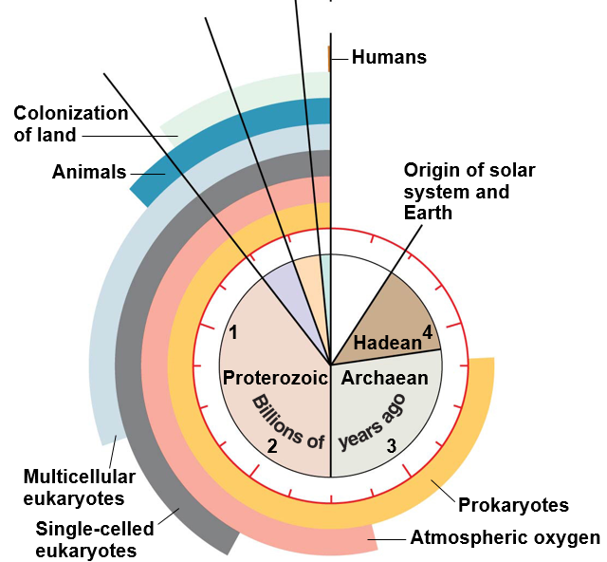
History of Life on Earth
Prokaryotes ~3.5 bya
Stromatalites for 1.5 billion years
Atmospheric Oxygen ~2.7 bya
Photosynthetic bacteria5
Multicellular eukaryotes ~2.0 bya
Endosymbiosis of prokaryotes
Soft bodied animals
Animals ~550 mya
Cambrian explosion
First predators
Colonization of land ~500 mya
Plants with mycorrhizae
Arthropods ~450 mya
Humans ~6-7 mya
Mesozoic
Cenozoic
Paleozoic
Notes:
Atmospheric oxygen likely killed many early prokaryotes but let to cellular respiration.
Humans = 0.2 seconds of

Slide 3
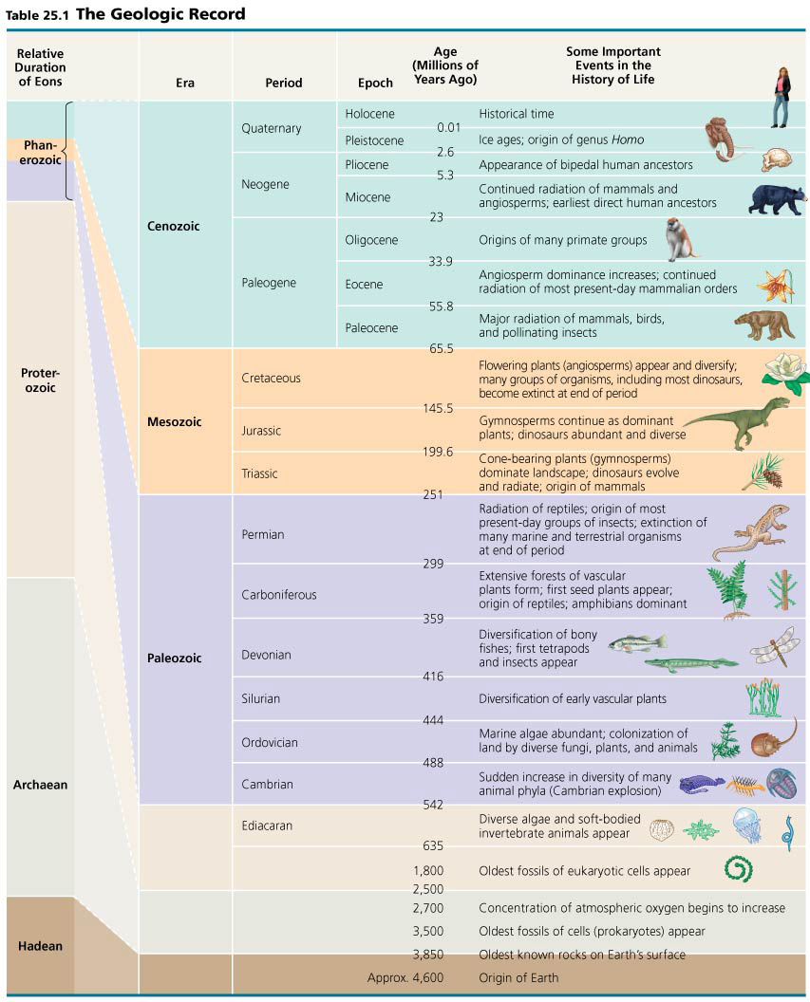
Geologic Timescale
Geologic record divided into Eons, Eras, Periods, and Epochs
Divisions between eras correspond to mass extinction events

Slide 4
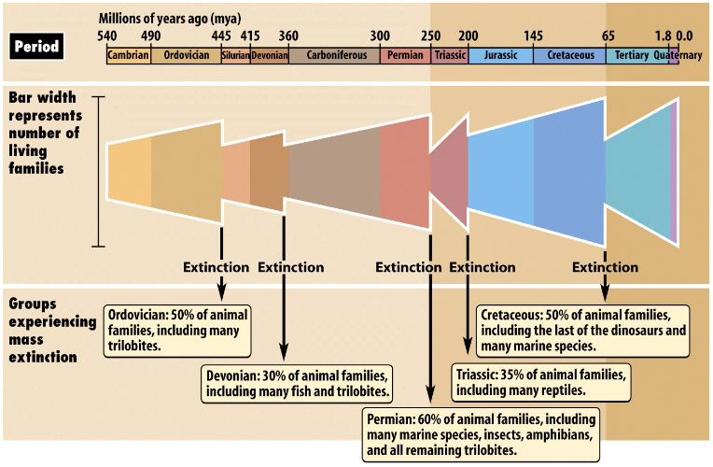
History of Mass Extinction Events
______ mass extinction events on earth
_________ are currently causing the sixth mass extinction event
Permian extinction event was the largest with a loss of 96% of all species
Cretaceous extinction led to the loss of the ___________ 65 mya

Slide 5
K-T Boundary (Cretaceous-Tertiary)
Chicxulub Crater - Caribbean Sea near the Yucatan Peninsula of Mexico
Notes:
Iridium deposits suggest reason for Cretaceous extinction
Block out sun for months

Slide 6
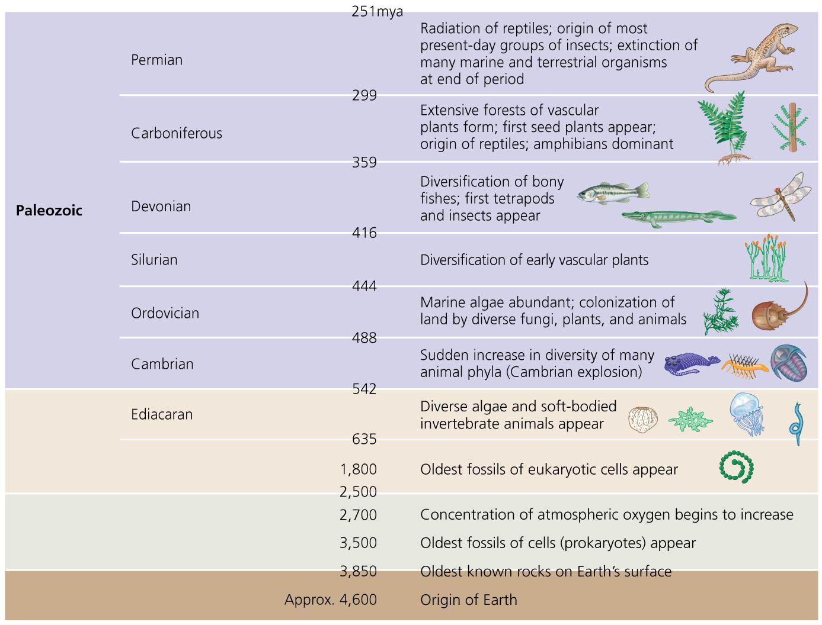
Geologic Timescale
Precambrian Era (4.6 bya – 542 mya)
90% of all time on Earth
First prokaryotes and eukaryotes
Soft bodies animals and algae at end of era
Paleozoic Era (251 mya – 542 mya)
Most animal phyla during Cambrian Period
Cambrian explosion ~500mya
Vascular plants dominant terrestrial environments
Fish diversity and first tetrapods in Devonian Period
Amphibians and reptiles dominate

Slide 7
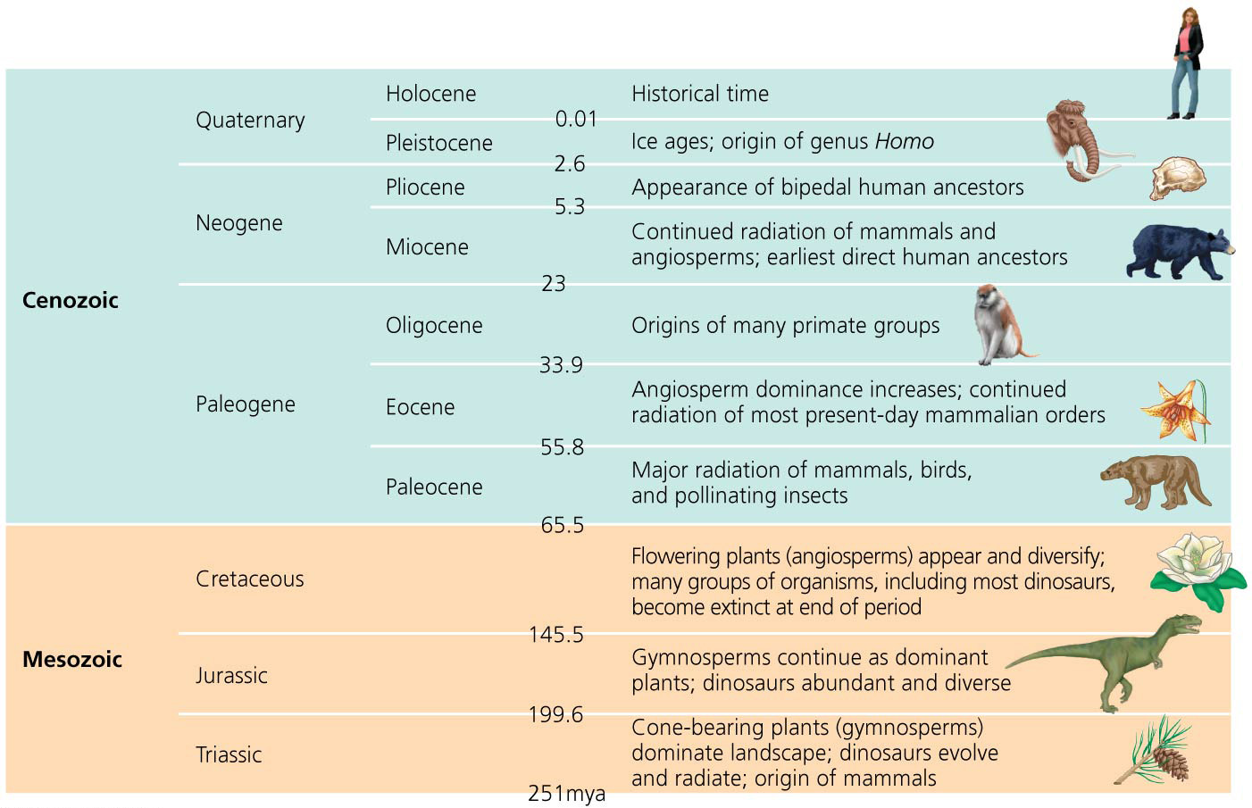
Geologic Timescale
Mesozoic Era (251 mya – 65 mya)
Gymnosperms dominate
Dinosaurs dominant
Angiosperms begin to diversify
Cenozoic Era (65 mya – Present)
Mammals radiate with loss of dinosaurs
Angiosperms dominate
Human ancestors diverge

Slide 8
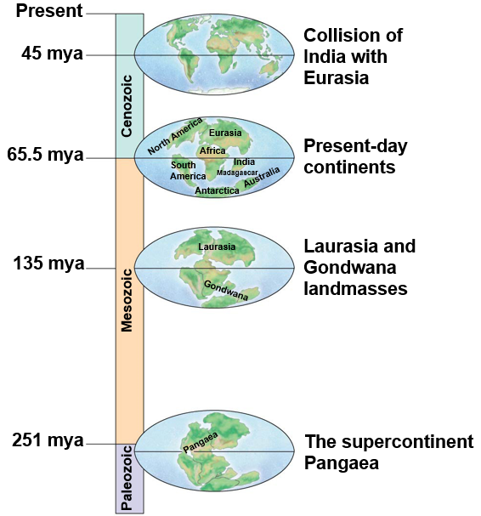
Earth’s History
Changes in climate and habitats on Earth
Pangaea (245 mya)- supercontinent
Deep oceans drained shallow seas
Pangaea began to break up (180 mya)
Laurasia
Europe, Asia and North America
Gondwana
Africa, Madagascar, South America, India, Australia, Antarctica

Slide 9
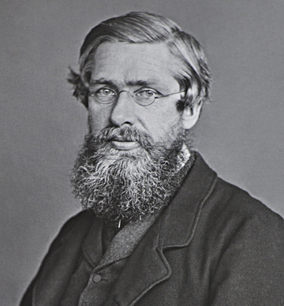
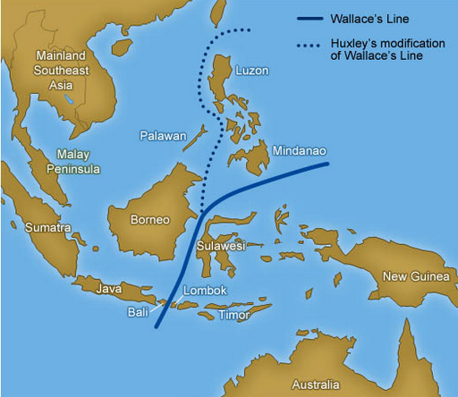
Biogeography
Biogeography: study of past and present geographic distributions of species through geologic time
Alfred Russel Wallace
Wallace’s line: separation of biogeographic regions in Malayan Archipelago based on wildlife distributions
Notes:
Why species are where they are.

Slide 10
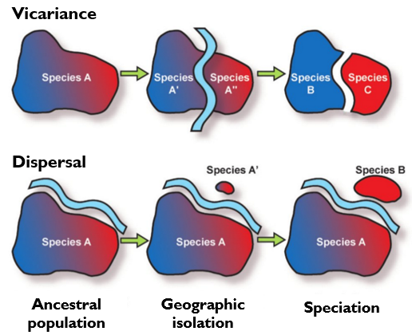
Vicariance vs. Dispersal
Vicariance: splitting of an organisms native range through the ________________ to gene flow
Dispersal: movement of organisms to locations outside of their native range

Slide 11
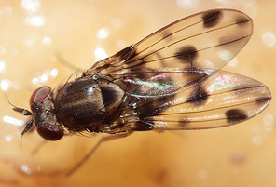
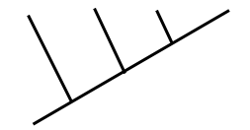
Biogeography: Dispersal
Drosophila dispersed as islands formed in the Hawaiian Archipelago
Older Island
Younger Island
More ancient lineage
More recent lineage
D. glabriapex
D. pilimana
D. vesciseta
D. conspicua

Slide 12
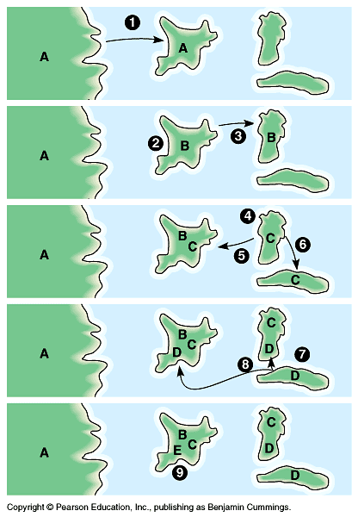
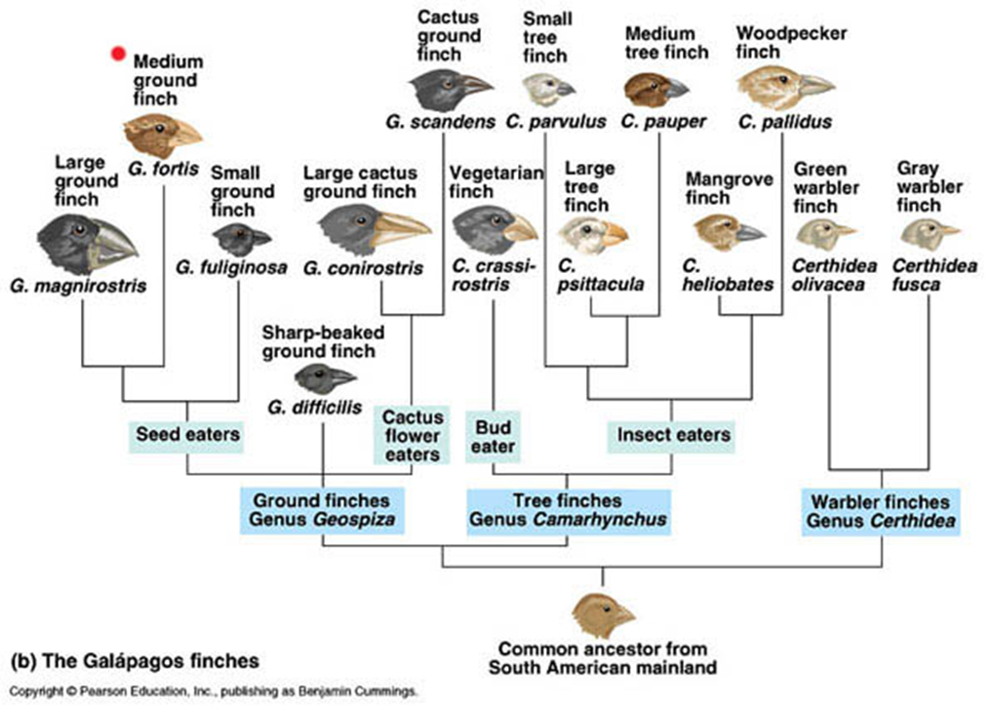
Biogeography: Dispersal on Islands
Adaptive radiation of Galapagos finches likely due to dispersal between islands in Galapagos archipelago

Slide 13
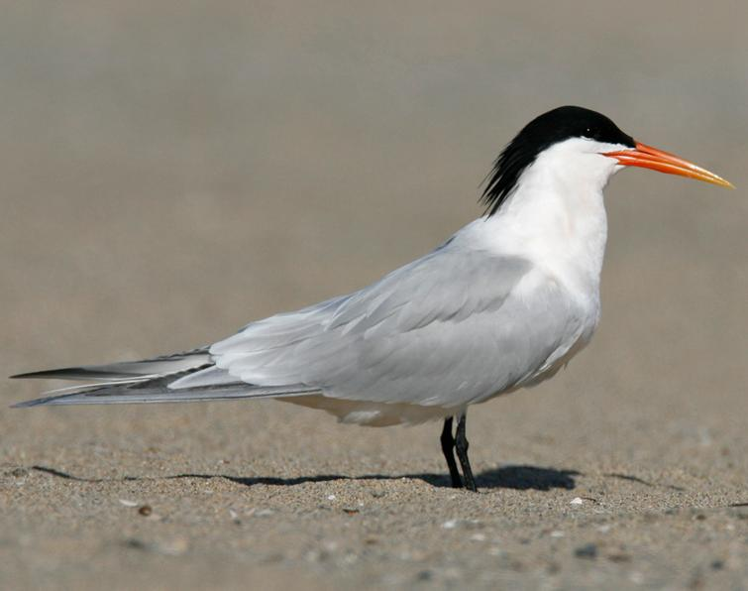
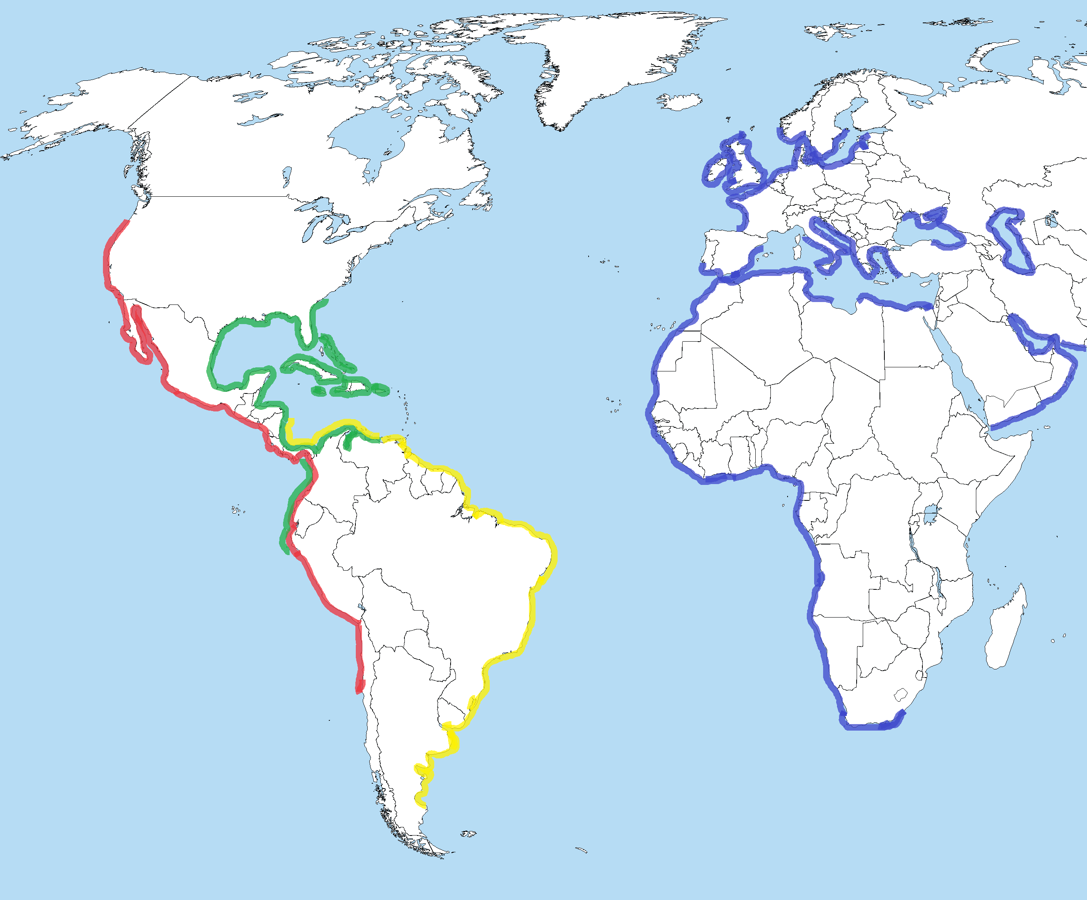
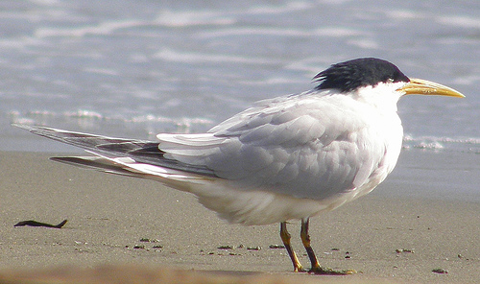
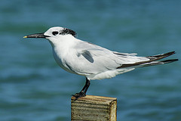
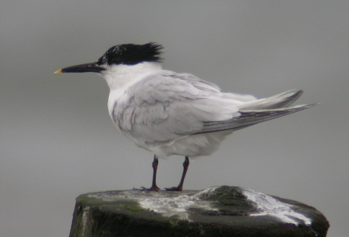
= Elegant tern
= Cabot’s tern
= Cayenne tern
= Sandwich tern

Slide 14
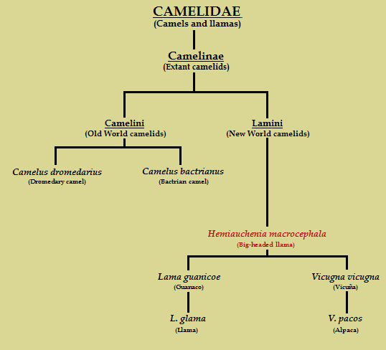
Biogeography of Camelidae: Dispersal

Slide 15
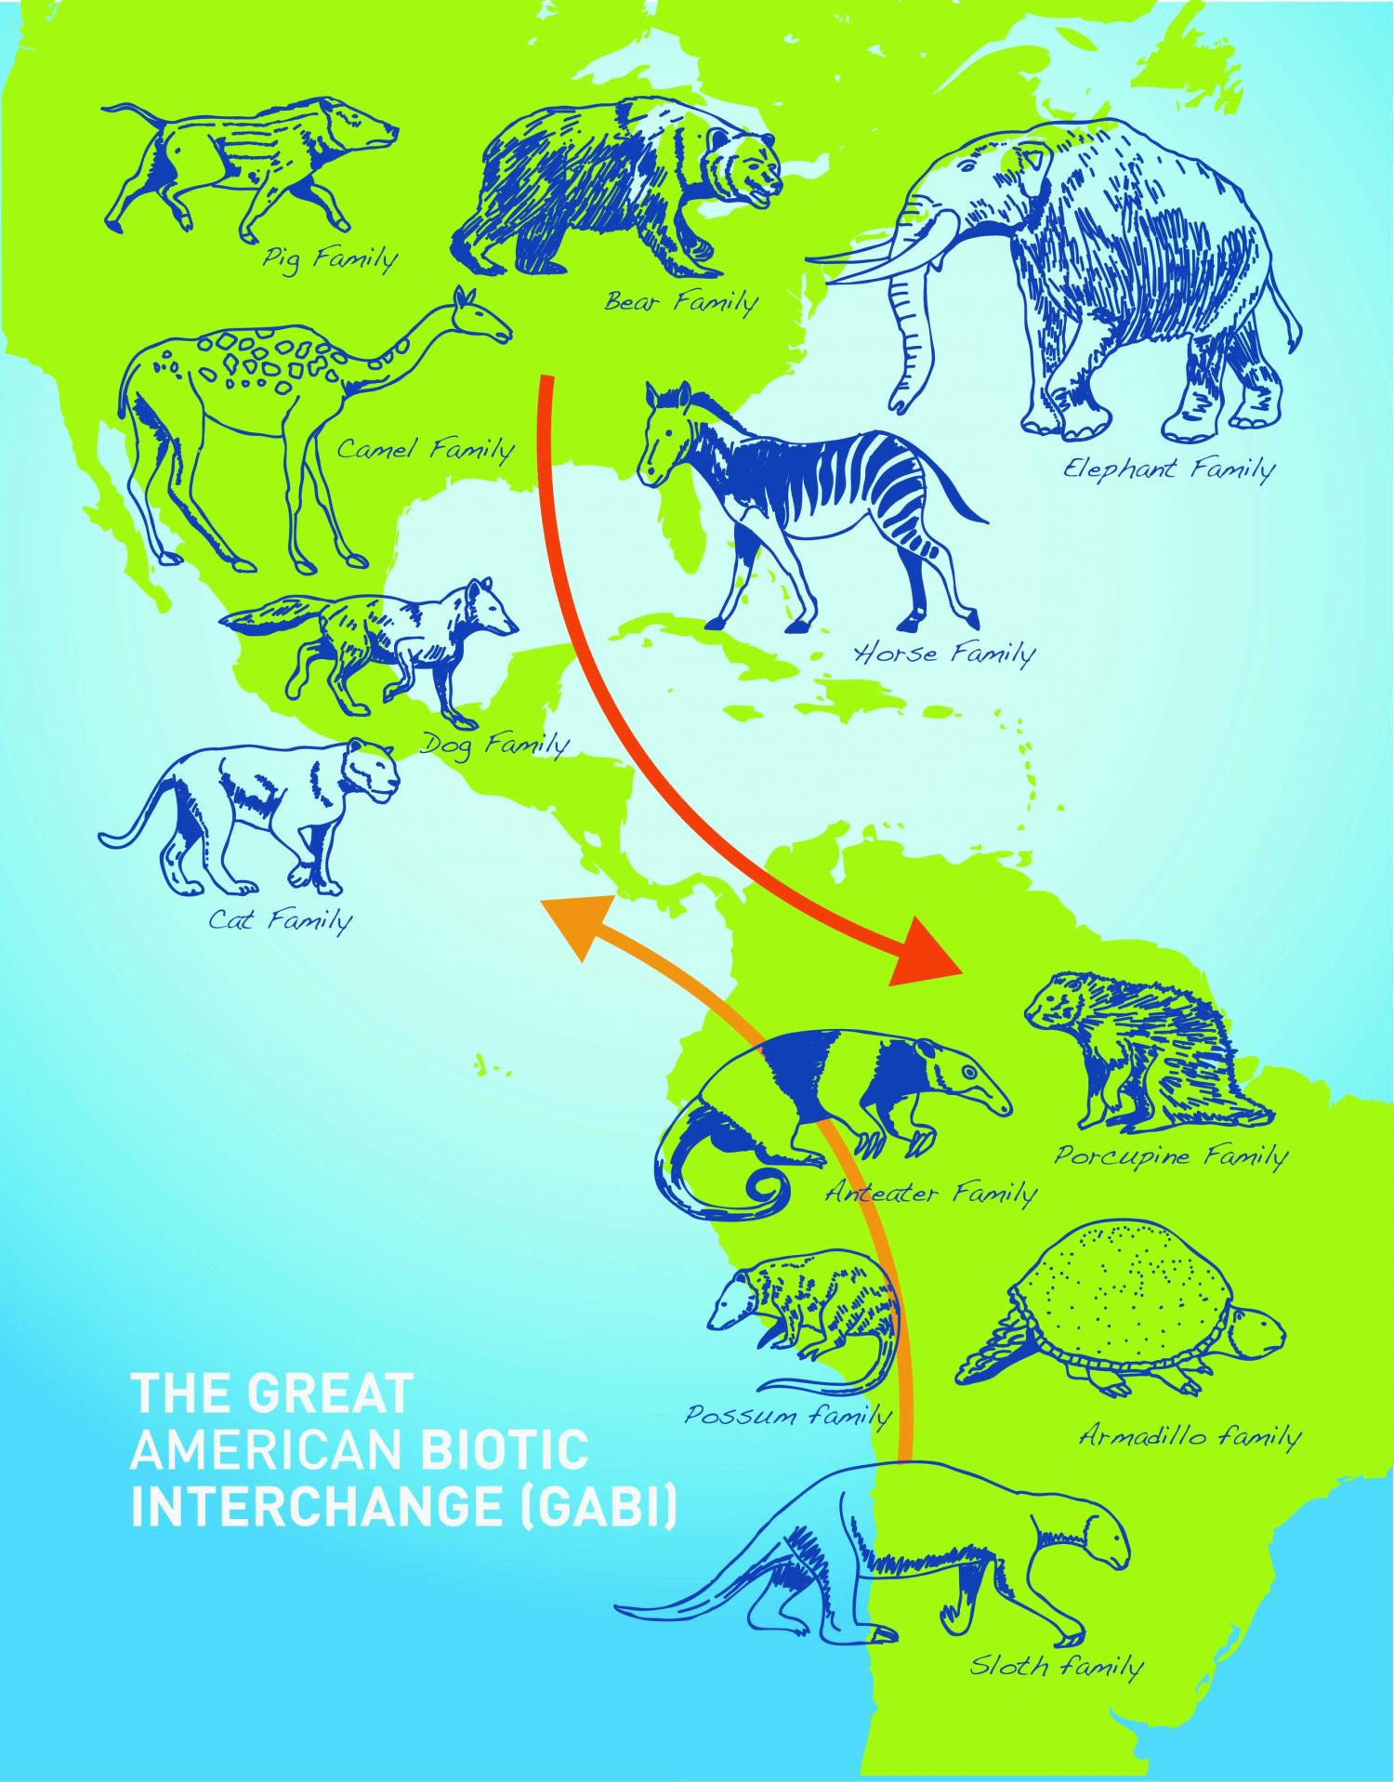
Biotic Interchange
Biotic interchange: when barrier between previously separated biotas breaks down, resulting in drastic changes to biodiversity
Great American Biotic Interchange
Isthmus of Panama connected North and South America
Heading south: Bear, Cat, Camel, Horse, Elephant, Dog and Pig families
Heading north: Anteater, Porcupine, Armadillo, Sloth, and Possum families
Notes:
North American carnivores led to extinction of many South American animals.

Slide 16
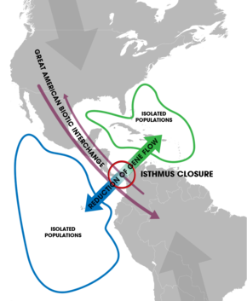
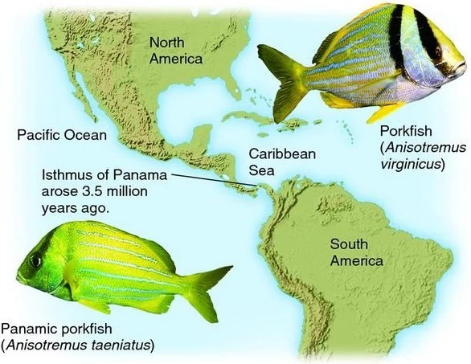
Biogeography: Vicariance
Connection of North and South America at the Panama isthmus led to the vicariance of the pork fish populations.

Slide 17
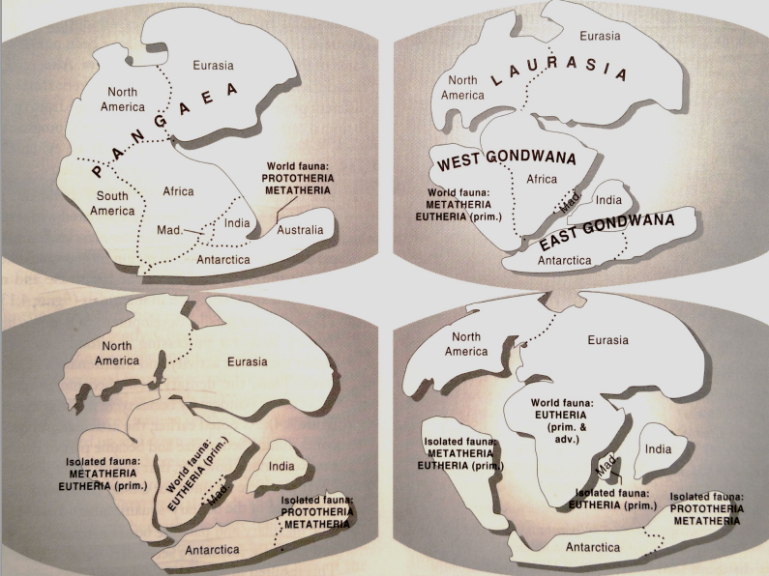
Biogeography of Mammals: Vicariance
Early Jurassic
(~ 200 mya)
Monotremes and marsupials in southern Pangaea
Late Jurassic (~ 180 mya)
Eutheria diverge from Marsupials in “South America”
Early Paleocene (~ 65 mya)
Dinosaurs extinct
Mammal radiation
Eutheria northern distribution
Early Cretaceous (~ 135 mya)
Marsupials and monotremes isolated in “Australia”
Marsupials isolated on “South America”
Notes:
Distribution of monotremes
Lemurs on Madagascar
New

Slide 18
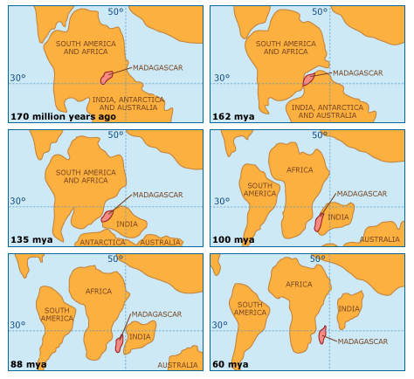
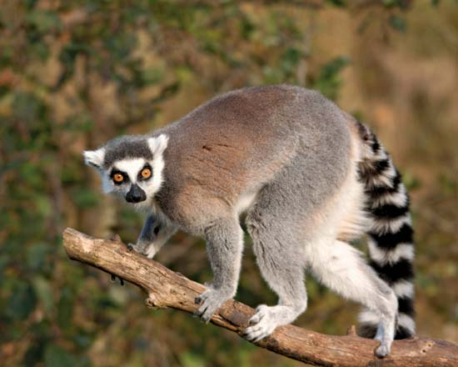
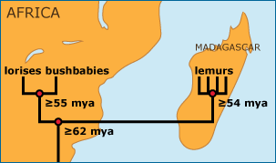
Biogeography: Vicariance
Lemurs are only found on Madagascar
Madagascar separated from Africa then India as Gondwana broke up
Lemurs closet living relatives are on Africa

Slide 19
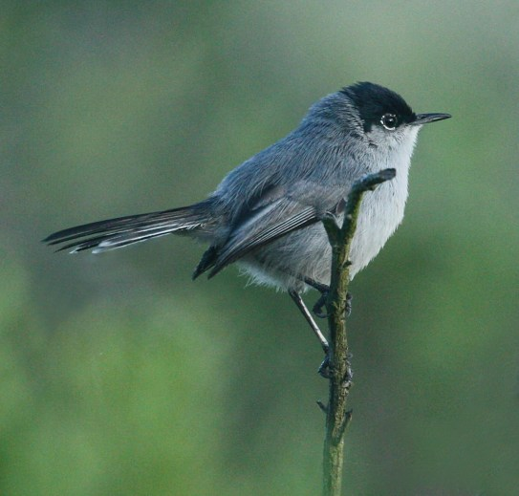
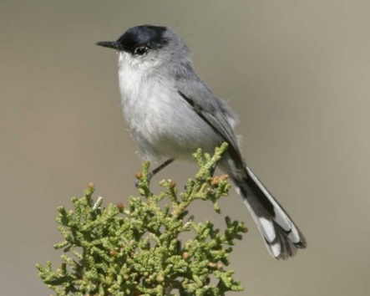
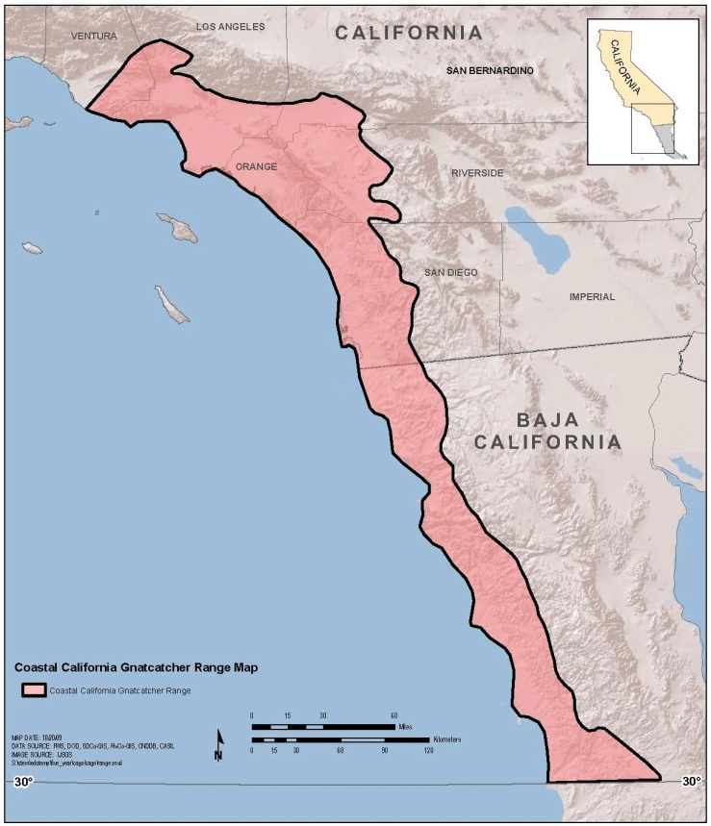
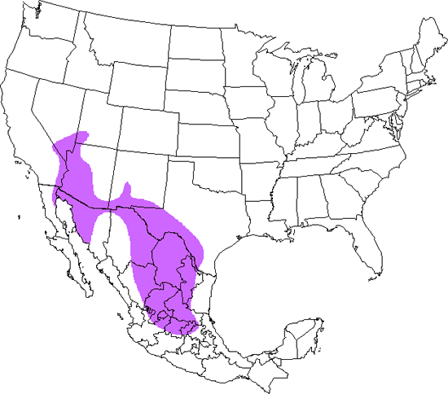
Biogeography or Gnatcatchers: Dispersal or Vicariance?
← California gnatcatcher
Black-tailed gnatcatcher →
Notes:
Coastal mountain range and Mojave desert separate sister species

Slide 20
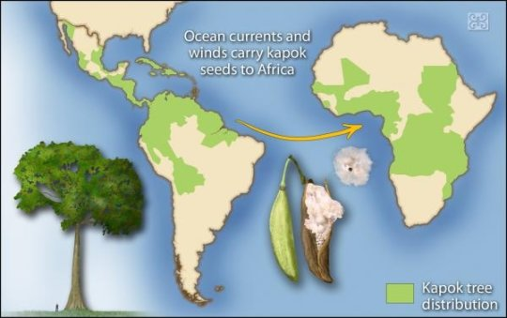
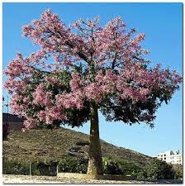
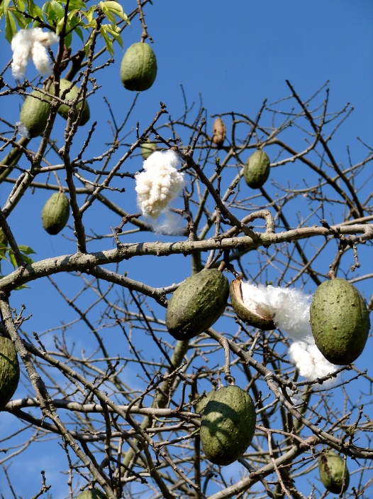
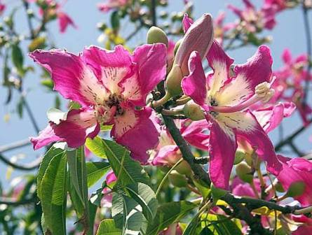
Biogeography of Kapok Tree: Dispersal or Vicariance?
African and Neotropic distribution
Low level of genetic divergence between populations
Long distance dispersal supported

Slide 21
Biodiversity
Biological diversity or biodiversity: the variety of plants and animals, or other living things, in a particular area or region
Why is it important?
Extrinsic value: The value to humans, ecosystem services
Provisioning services: we need it for food, medicine or industrial uses
Cultural services: we like the way it looks, spiritual value
Regulating services: decomposition and pest control
Habitat services: produces oxygen (photosynthesis), nutrient cycling
________________: The worth of an entity independent from external circumstances or its value to human
Value to biodiversity
Notes:
40% of all prescriptions are for medicines that originated from plants and animals.
80,000 species of edible plants known on Earth, but 90% of the world’s food comes from a mere 20 of these species.
Since 2000, 53 new species of primates have been described (IUCN 2008) including a new species of Brazilian monkey, Mura’s saddleback tamarin.

Slide 22
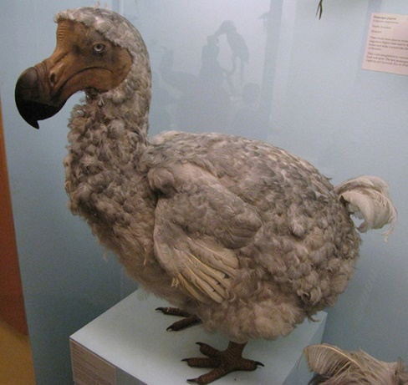
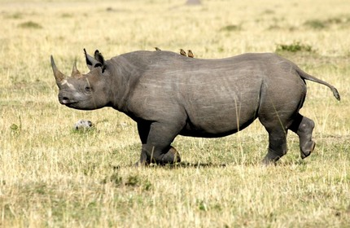
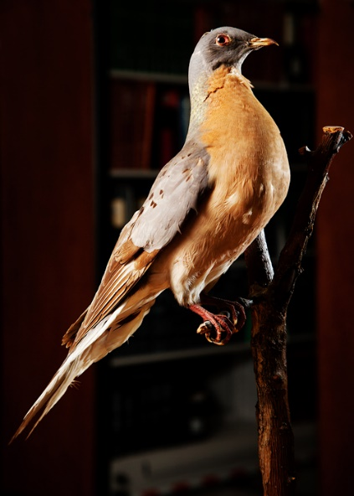
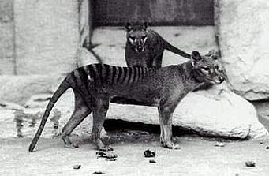
Loss of Biodiversity
Human caused mass extinction event
1,000 to 10,000 times greater than natural extinction rates
Six mass extinction since evolution of life
Worst since extinction of dinosaurs
___________ under the greatest threat
40% at risk of extinction
Indicator species
Thin skin makes them susceptible to toxins
Live in both aquatic and terrestrial environments
___% of primates are endangered
Palm oil and orangutans
Most _____________ are threatened or endangered
Notes:
Human destruction and human influenced changes exceed conservation and preservation
Passenger pigeon: “One flock in 1866 in southern Ontario was described as being 1 mi (1.5 km) wide and 300 mi (500 km) long, took 14 hours to pass, and held in excess of 3.5 billion birds.”
Habitat loss (deforestation of east) and hunting
Last one died in 1914

Slide 23
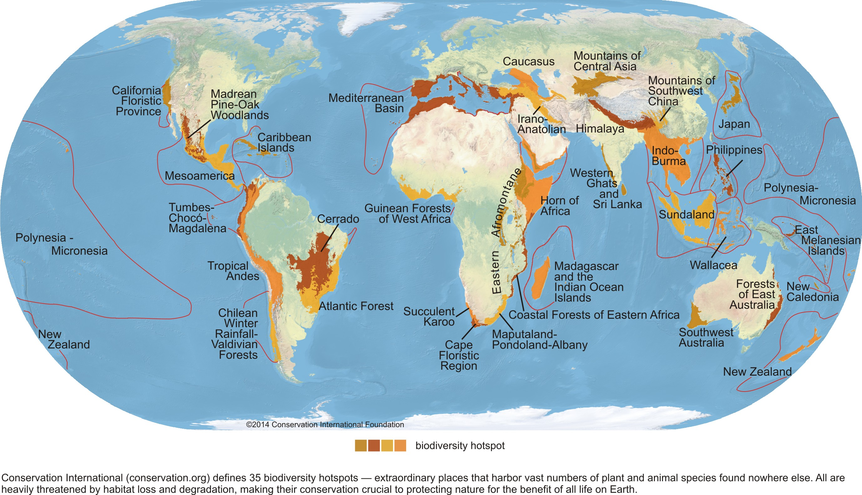
Biodiversity Hotspots
Requirements
At least 1500 endemic plant species
________: species found only in a distinct geographic area
70% loss of original habitat
35 areas around the world
Support nearly 60% of all plant and animal species
California Floristic Province
Notes:
Endemic species: a species that is only found in a distinct geographic area

Slide 24
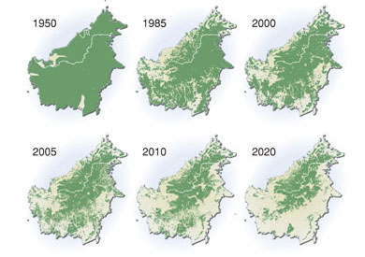
Human Impacts on Biodiversity
Habitat loss: the conversion or transformation of a natural area into wholly human occupied area of little or no use to wild species
__________ threat to biodiversity
Mostly caused by expansion of agricultural land
___% of species listed as either threatened or endangered due to habitat loss
Palm tree plantations in Borneo

Slide 25
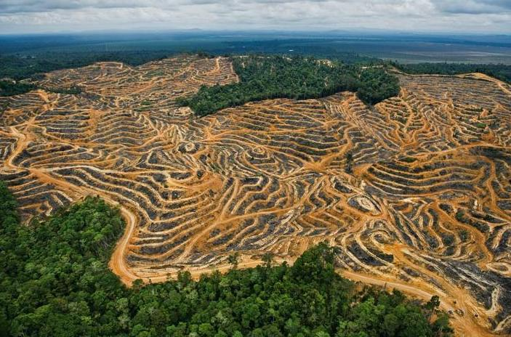
Human Impacts on Biodiversity
_______________ the clearing of forests and the conversion of the land for non-forests use
Slash and burn
Causes:
48% due to subsistence farming
32% due to commercial agriculture
14% due to logging
5% used as wood for fuel
Consequences:
Less oxygen
Less water
Land slides

Slide 26
Succession in Communities
Succession: a series of replacements of community members at a given location until a relatively stable final state is reached
Primary succession: succession in which the starting state is one of little or no life and a soil void of nutrients.
Glaciers, floods, volcanic eruptions and landslides
Pioneering species: hardy species that are the first to colonize disturbed ecosystems
Secondary succession: succession in which the final stage of the habitat has been disturbed, but life remains and the soil has nutrients
Fires or logging
Climax community: an ecological community in the final stage of succession in which the species composition remains relatively stable
Notes:
Not all environments progress into dense forests. Each habitat has its own climax community

Slide 27
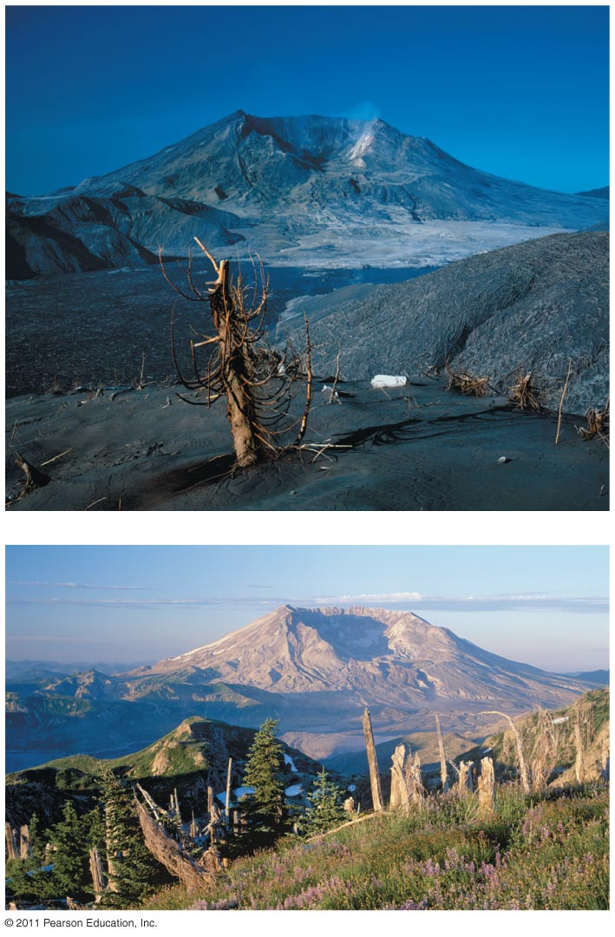
Habitat Succession
1980
1998

Slide 28
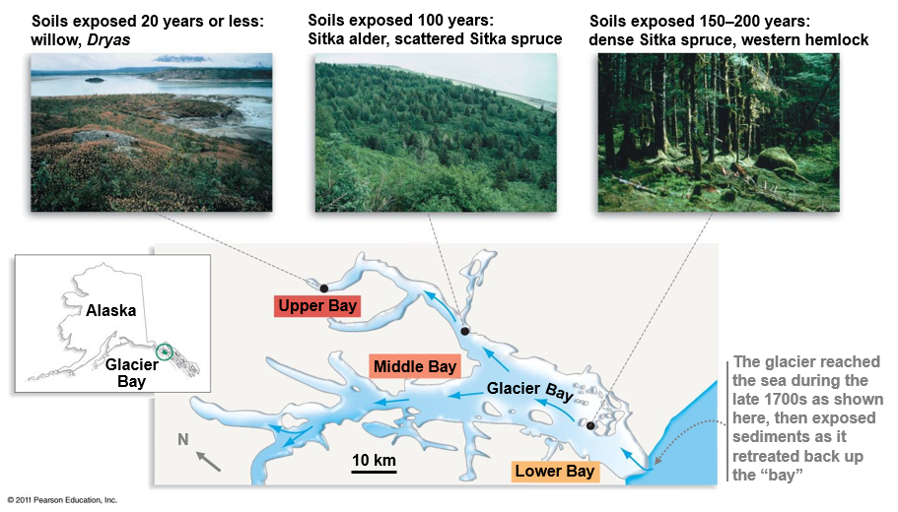
Habitat Succession

Slide 29
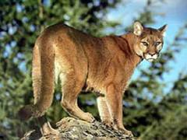
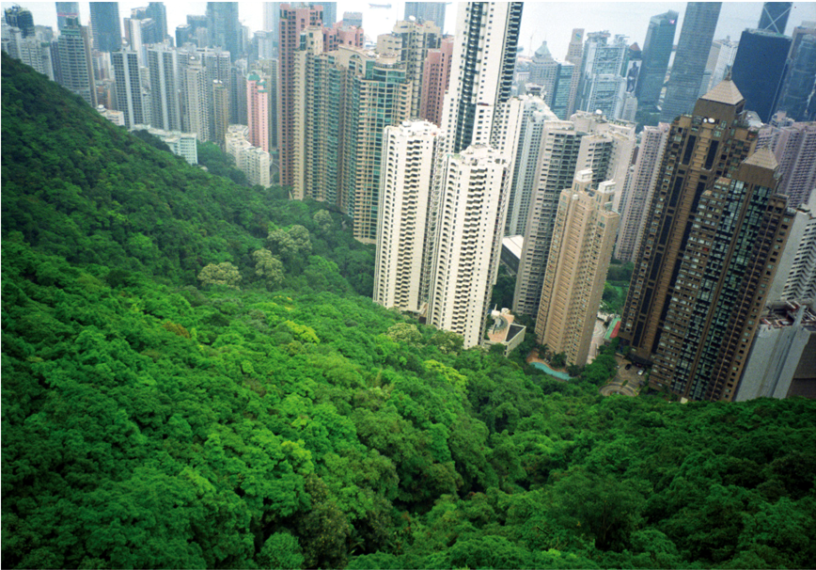
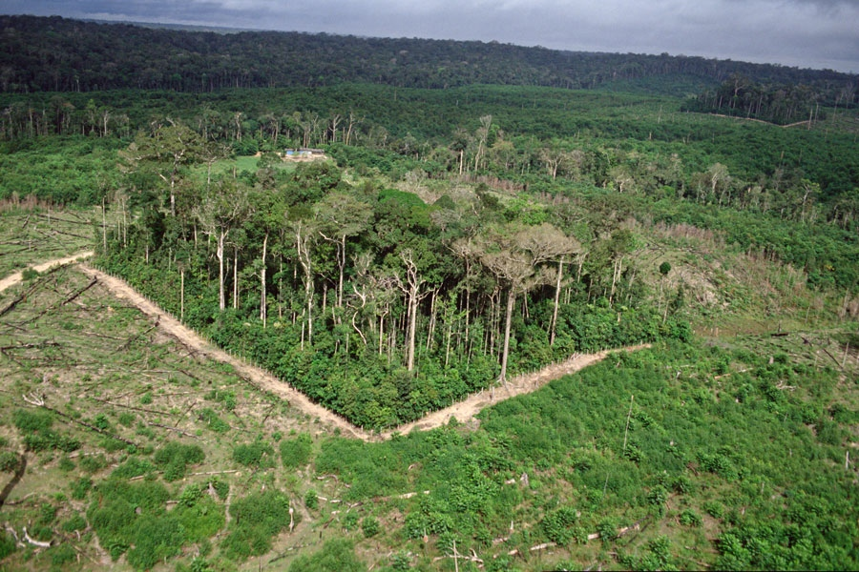
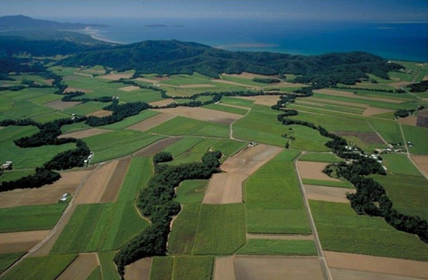
Human Impacts on Biodiversity
_________________________: the disruption of extensive habitats into isolated and small patches
Smaller territories cannot sustain large carnivores
Urbanization: expansion of urban environments
Associated with habitat loss and fragmentation

Slide 30
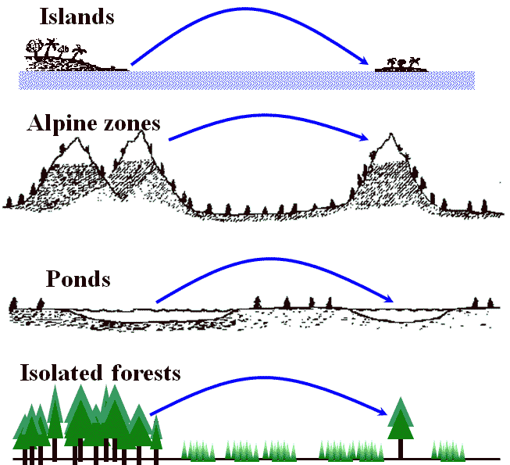
Theory of Island Biogeography
Island: area of land isolated from mainland by a body of water
Habitat island: area of suitable habitat some distance from source population
Sky island: isolated mountains surrounded by radically different lowland environments

Slide 31
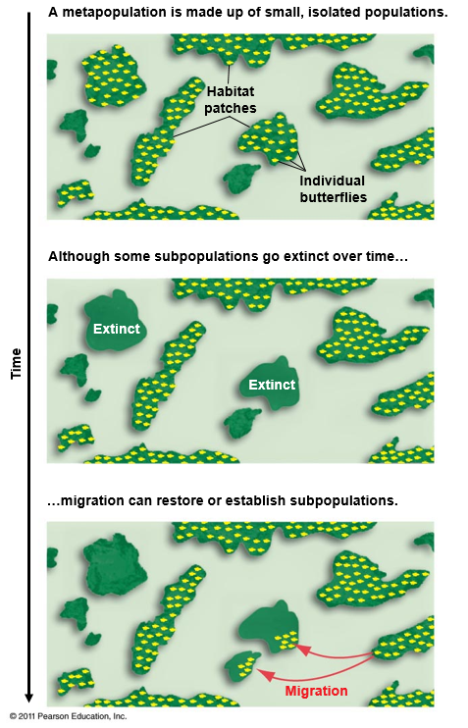
Metapopulations
Metapopulation: a population of populations
Source population: stable or growing population that produces offspring that disperse to other areas
Sink population: a population with declining growth that must be sustained by immigration from other populations
Notes:
As humans continue to fragment more habitat into isolated patched or reserves, a greater number of species are being forced into the metapopulation structure

Slide 32
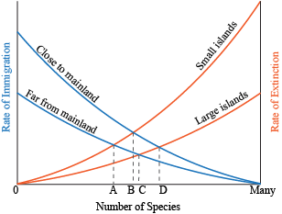
Equilibrium Theory of Island Biogeography
Greatest number of species based on rates of immigration and extinction
Large islands close to mainland/source
Large islands far from mainland/source
Small islands close to mainland/source
Small islands far from mainland/source

Slide 35
Corridors
Wildlife corridors: an area of habitat usually comprising native vegetation that links two separate fragments of similar habitat.
Connects nearby plant and animal populations separated by an impassable barrier.

Slide 36
Human Impacts on Biodiversity
_______________: excessive richness of nutrients in a lake or other body of water, frequently due to runoff from the land, which causes a dense growth of algae and bacteria resulting in the death of animal life from lack of oxygen.
Hypoxia: the depletion of oxygen in the water often resulting in dead zones
Notes:
Nitrogen and phosphorus

Slide 37
Overfishing
Overfishing: overexploitation of fish stocks in an unsustainable manner
30% of all commercial fish stocks are overfished
Factors that lead to overfishing:
International waters (>200 mi from shore) are unregulated resulting in open access fisheries
Poor fisheries management
Fish are caught by multiple countries making data collection difficult to impossible
Illegal fishing
Many catches are unreported
Subsidized fishing fleets result in 2 times more fleets than necessary
Notes:
Many of the Chinese boat owners rely on government money to build vessels and fuel their journeys to Senegal, a monthlong trip from crowded ports in China. Over all, government subsidies to the fishing industry reached nearly $22 billion between 2011 and 2015, nearly triple the amount spent during the previous four years, according to Zhang Hongzhou, a research fellow at Nanyang Technological University in Singapore.

Slide 38
Overfishing
Fishing down the food web: process by which fisheries deplete large predatory fish then begin to catch smaller and smaller species
Trophic Level

Slide 39
World Commercial Catch of Marine Species
The total catch of marine species has been increasing since 1975
Estimated at 109 million metric tons in 2016
Approximately 30% of marine catch is unreported
Amount of large predatory fish (tuna, billfish) has increased by 250% since 1975
Notes:
1 metric ton = 2,200 lbs
1 million metric tons = 2,200,000,000 lbs

Slide 40
Human Impacts on Biodiversity
___________: a fish or other species that is caught unintentionally
38.5 million tones of bycatch caught world-wide

Slide 41
Aquaculture
Aquaculture: ______ of aquatic organisms including fish, molluscs, crabs and algae
Accounts for more than half of all seafood consumed annually
Expected to exceed wild capture fisheries by 2050

Slide 42
Marine Plastics
Estimated that _________ metric tons of plastic are dumped into the ocean annually.
Most of the plastic in the ocean consists to microplastics (< 5mm)
Plastics are consumed by a variety of marine species
Plastics coated in algae mimic food items
Plastic chemicals can be transferred up the food chain
Fishing nets and other plastics entangle marine life
Over 300 marine species have been recorded
https://youtu.be/AWgfOND2y68
Notes:
Dead sperm whale recently discovered with 64 lbs of plastic in its stomach

Slide 43
Marine Plastics
Some of the 65 pounds of plastic found in the gut of a deceased sperm whale that washed on shore in Spain
It is estimated that 90% of seabirds are ingesting some plastic. Plastics covered in algae take on the smell of seabird prey items. Many seabirds mistakenly feed plastic to their chicks
It is estimated that hundreds of sea turtles die every year from becoming entangled in plastics. More than half of all sea turtles are reported to have ingested some plastic

Slide 44
Marine Plastics
Giant Pacific Garbage Patch
Covers 617,000 square miles of the northern Pacific Ocean
Plastics make up 99.9 percent of the trash in the patch
Discarded _________ made up almost 50% of all plastic discovered

Slide 45
Shark Finning
Shark finning: the removal of shark fins often while the shark is still alive
Driven primarily for demand of shark fin soup
Estimates of __________ sharks killed every year
Late maturity and k-selected life history strategy of sharks leads to drastic population declines
Populations increasing in United States due to protections

Slide 46
Human Impacts on Biodiversity
Hydroelectric dams alter natural water ways
Reduce natural nutrient-rich runoff
Impede fish ______________
Fish ladders

Slide 47
Human Impacts on Biodiversity
Climate change
97% of climate scientists agree that climate trends over the last century are extremely likely to be due to human activity (NASA, 2016)
Climate change predicted to cause widespread extinction, and migration, in plants and animals

Slide 48
Human Impacts on Biodiversity
_________ species: a species that is non-native to and ecosystem and has caused or is likely to cause economic or environmental harm
Characteristics of Successful Invasive Species
Fast growth
Rapid ______________
Tolerance to wide range of environmental conditions
High dispersal ability
Lack of natural predators
Rapid evolution
Notes:
Second greatest threat to biodiversity after habitat destruction
Linked to the decline of greater than 42% of the threatened and endangered species in the United States
Cost U.S. an estimated 120 billion dollars a year
Approximately 100 million acres (size of California) suffering from invasive plant infestations

Slide 49
Negative Impacts of Invasive species
Change an entire habitat
Asian chestnut blight fungus nearly wiped out chestnut forests in Eastern U.S.
Alter ecosystem dynamics
Asian carp in Mississippi river basin
Loss of __________________ (genetic extinction)
Hybridization between native and invasive species
Spread of disease
Asian tiger mosquito
Notes:
Introduced around 1904 with imported Asian chestnut trees, wiped out nearly all American chestnut forests by 1950.

Slide 50
Invasive Species Introductions
Intentional introductions
Feral pigs, European starling
Unintentional introductions
Rats aboard ships, hitchhikers in cargo
Horticulture
Ornamental or crop plants that later escape
Ballast water
Many small marine organisms
Pet trade and aquarium release
Lion fish, pythons

Slide 51
Invasive Species Introductions
Ballast water: water carried in the ballast tanks of cargo ships to level the load and provide stability during transit
Many small marine organisms are transported in ballast water
American comb jelly in European Seas
Zebra mussel in North America
Ballast exchange at sea to reduce introductions

Slide 52
Negative Impacts of Invasive species
Zebra Mussel
Can produce 5 million eggs in 5 years
Dense growth blocks pipes and damage boats and other structures
Consume majority of plankton leading to a collapse of the food web

Slide 53
Invasive Species Introductions
Unintentional introductions
Rats have been introduced to most islands where they have caused the extinction of countless species including many seabirds
Eradication of rats from islands is on-going challenge
The brown tree snake hitchhiked to Guam in military cargo and has led to the extinction of at least 12 bird species on Guam

Slide 54
Invasive Species Introductions
Pet trade and aquarium release
Lionfish were released into the waters off Florida and are now found throughout the east coast of U.S, the Caribbean, and Gulf of Mexico
Large venomous spines and appearance likely deters predators
They breed year round and can produce young every 4 days
Reduce populations of juvenile and small fish on coral reefs by as much as 90%
Caulerpa taxifoila is a popular aquarium algae that became established off southern California coast
Caulerpa taxifolia is now illegal in California
Notes:
Caulerpa was introduced into the Mediterranean in 1984 and now covers thousands of acres of coastline

Slide 55
Negative Impacts of Invasive species
Black Mustard
Allelopathic chemical
Prevents germination of native plants
Converts native habitats to grasslands
Spreads quickly after fire
Dormant fire-stimulated seed banks
One week after 2008 complex fire
Five months after 2008 complex fire

Slide 56
Preservation of Species
Endangered Species Act of 1973: a U.S. environmental law designed to protect and recover imperiled species and the ecosystems upon which they depend
Governed by U.S. Fish and Wildlife Service (FWS) and the Commerce Department’s National Marine Fisheries Service (NMFS)
Species designated as either threatened or endangered
Designates _______________
Develops a recovery plan
Notes:
Bald Eagle (increased from 417 to 11,040 pairs between 1963 and 2007); removed from list 2007
Whooping Crane (increased from 54 to 436 birds between 1967 and 2003)
Peregrine Falcon (increased from 324 to 1,700 pairs between 1975 and 2000); removed from list
Gray Wolf (populations increased dramatically in the Northern Rockies, Southwest, and Great Lakes)
Gray Whale (increased from 13,095 to 26,635 whales between 1968 and 1998); removed from list (Debated because whaling was banned before the ESA was set in place and that the ESA had nothing to do with the natural population increase since the cease of massive whaling [excluding Native American tribal whaling])
Grizzly bear (increased from about 271 to over 580 bears in the Yellowstone area between 1975 and 2005); removed from list 3/22/07
California’s Southern Sea Otter (increased from 1,789 in 1976 to 2,735 in 2005)
San Clemente Indian Paintbrush (increased from 500 plants in 1979 to more than 3,500 in 1997)
Red Wolf (increased from 17 in 1980 to 257 in 2003)
Black-Footed Ferret (increased from 18 in 1986 to 600 in 2006)

Slide 57
Preservation of Species
Captive breeding programs
Protection of species and their habitats
Seed banks and frozen zoos
Notes:
Captive breeding is the last resort
Svalbard Global Seed Vault - Norway

Slide 58
Preservation of Species
Protected Areas
Protection of critical habitat
National parks, preserves
Marine protected areas

Slide 59
CEQA and NEPA
National Environmental Policy Act (1970): requires all federal agencies prepare environmental assessments (EAs) and environmental impact statements (EISs) to determine negative impacts associated with proposed projects
Environmental Impact Report (EIR): an assessment of all environmental impacts that a proposed project may incur
California Environmental Quality Act (1970): requires all state and local agencies analyze and disclose all potential environmental impacts of proposed projects, and adopt measures to mitigate any negative impacts to the environment.

Slide 60
Biological Surveys
Biological surveys: use of various methods to quantify the abundance and distribution of various living organisms.
Quadrat Sampling Method
Line Transect Sampling Method
Point Count Sampling Method

Slide 61
Biological Surveys

Slide 62
Check Your Understanding
True of False: Humans are currently causing the sixth great mass extinction event on earth
True or False: The Permian extinction was the worst extinction event of all time.
True or False: Aquaculture is the greatest threat to marine species on earth

Slide 63
Check Your Understanding
Which of the following are not one of the ways that humans are trying to preserve species?
a. Seed banks
b. Pet trade
c. Captive breeding
d. Protected habitats
e. All of the above are ways that humans work
preserve species

Slide 64
Check Your Understanding
What is an invasive species? What are the characteristics that make something a successful invader? Provide two ways that invasive species can be introduced to new environment.

